Slide 1
Evolution and Biological Diversity

Slide 2
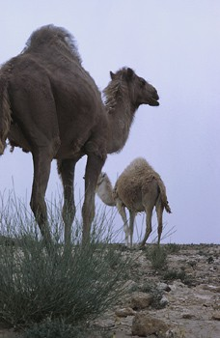
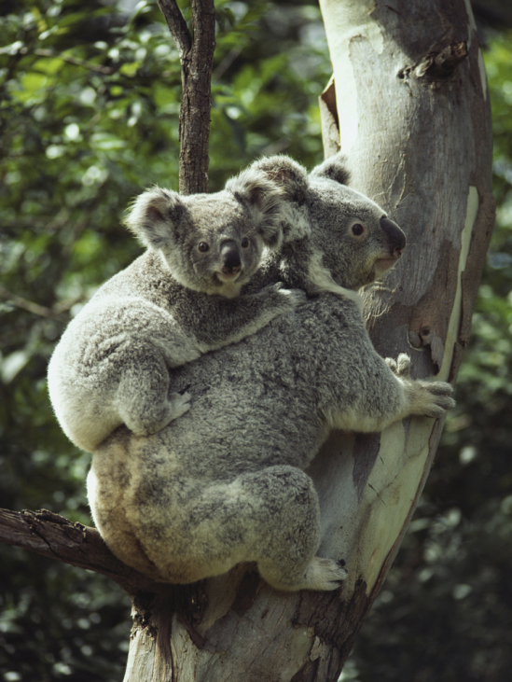
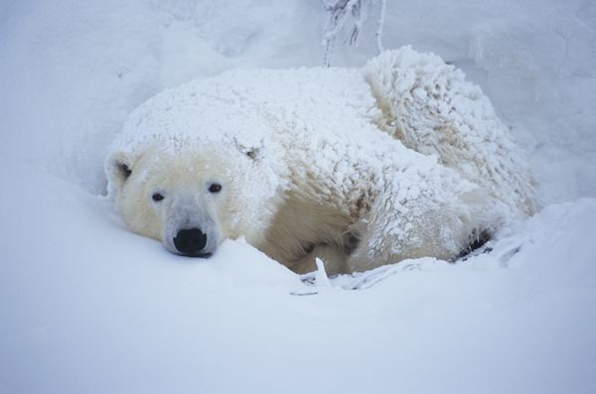
Natural Selection
Changes to environments may stress organisms. The organisms best adapted to the new environment will survive and reproduce in greater numbers.

Slide 3
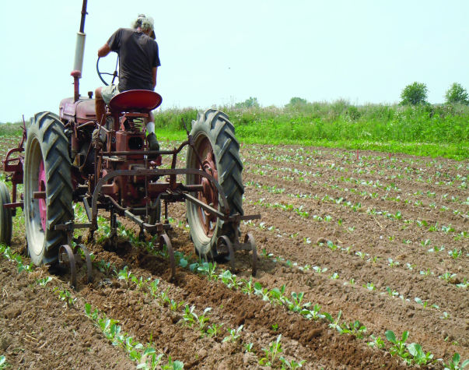
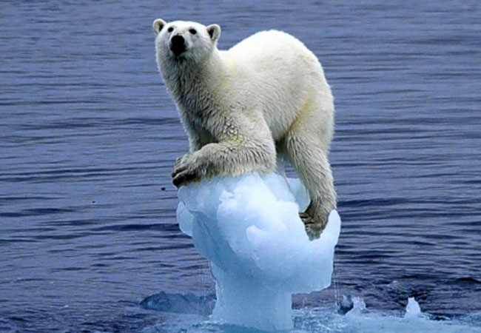
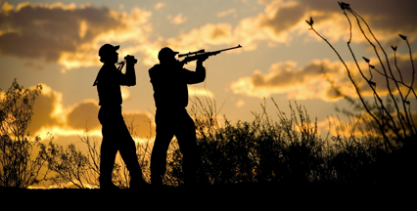
Changes to environments can be natural or human-caused
climate changes
shifts in landmasses due to plate tectonics
Farming
logging
hunting

Slide 4
Natural Selection

Slide 5
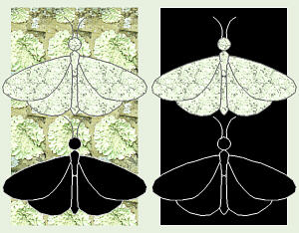
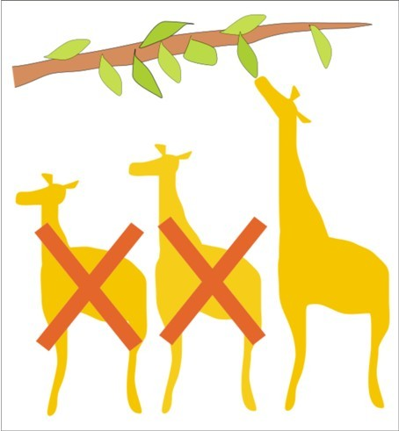
Natural Selection
Produces organisms best suited to their natural environments.

Slide 6
Peppered Moths

Slide 7
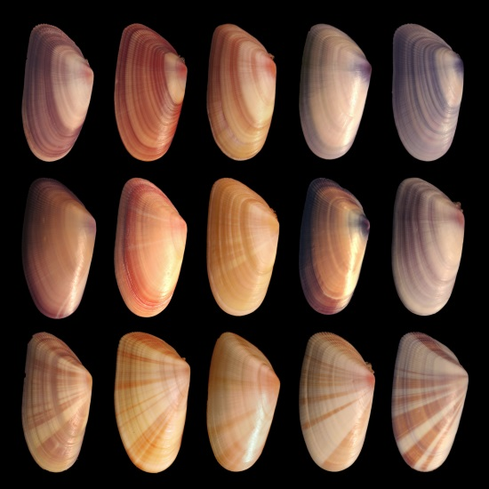
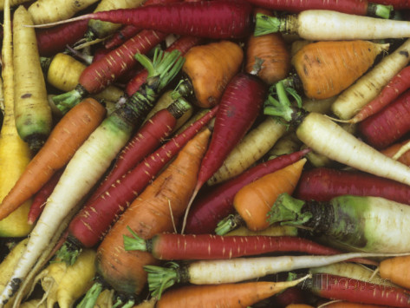
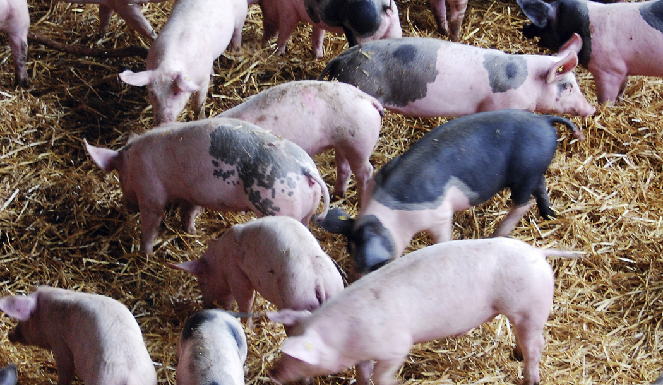
Biodiversity
•Species with the greatest variation in their genetic material will have the greatest potential for adaptation.

Slide 8
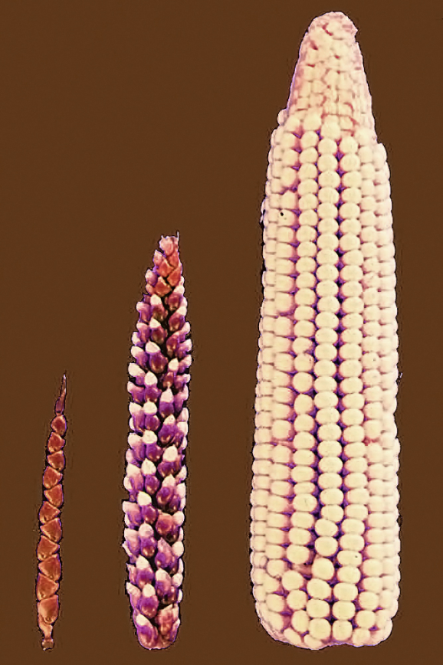
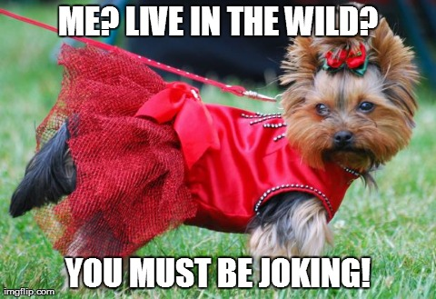
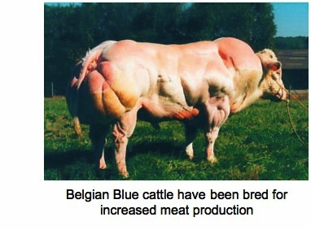
Selective Breeding (artificial selection)
Has had a dramatic effect on the appearance and usefulness of farm animals.
Cows, pigs and chickens produce more meat per animal than ever before.

Slide 9
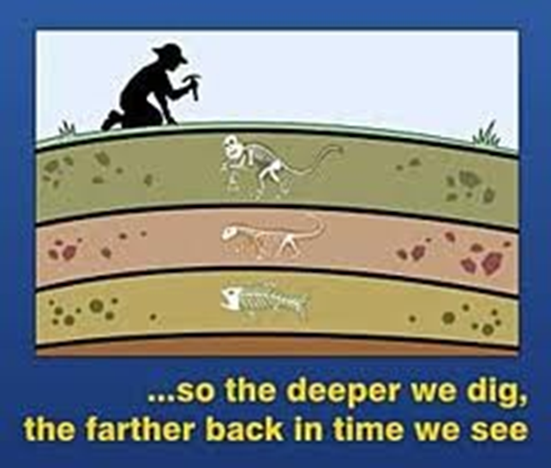
Evidence
Fossils (dating)
The preserved remains or traces of organisms that lived long ago
Evidence of evolution!
Fossil record- the record of life that unfolded over four billion years

Slide 10
Evidence
DNA Similarities

Slide 11
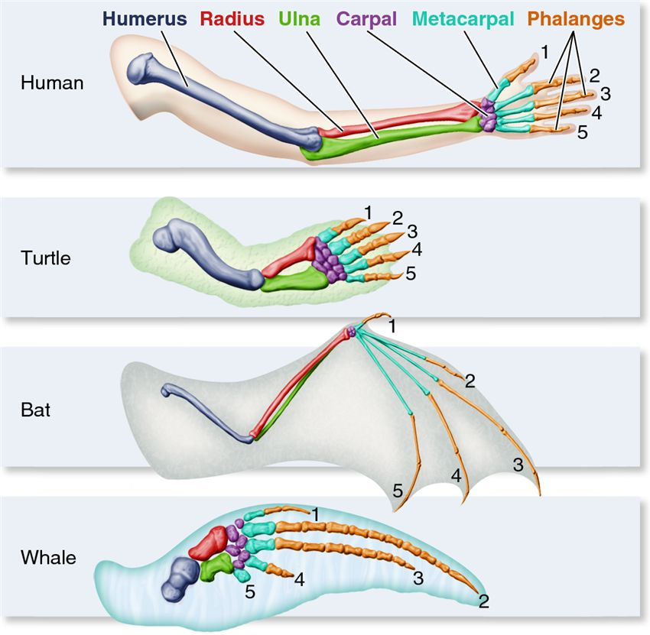
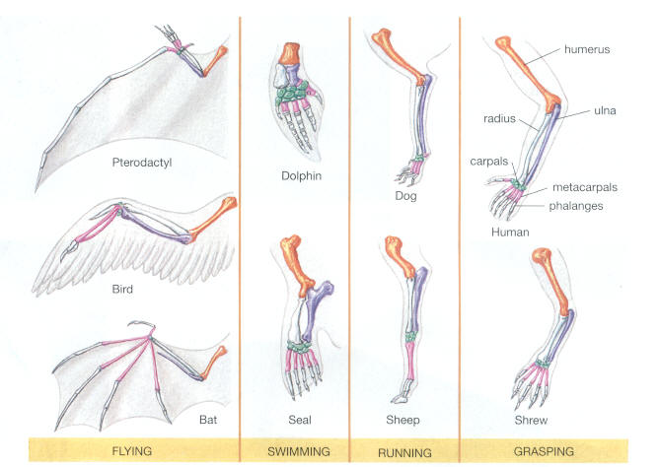
Evidence
Homologous Structures- derived from a common ancestor

Slide 12
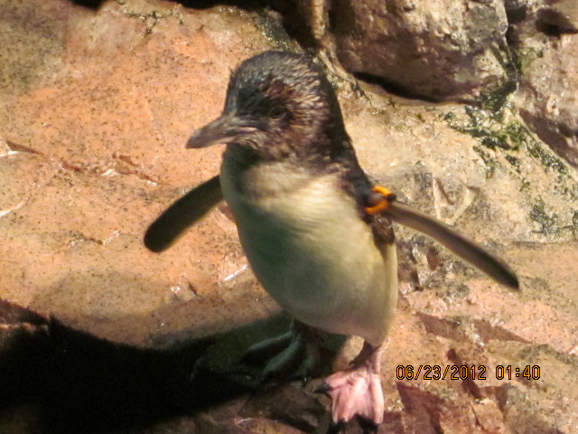
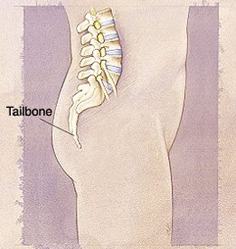
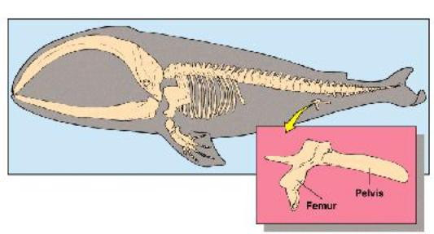
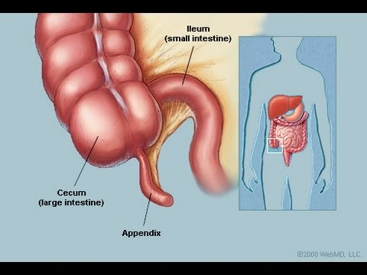
Evidence
Vestigial Structures- structure in an organism that has lost all or most of its original function

