Slide 1
Components of Matter
What are you made of?

Slide 2
Matter
Anything that occupies space and has mass is known as matter.
Matter consists of chemical substances.

Slide 3
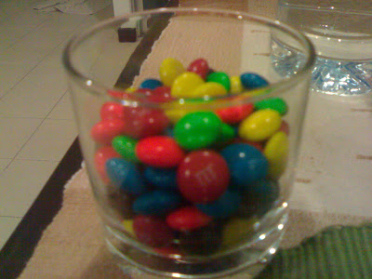
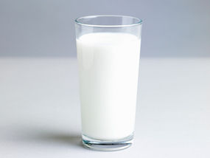
Chemical Substance
Definite chemical composition.
Homogeneous- the same chemical composition is found uniformly throughout the substance.
May be an element or a chemical compound.

Slide 4
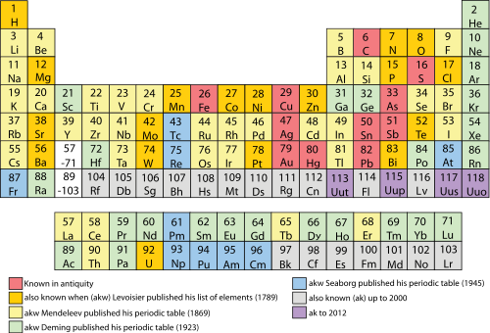
Elements
Pure substances that cannot be broken down into different types of substances.
The most abundant elements in cells are carbon, hydrogen, nitrogen, oxygen, phosphorous, and sulfur.
CHNOPS
An atom is the smallest particle of an
element that still characterizes the element.

Slide 5
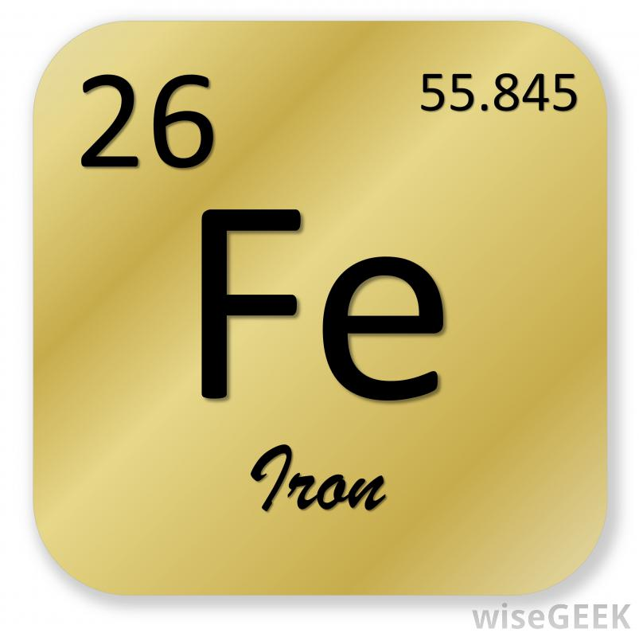
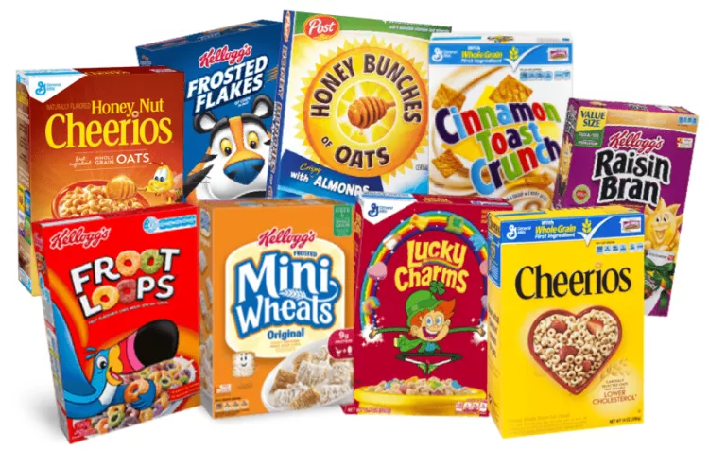
Trace Elements
Trace elements are elements that are required by living things in small amounts, but play a role in helping the body function properly.
An example of a trace element is iron

Slide 6
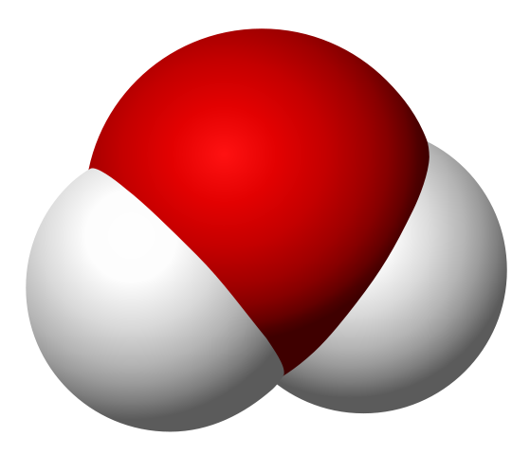
Chemical Compound
new substance that forms when atoms of two or more elements react with one another.
A chemical reaction is a process that changes some chemical substances into other chemical substances.

