Slide 1
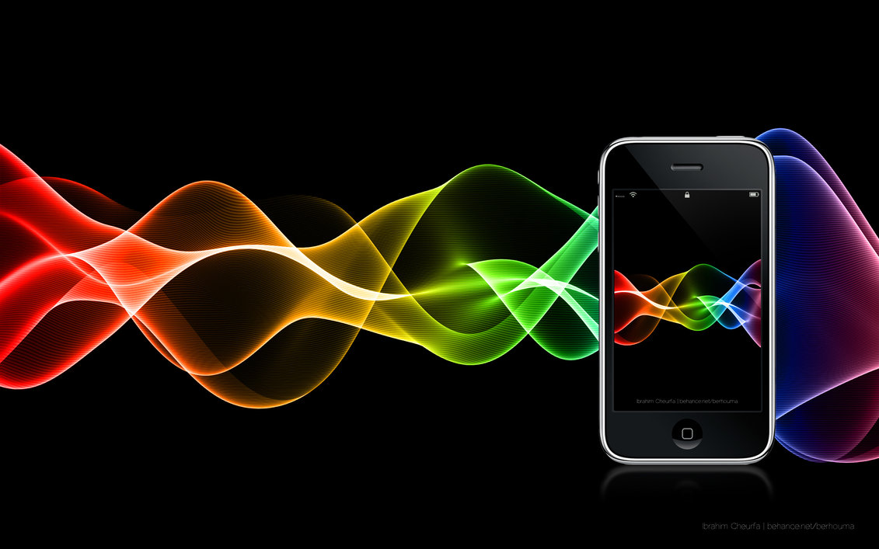
Behavior Of Waves

Slide 2
Behavior of Waves
Light and sound waves can change when they come in contact with different mediums, barriers, or objects.

Slide 3
Types of Mediums
There are 4 types of mediums
solid
liquid
gas
plasma

Slide 4
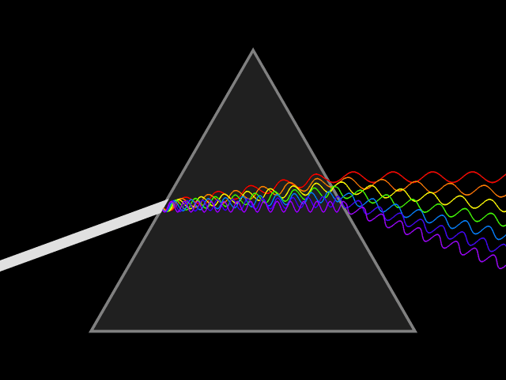
Behavior of Waves
Light and sound waves are affected differently as they pass through different obstacles. They can be:
reflected
absorbed
refracted
diffracted or
scattered

Slide 5
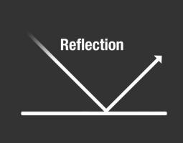
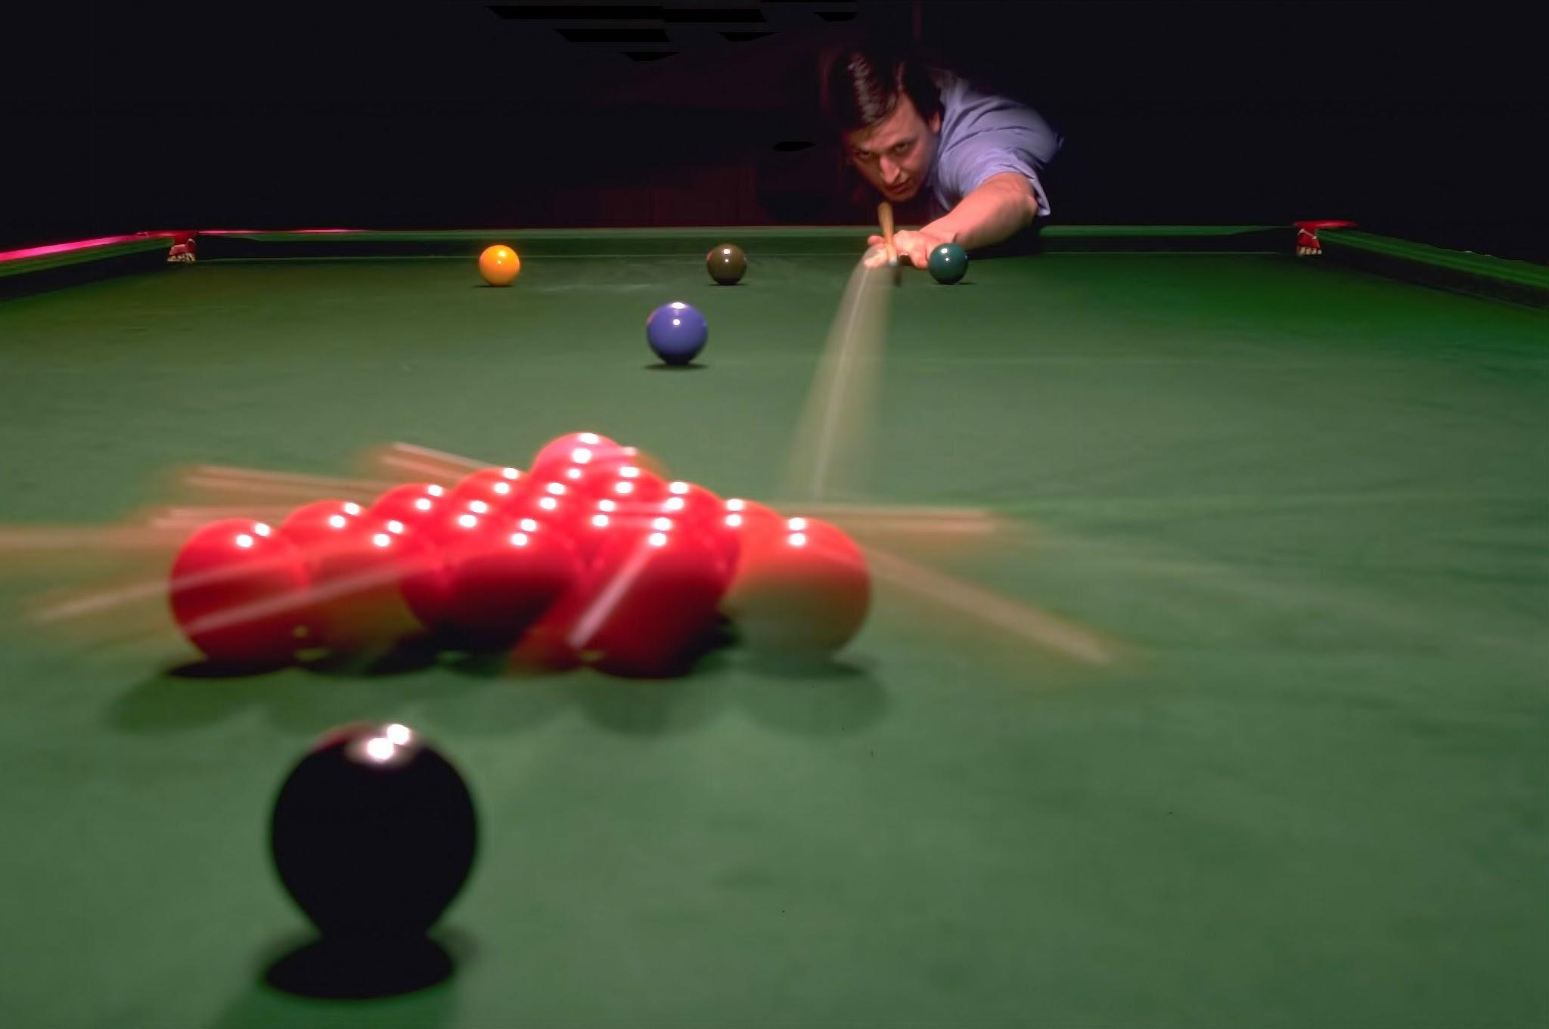
Reflection
When incoming light or sound waves hit an object and bounce off

Slide 6
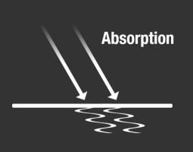
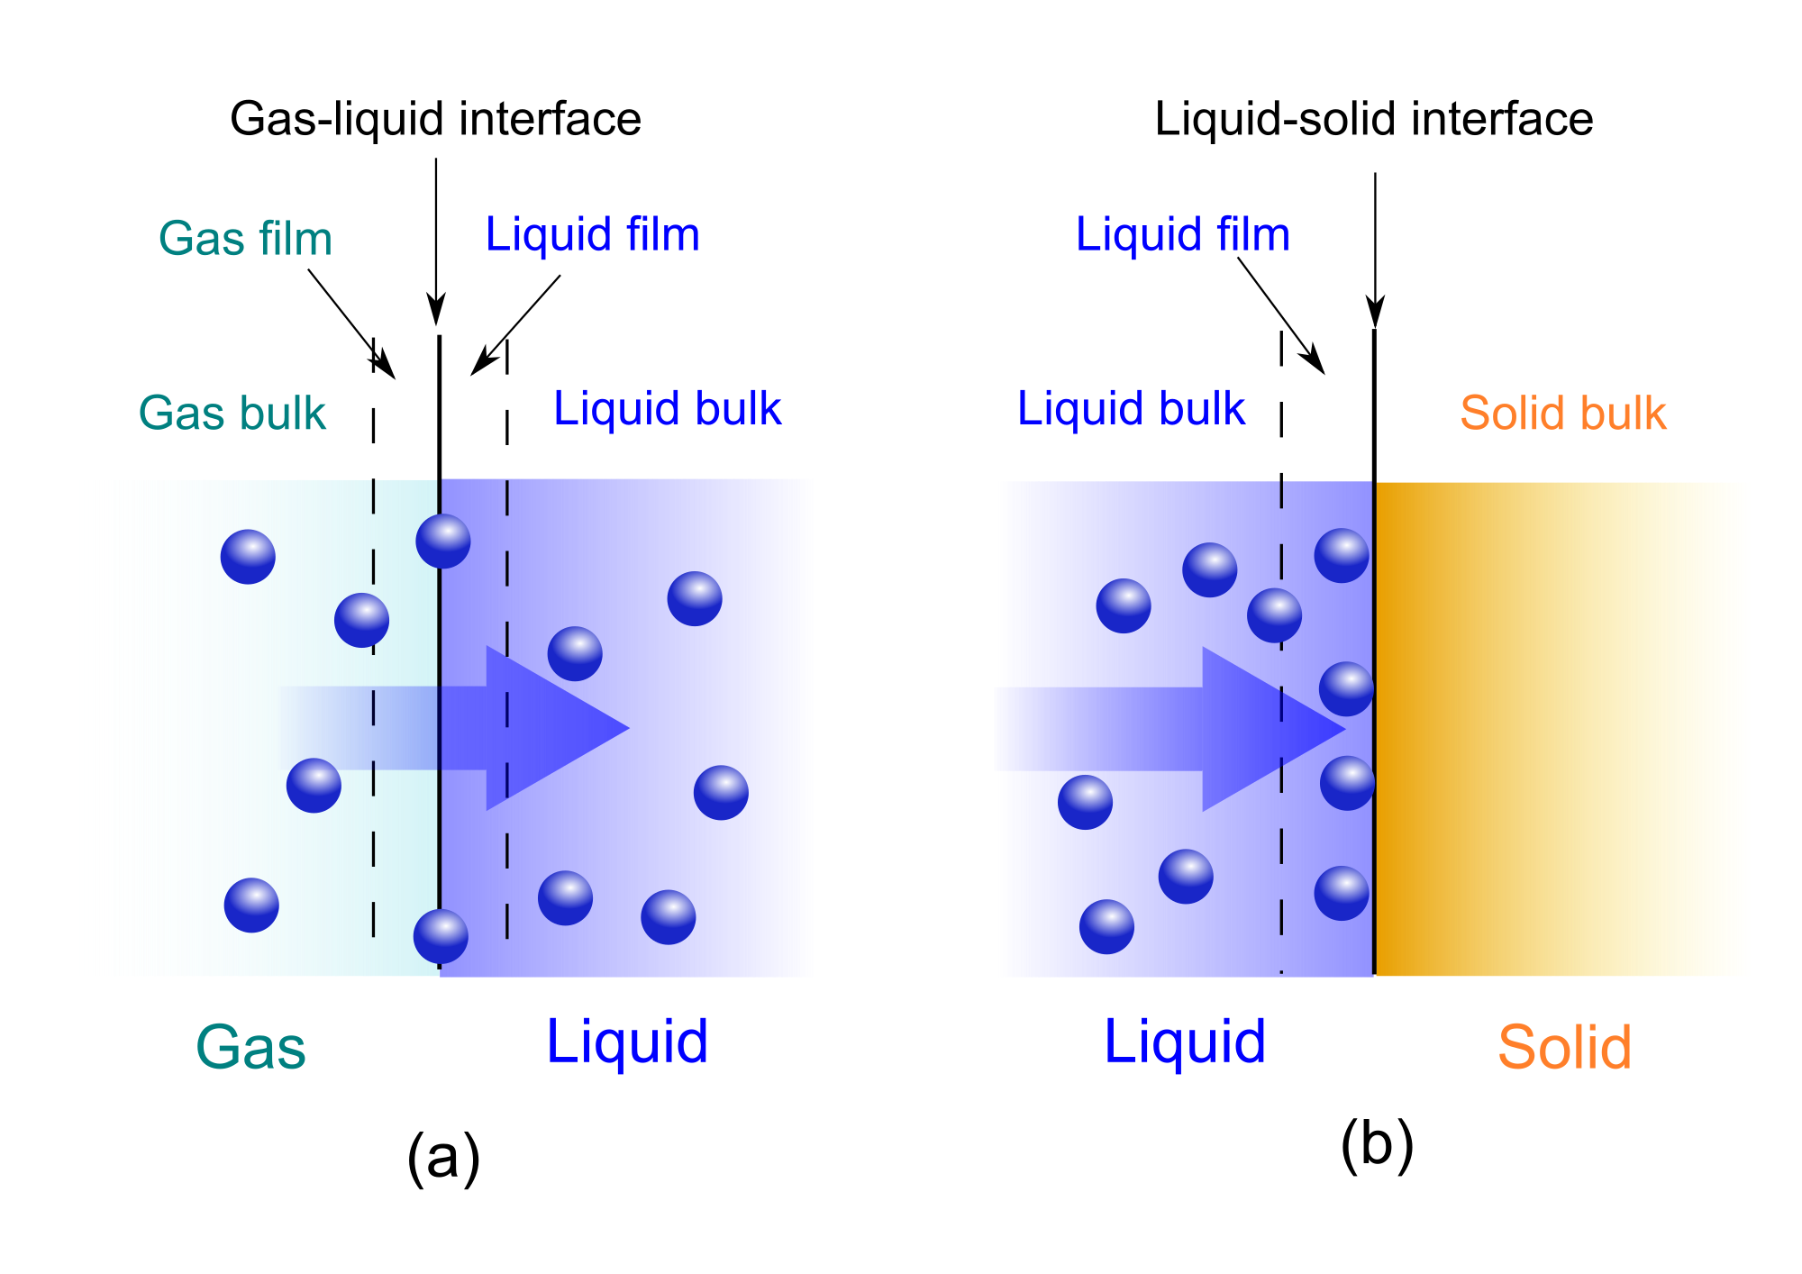
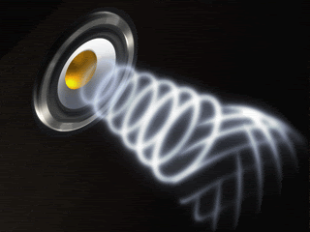
Absorption
Sound or light waves hit the molecules inside the object and are taken in and transferred into heat

Slide 7
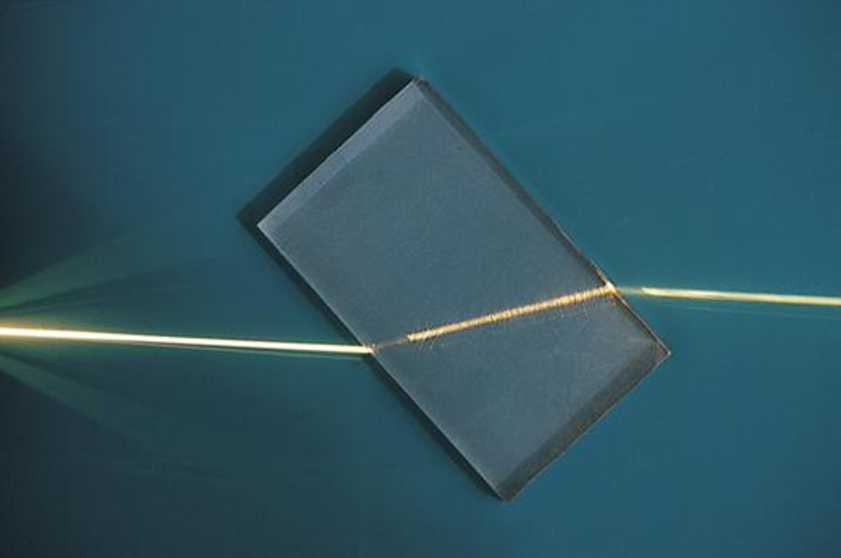
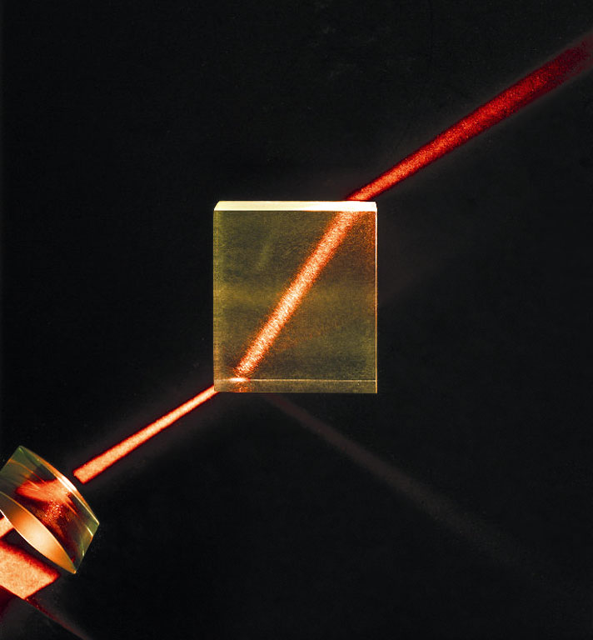
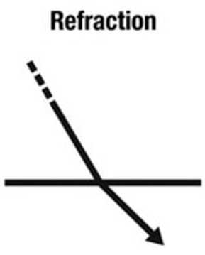
Refraction
Light and sounds waves change directions as they pass through different mediums bending the waves at different angles

Slide 8
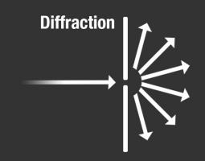
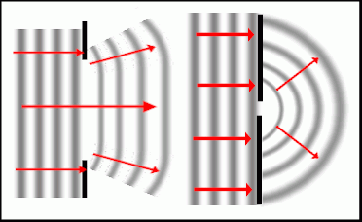
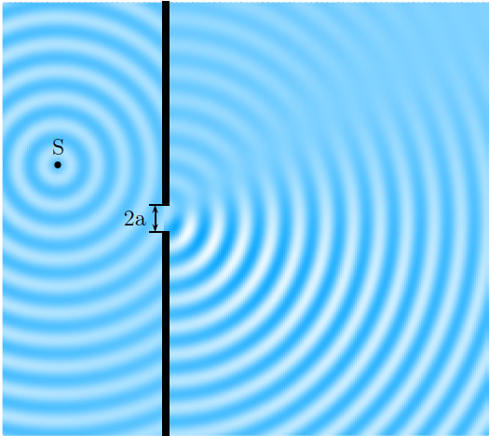
Diffraction
The Bending and spreading of waves through a small slit around obstacles

Slide 9
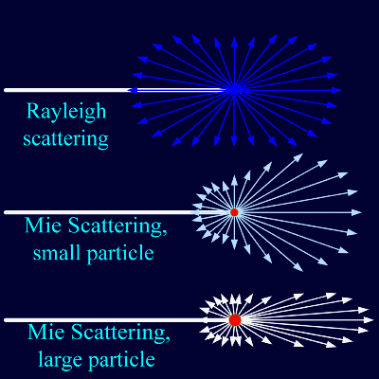
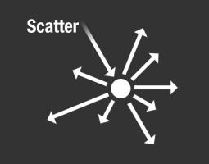
Scattering
When light and sound waves bounce off an object the waves go in a variety of different ways and in different angles.

Slide 10
Light Waves
Light can travel through Space (vacuum), gases, liquids, solids, and plasmas.

Slide 11
Sound Waves
Sound can travel through Solid, Liquid, Gas, and Plasma
Sound cannot travel through Space (Vacuum)

