Slide 1
Volcanoes

Slide 2
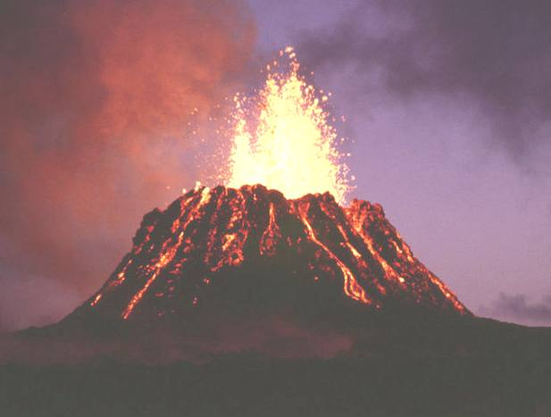
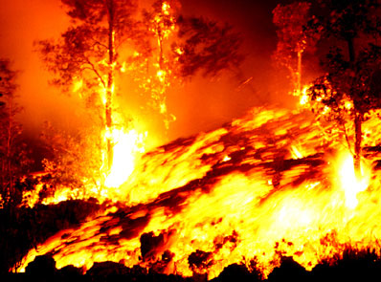
Volcanoes
Volcanoes are openings in the Earth’s crust where molten rock, rock fragments and gases erupt.

Slide 3
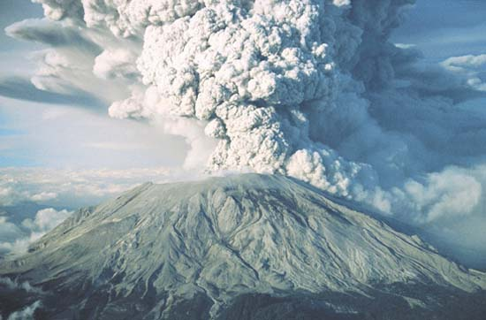
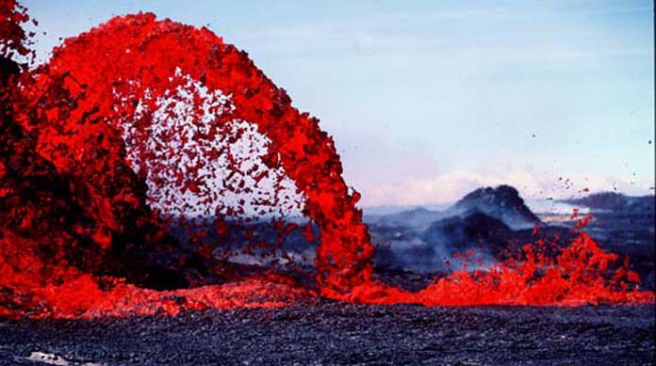
Volcanoes
Volcanoes are formed along tectonic plate boundaries and over hot spots which are areas where the Earth’s crust is thin.

Slide 4
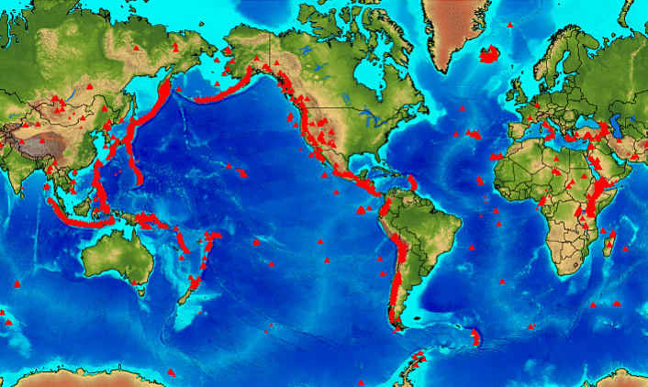
Volcanoes
About 75% of all the Earth’s active volcanoes are in an area known as the Ring of Fire which surrounds the Pacific Ocean.

Slide 5
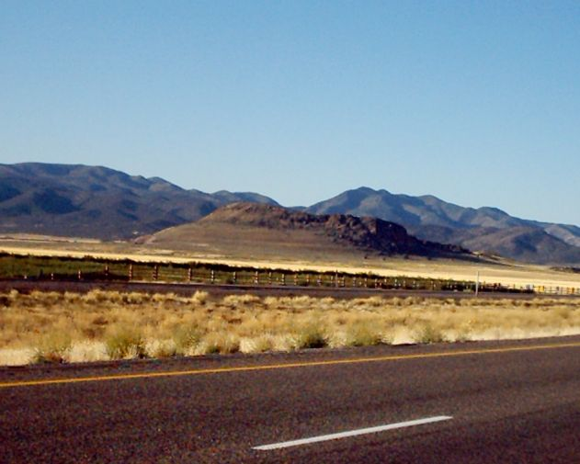
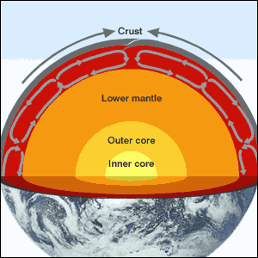
Volcanoes
Volcanoes are relieving stress of the earth the same as earthquakes. The difference is that magma comes to the surface.

Slide 6
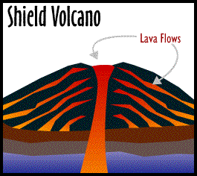
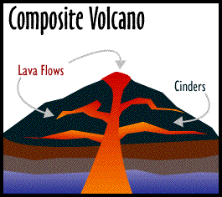
Types of Volcanoes
Cinder cone – steep sided volcanoes
Shield – broad and flat volcanoes
Composite – Violent, combination of the other 2 types of volcanoes.

Slide 7
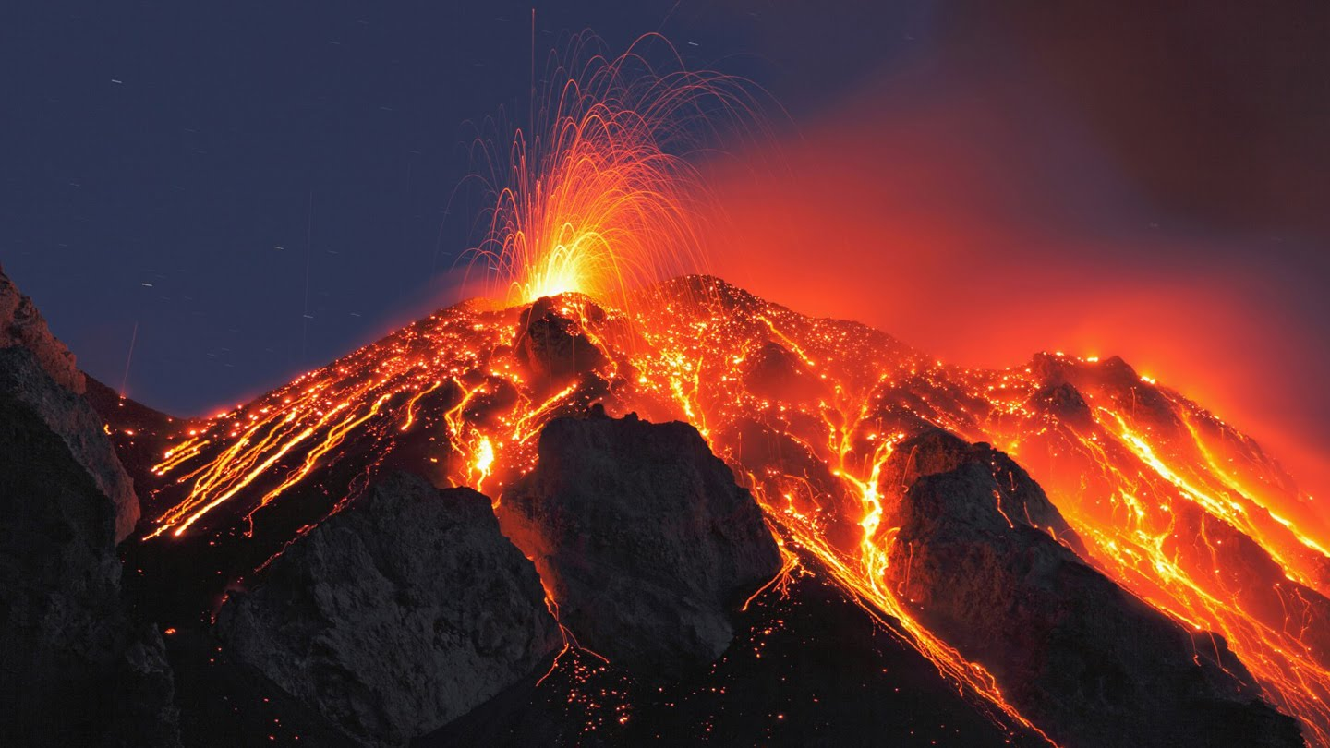
How and why do volcanoes erupt?
Hot, molten rock (magma) is less dense than the surrounding rocks and will rise up through the crust to erupt on the surface.
When magma reaches the surface it depends on how easily it flows (viscosity) and the amount of gas it has in it as to how it erupts.
Notes:
Why Do Volcanic Eruptions Occur?
High temperature of the Earth’s interior
Melting of lower crust and mantle = molten rock = magma
At depths > 20 km the temperature = 800-1,600 degrees Celsius
The density of the magma is less than the crustal rock, therefore it rises to the surface
Source of this heat?
Residual from the cooling of the Earth (& solar system)
Radioactive decay
Convection in the mantle
- Brings hot rock up from near the interior of the Earth and returns cooler material towards the centre of the Earth for reheating.
Shock/impact melting
E.g. meteorite impacts produce instantaneous heat and melting from high energy collisions
Two styles of volcanic eruption: Explosive and Effusive (see next slides for further descriptions of each)
Explosive: where rapidly escaping gas bubbles (= vesicles) rip apart the magma, fragmenting it.
Effusive: where the magma leaks out onto the surface passively as lava flows.
- NOTE: Some effusive eruptions involving highly viscous lava may turn into explosive eruptions. If the magma is too viscous (sticky) it can block up the volcanic vent, trapping gas inside the volcano. If this gas builds up enough to break through the blockage an extremely dangerous explosive eruption may form.
- Some of the most explosive eruptions have formed this way, e.g. Pinatubo 1991

Slide 8
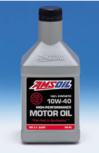
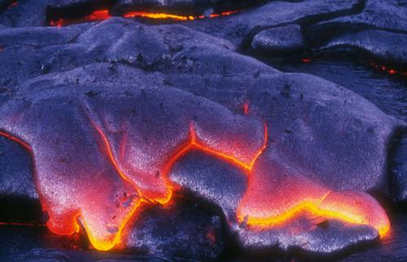
Large amounts of gas and a high viscosity (sticky) magma will form an explosive eruption!
Think about shaking a carbonated drink and then releasing the cap.
Small amounts of gas and (or) low viscosity (runny) magma will form an effusive eruption
Where the magma just trickles out of the volcano (lava flow).
Notes:
Why Do Volcanic Eruptions Occur?
High temperature of the Earth’s interior
Melting of lower crust and mantle = molten rock = magma
At depths > 20 km the temperature = 800-1,600 degrees Celsius
The density of the magma is less than the crustal rock, therefore it rises to the surface
Source of this heat?
Residual from the cooling of the Earth (& solar system)
Radioactive decay
Convection in the mantle
- Brings hot rock up from near the interior of the Earth and returns cooler material towards the centre of the Earth for reheating.
Shock/impact melting
E.g. meteorite impacts produce instantaneous heat and melting from high energy collisions
Two styles of volcanic eruption: Explosive and Effusive (see next slides for further descriptions of each)
Explosive: where rapidly escaping gas bubbles (= vesicles) rip apart the magma, fragmenting it.
Effusive: where the magma leaks out onto the surface passively as lava flows.
- NOTE: Some effusive eruptions involving highly viscous lava may turn into explosive eruptions. If the magma is too viscous (sticky) it can block up the volcanic vent, trapping gas inside the volcano. If this gas builds up enough to break through the blockage an extremely dangerous explosive eruption may form.
- Some of the most explosive eruptions have formed this way, e.g. Pinatubo 1991

