Slide 1
Forms of Energy

Slide 2
Forms of Energy
1. All energy falls into two categories:
Potential: stored energy and energy of position
Kinetic: motion of waves, electrons, atoms, molecules and substances.

Slide 3
2. What Forms of Energy Are There?
POTENTIAL | KINETIC
Chemical Energy Nuclear Energy Gravitational Energy | Radiant Energy Electrical Energy Mechanical Energy Sound Energy Thermal Energy

Slide 4
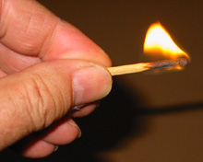
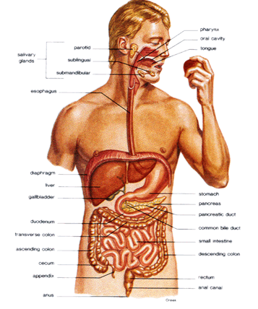
1. Chemical
Energy stored in the bonds of atoms and molecules.
Example: Matches, Digestion, batteries

Slide 5
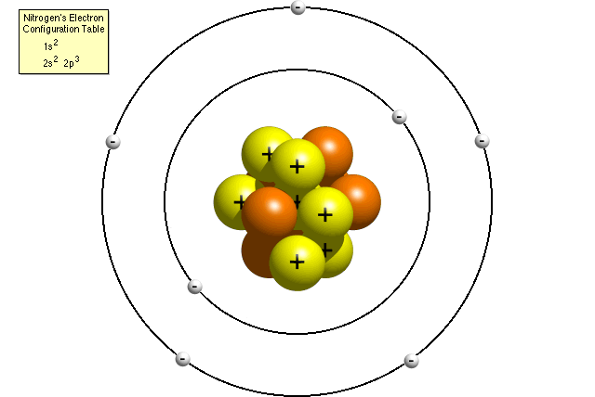
2. Nuclear
Energy stored in the nucleus of an atom. The energy that holds the nucleus together.
Example: Breaking down Uranium, fusion (sun and stars), fission

Slide 6
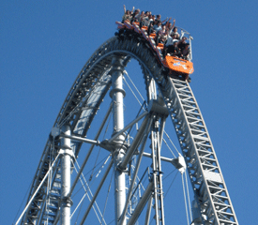
3. Gravitational
Energy of place or position. Higher=more gravitational energy.
Example: things that can fall or swing.

Slide 7
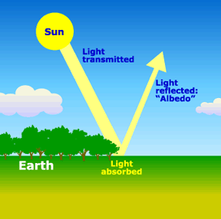
4. Radiant
Electromagnetic energy that travels in waves like light.
Example: Visible Light

Slide 8
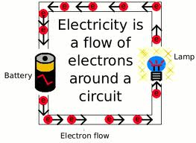
5. Electrical
Movement of electrons.
Example: lamp, computer, anything that plugs in.

Slide 9
6. Mechanical
The movement of a substance from one place to another. Energy of Motion.
Example: Riding a bike

Slide 10
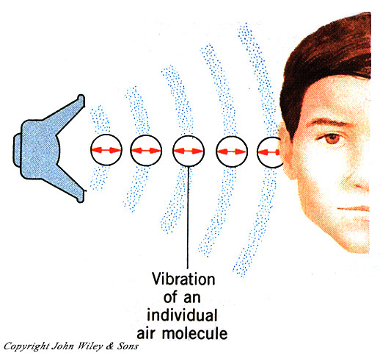
7. Sound
Movement of energy through substances in vibrations.
Example: bell

Slide 11
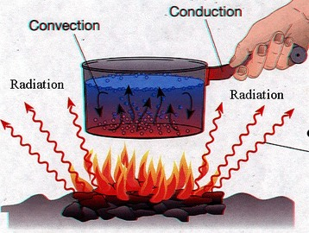
8. Thermal
internal energy of an object due to the kinetic energy of its atoms and/or molecules.
HEAT.
Example: stove boiling water

Slide 12
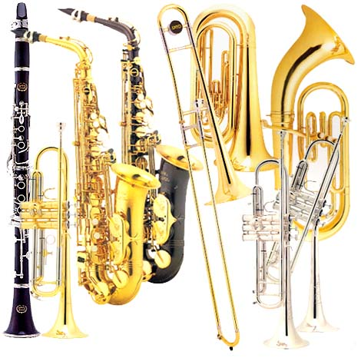
What form of Energy?

Slide 13
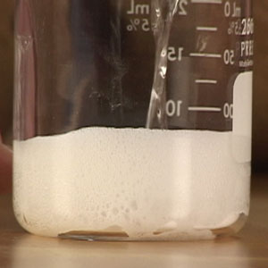
What form of Energy?

Slide 14
What form of Energy?

Slide 15
What form of Energy?

Slide 16
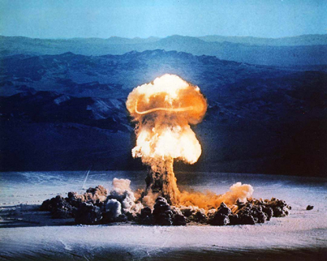
What form of Energy?

Slide 17
What form of Energy?

Slide 18
What form of Energy?

Slide 19
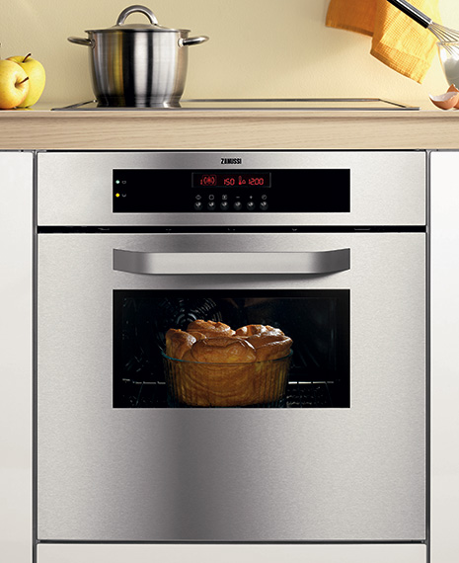
What form of Energy?

Slide 20
What form of Energy?

Slide 21
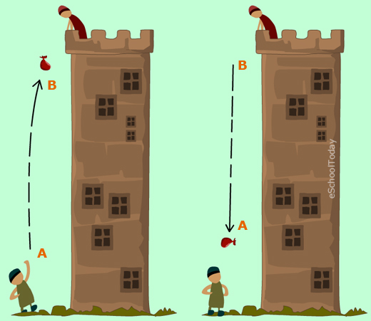
What form of Energy?

