Slide 1
Cellular Respiration

Slide 2
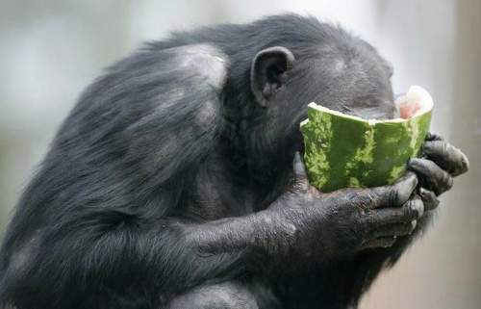
Cellular Respiration
Cellular respiration is the process in which organisms break down food to create usable energy.
Chemical energy in food is converted into mechanical and thermal energy in the living organism.

Slide 3
The Chemical Formula of Cellular Respiration
Glucose + 6 molecules of oxygen produce 6 molecules of carbon dioxide + 6 molecules of water + mechanical and thermal energy.

Slide 4
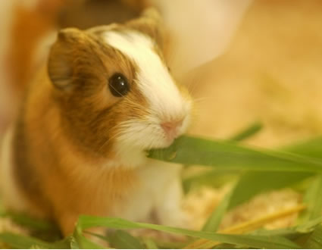
Where does cellular respiration occur?
Cellular respiration occurs within every cell of every living organism.
It occurs within the mitochondria of each cell.

Slide 5
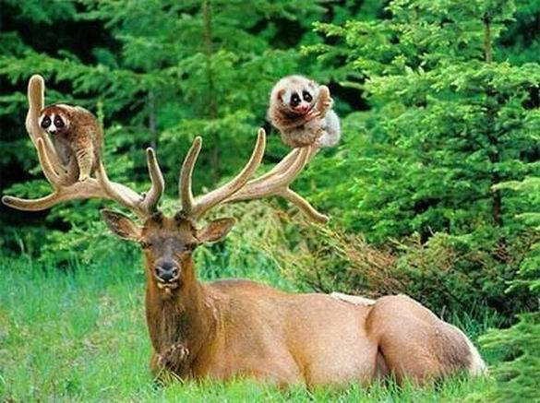
What is the energy from cellular respiration used for?
Movement
Growth
Development
Reproduction
Warmth

Slide 6
Energy Conversions
Which types of energy are converted from the sun to a person moving?
Radiant/Solar/Light (light from sun)
Chemical (glucose stored in plant through photosynthesis, cellular respiration & digestion in animal)
Mechanical (organism breaks down glucose to produce energy to move and grow)
Thermal (heat is released in the atmosphere)

Slide 7
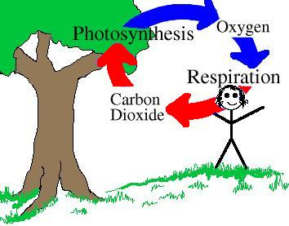
The Oxygen Cycle
Photosynthesis and Cellular Respiration are complimentary reactions that result in the oxygen cycle.
The products of photosynthesis are the reactants of cellular respiration and the products of cellular respiration are the reactants of photosynthesis.

Slide 8
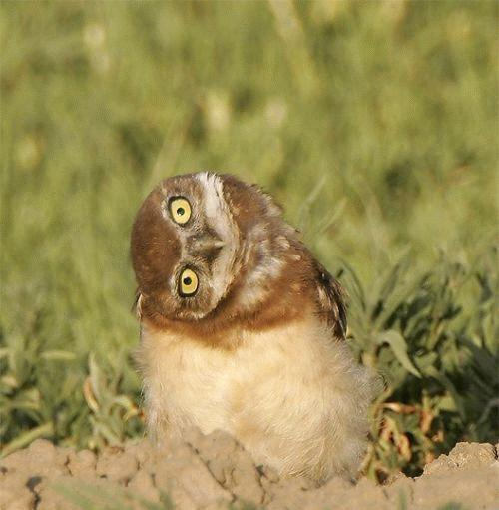
Photosynthesis vs. Respiration
Reaction: 6CO2+6H2O+ light→C6H12O6+6O2 C6H12O6+6O2→6CO2+6H2O+energy
Reactants: Carbon dioxide, water, sun Glucose, oxygen
Products: Glucose Energy
Waste products: Oxygen Carbon dioxide, water
Energy needs: Requires energy Releases energy
Summary: Sugar synthesized using Energy released from energy from the sun sugar breakdown

