Slide 1
Topic: Ecosystem Stability
Don’t forget to write your essential question after you take your notes

Slide 2
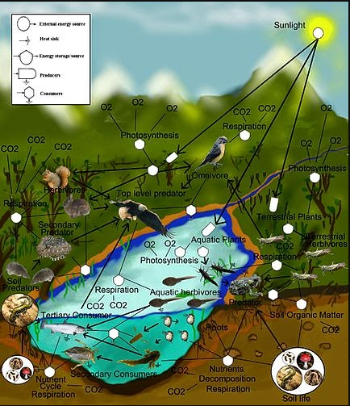
What is ecosystem stability?
It is defined as the ability of an ecosystem to maintain structure and function despite disturbances
Ecosystem Structure: physical and geological structures, numbers and diversity of species, how the species interact
Ecosystem Function: water and nutrient cycling, biomass productivity

Slide 3
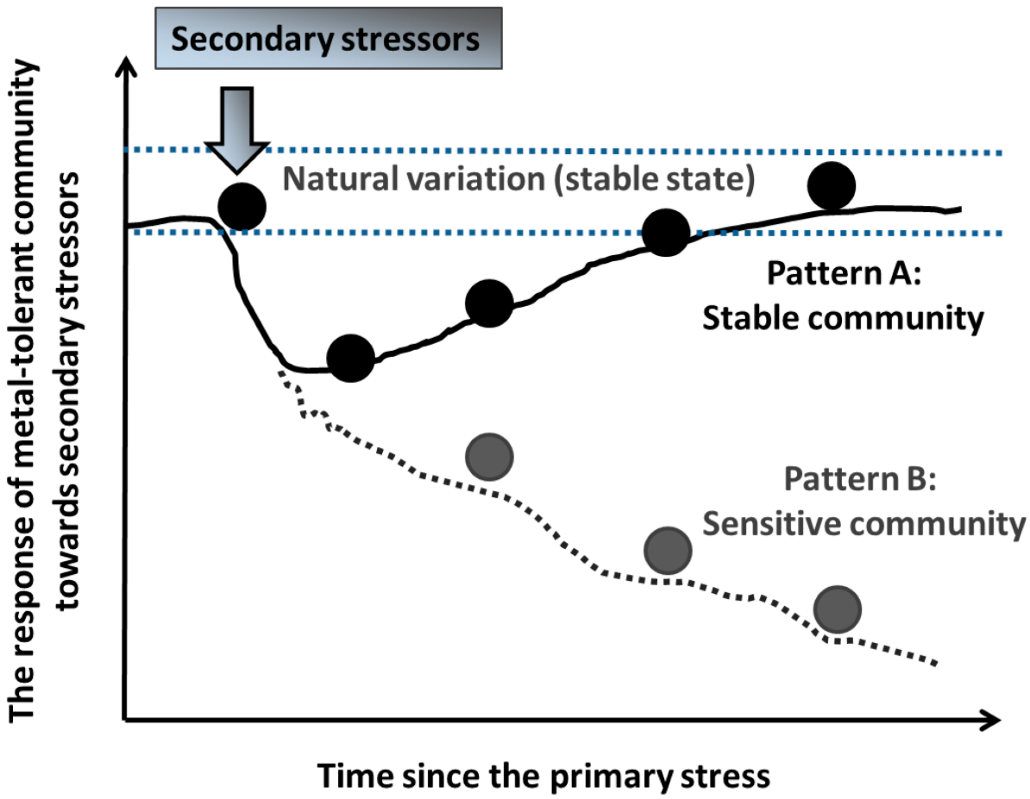
Resistance and Resilience
2 main components to ecosystem stability
RESISTANCE: if it keeps its structure and continues normal functions when disturbances occur
RESILIENCE: following a disturbance the environment can return to normal conditions

Slide 4
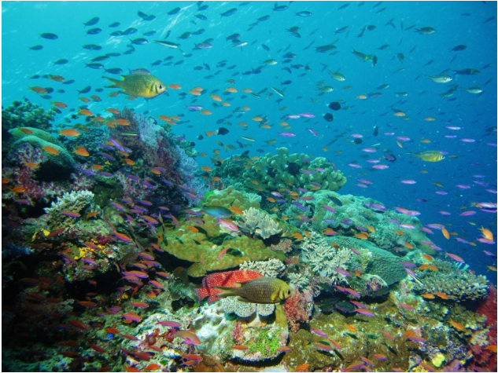
Ecosystems that show a high degree of stability may have a different combinations of resiliency and resistance.
A KEY to both ecosystem resilience and resistance is the level of BIODIVERSITY

Slide 5
Knowledge Check
What are the 2 main components of a stable ecosystem?
2. Summarize the difference between the two.
3. What is the key to maintaining a stable ecosystem?
4. What examples of biodiversity can you come up with?

Slide 6
Types of Biodiversity

Slide 7
Genetic Diversity
Species Diversity
Ecosystem Diversity
Different genes and combinations of genes to survive environmental changes
Different kinds of organisms and the types of relationships among them
Numbers of habitats and organisms interacting in those habitats

Slide 8
Natural and Man-made Disturbances.
Natural disasters: tornadoes, earthquakes, volcanoes, tsunamis, hurricanes, floods, etc.
Habitat Fragmentation
Illegal Hunting
Invasive Species
Pollution
Climate Change

Slide 9
Review

