Slide 1
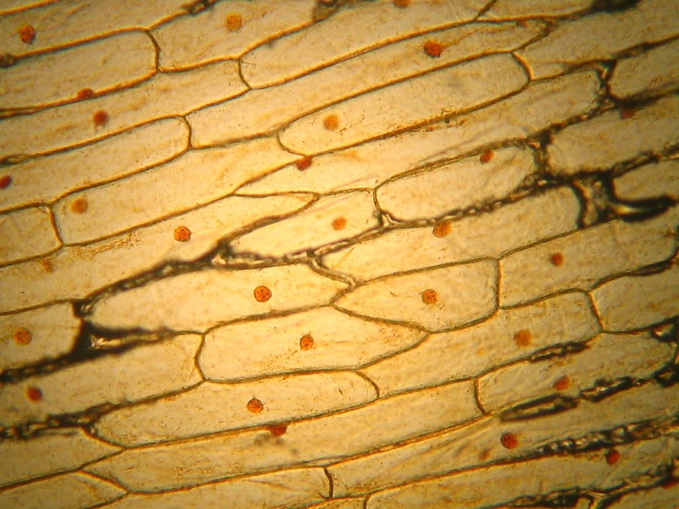
Introduction to Cells: How Were Cells Discovered?

Slide 2
Cells
How do all those macromolecules come together to form a living organism?
By forming a cell!

Slide 3
Organisms are ALL made of cells!
A cell is the smallest unit of an organism that is still considered living.
Basic unit of life!
Some organisms, like bacteria, consist of only one cell.
Others, like humans, have of trillions of specialized cells working together.

Slide 4
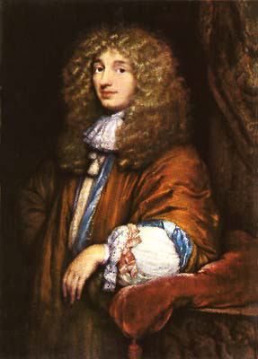
Microscopes
Most cells are so tiny that you can’t see them without the help of a microscope.
We use light microscopes (we can’t see some small structures with these)
Robert Hooke created a primitive light microscope in 1665 and observed cells for the very first time.
1950- more powerful microscopes, biology grew rapidly!

Slide 5
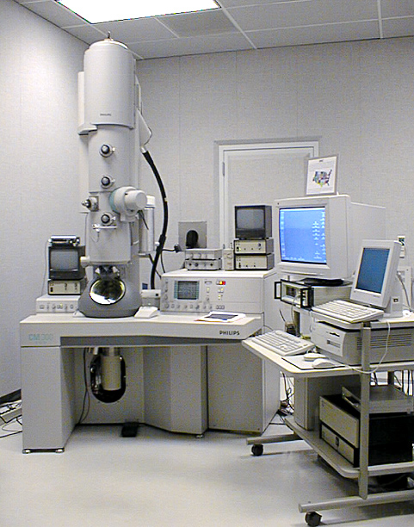
TEM
Transmission electron microscopes (TEM) pass an electron beam through a very thin section of an organism and allow us to study the internal structure of cells.

Slide 6
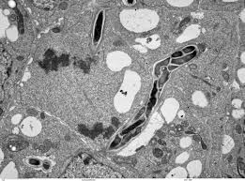

Slide 7
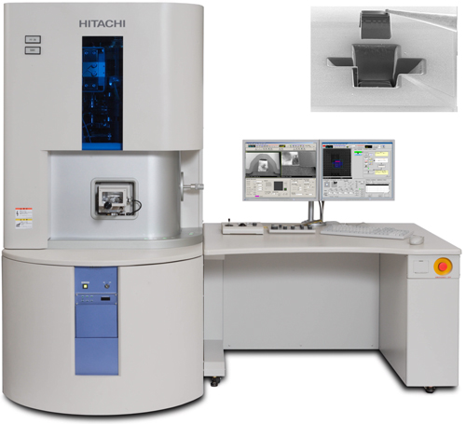
SEM
Scanning electron microscopes (SEM) pass a beam of electrons across the surface of something to show the details of the shapes of surfaces giving a 3D image

Slide 8
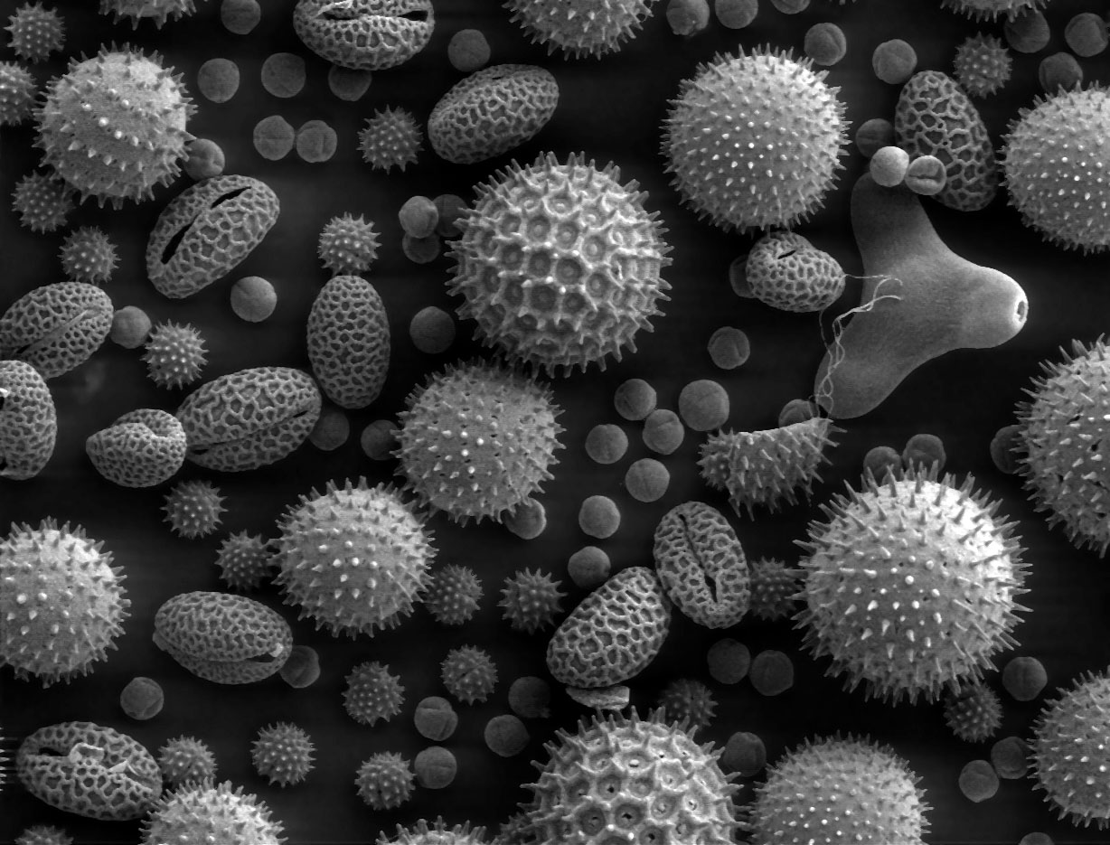

Slide 9
The Cell Theory
All organisms are composed of cells.
Cells are alive and the basic living units of organization in all organisms.
All cells come from other cells.

