Slide 1
The Carbon Cycle
How does carbon cycle through the biosphere, geoshpere, hydrosphere, and atmoshphere?

Slide 2
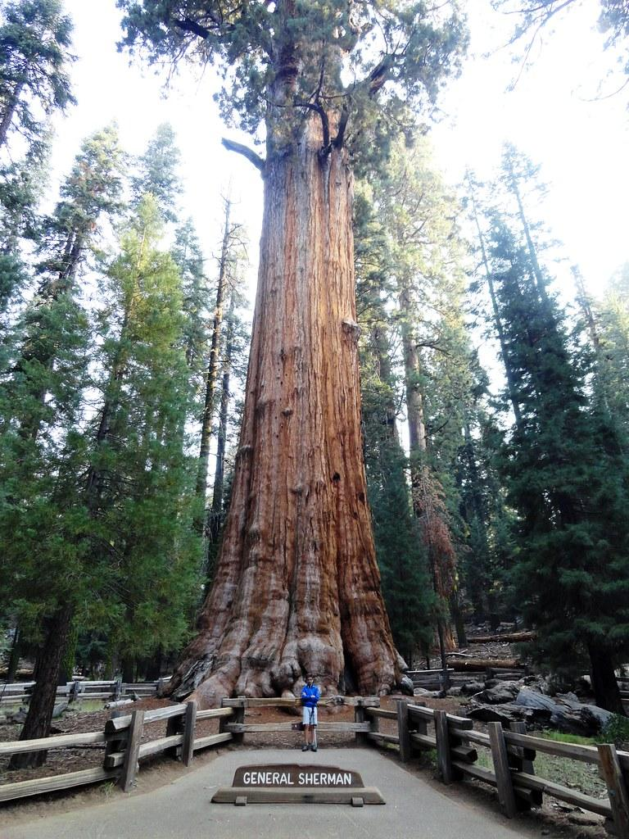
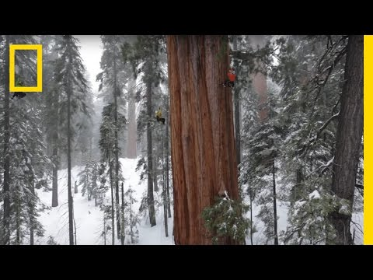
Trees- The Carbon Storage Experts
General Sherman is the largest organism on Earth by volume
2,204,622 lbs
Where does all that mass come from? (mass is matter and matter is atoms)

Slide 3
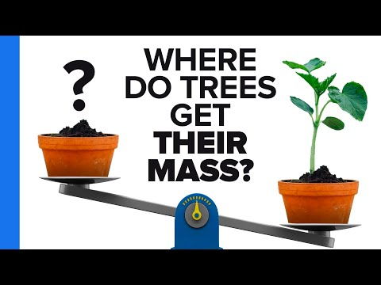
Where/How do trees get their mass?

Slide 4
Class discussion
Misconceptions about where trees get their mass.
Where do trees ACTUALLY get their mass?

Slide 5
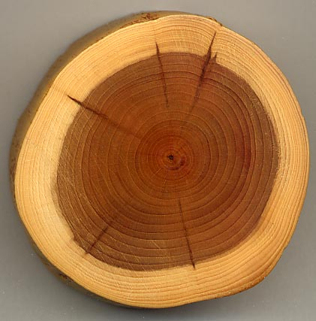
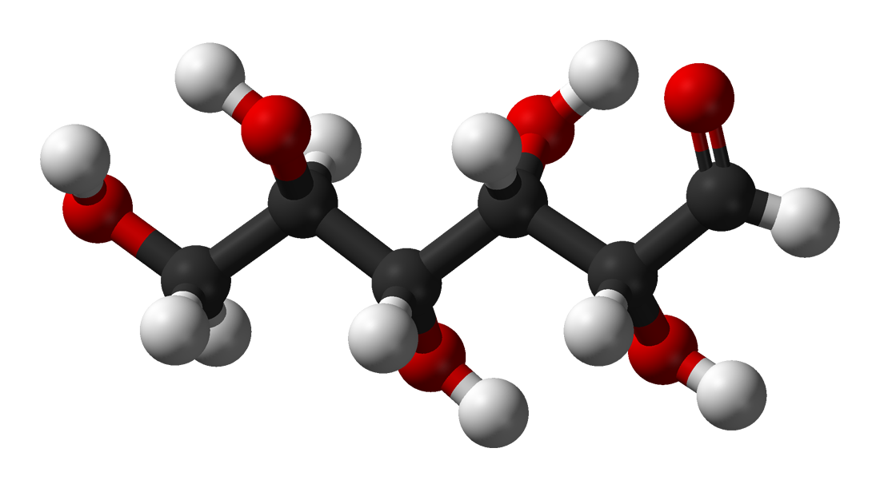
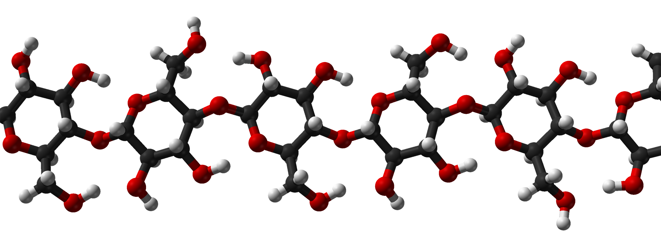
Carbon Fixation
*Making carbon a part of a living organism
Trees grow, like all other living organisms, by adding biomass.
Carbon is the central ingredient to biomass.
Wood of a tree is made mostly of cellulose, a carbon compound.

Slide 6
Knowledge Check
Where do you think the carbon atoms for glucose originally came from?
( soil, water, air)
2. Where do you think the carbon atoms for cellulose came from?
(soil, water, air, glucose)

Slide 7
Carbon Atoms Travel
GEOSPHERE BIOSPHERE ATMOSPHERE HYDROSPHERE
Earth Organisms Gases Water
Limestone Trees Carbon Dioxide Ocean Water
Carbon cycles through the different spheres by being transformed into different carbon compounds.
Carbon can also be stored in the different spheres for short or long periods of time

Slide 8
Photosynthesis/Respiration
The amount of carbon stored in biomass depends on carbon input by photosynthesis and carbon output by cellular respiration.
Knowledge Check:
Discuss with your elbow partner which sphere provides the carbon for tree biomass.
Discuss with your elbow partner which sphere takes carbon from the biosphere.

Slide 9
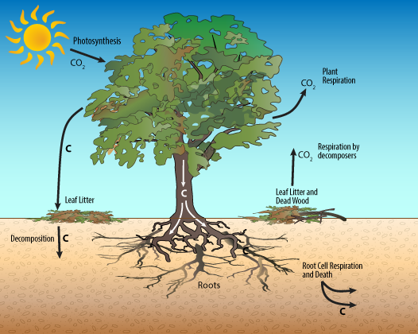
D
R
A
W

