Slide 1
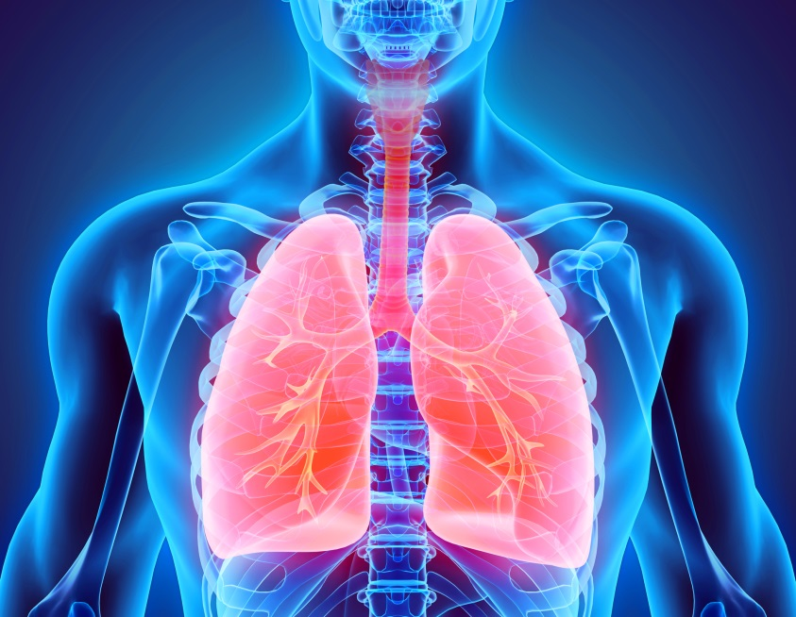
Respiratory System

Slide 2
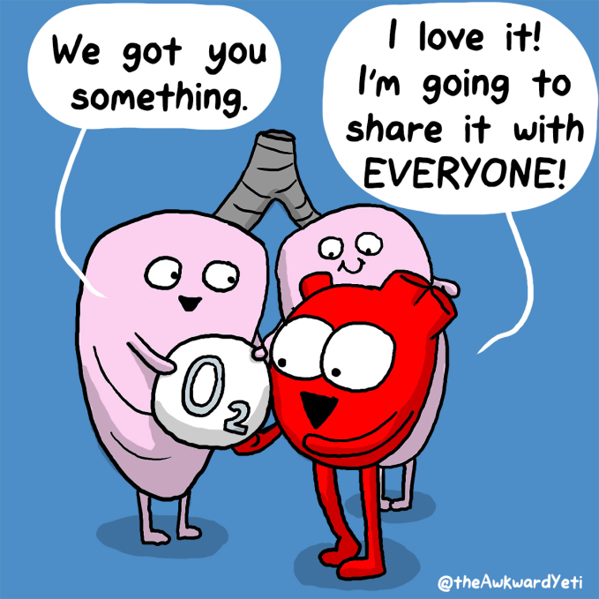
Respiratory System
Main function is to supply oxygen to the body and remove carbon dioxide and water.

Slide 3
What is the difference between breathing and respiration?
Breathing
Respiration
Movement of the chest that brings air into the body through the lungs
Chemical reaction used by cells to release energy from glucose
Produces CO₂ and H₂O as waste products

Slide 4
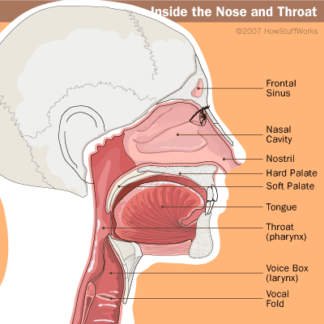
Organs of the respiratory system
The nose- Air enters the body through the nose into the nasal cavities which are lined with cilia- tiny hair-like projections that move together in a sweeping motion.

Slide 5
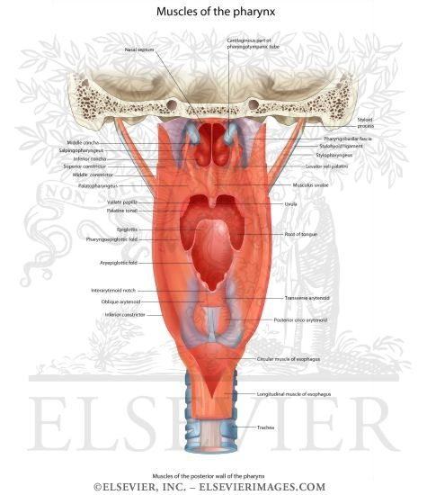
Organs of the respiratory system
The Pharynx- air enters the pharynx (a.k.a. the throat), a tube-like passage way also used by food and liquid
Contains the vocal chords

Slide 6
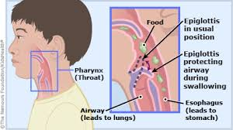
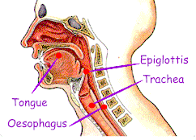
Organs of the respiratory system
The trachea- tube held open by rings of cartilage – called the wind pipe
Lined with cilia and mucous
Epiglottis- small flap of tissue that folds over the trachea and prevents food or liquid from entering.

Slide 7
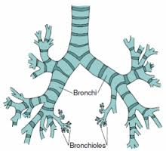
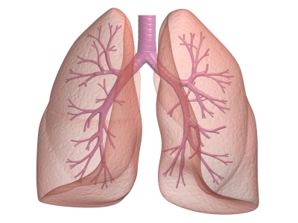
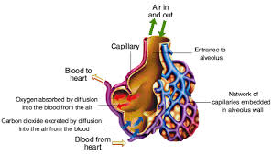
Organs of the respiratory system
Bronchi and Lungs-
Bronchi are passages that direct air into the lungs.
Lungs are the main organ of the respiratory system.
Bronchioles are the smallest tubes of the bronchi that end in clusters called alveoli- tiny sacs of tissue that specialize in the movement of gasses between the blood and air.

