Slide 1
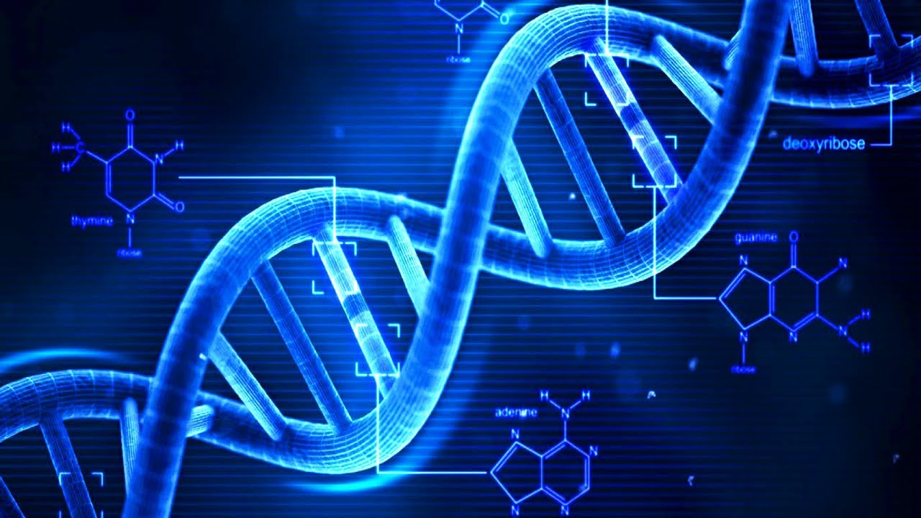
DNA and Bioethics

Slide 2
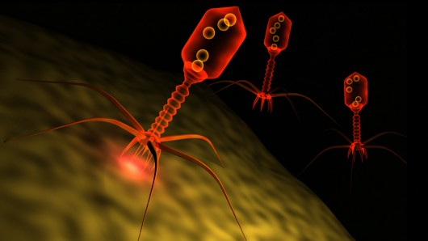
Hershey and Chase
Virus -made of DNA and protein
The experiments
a virus with either radioactive DNA or radioactive protein were used to infect bacteria
Either the radioactive proteins or radioactive DNA would be transferred to the bacteria
Identifying which one is transferred would identify the genetic material.
Only the radioactively labeled DNA was transferred.

Slide 3
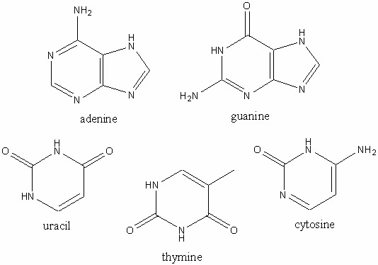
DNA Structure
Composed of nucleotides
nitrogen containing base, a five -carbon sugar (deoxyribose), and a phosphate group.
Four possible bases: adenine (A), guanine (G), cytosine (C), or thymine (T)

Slide 4
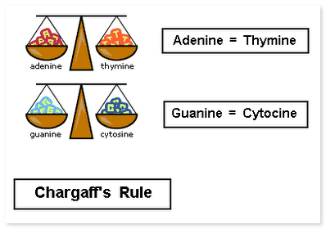
Chargaff’s Rules
1st: The composition of DNA varied from one species to another.
This molecular diversity added evidence that DNA could be the genetic material.
2nd: the amount of one base always approximately equals the amount of a particular second base.
Example: guanines equals the number of cytosines

Slide 5
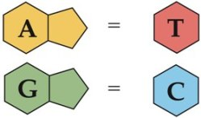
Base Pairing
Purines- Adenine and guanine
two ring structures.
Pyrimidines- Thymine and cytosine
one ring structure.
A purine always combines with a pyrimidine in the DNA double helix!

Slide 6
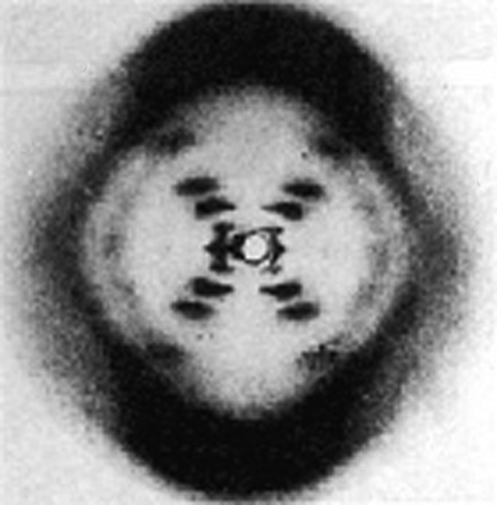
The double Helix
Rosalind Franklin
Worked with DNA fibers.
Maurice Wilkins, used x-ray diffraction photographic techniques to analyze the structure of DNA.
In February 1953, Francis Crick and James D. Watson had started to build a model of DNA.
indirectly obtained Franklin's data which had crucial information
Crick and Watson then published their double helical model of DNA! (They get most of the credit)

Slide 7
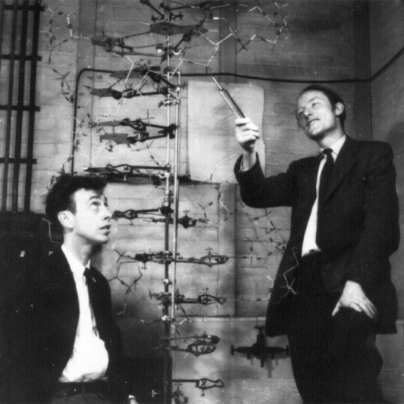
Watson and Crick

Slide 8
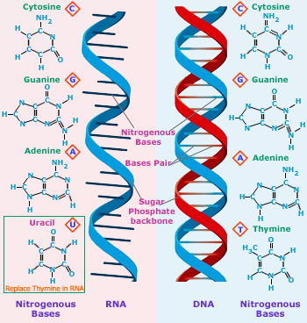
 | RNA | DNA
 | Single Stranded | Double Stranded
Specific Base | Uracil | Thymine
Sugar | Ribose | Deoxyribose
Size | Relatively small | Big (chromosomes)
Location | Moves to cytoplasm | Stays in Nucleus
Types | mRNA, tRNA, rRNA | DNA

