Slide 1
Bioethics and Pedigree Charts

Slide 2
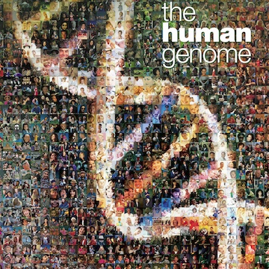
Right or wrong? Good or bad? Legal or illegal?
The completion of The Human Genome Project! WOW!!!!!
However, is knowing all of our DNA a good thing?

Slide 3
Ethical, Legal, Social Issues
Imagine someone analyzes part of your DNA. Who controls that information?
What if your health insurance company found out you were predisposed to develop a devastating genetic disease. Might they decide to cancel your insurance? Privacy issues concerning genetic information is an important issue in this day and age.
ELSI stands for Ethical, Legal and Social Issues.

Slide 4
Concerns for Biotechnology
Who owns genetically modified organisms such as bacteria?
Can such organisms be patented like inventions?
Are genetically modified foods safe to eat? Might they have unknown harmful effects on the people who consume them?
Are genetically engineered crops safe for the environment?
Might they harm other organisms or even entire ecosystems?
Who controls a person’s genetic information? What safeguards ensure that the information is kept private?
How far should we go to ensure that children are free of mutations? Should a pregnancy be ended if the fetus has a mutation for a serious genetic disorder?

Slide 5
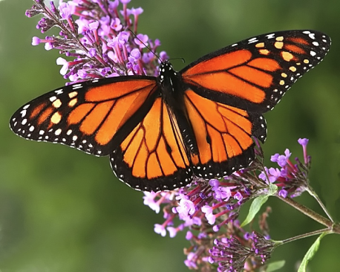
Let’s consider…
A strain of corn has been created with a gene that encodes a natural pesticide. On the positive side, the transgenic corn is not eaten by insects, so there is more corn for people to eat. The corn also doesn’t need to be sprayed with chemical pesticides, which can harm people and other living things. On the negative side, the transgenic corn has been shown to cross-pollinate nearby milkweed plants. Offspring of the cross-pollinated milkweed plants are now known to be toxic to monarch butterfly caterpillars that depend on them for food. Scientists are concerned that this may threaten the monarch species as well as other species that normally eat monarchs

Slide 6
Pedigree Charts
Shows the inheritance of a trait over several generations.
Commonly created for families
outlines the inheritance patterns of genetic disorders.
Scientists can tell the genetics of inheritance from studying a pedigree,
sex-linked (on the X or Y chromosome)
autosomal (on a chromosome that does not determine sex),
dominant or recessive

Slide 7
recessive inheritance of a disorder through three generations

Slide 8
Is the Trait Dominant or Recessive?
If a trait is autosomal dominant, every person with the trait will have a parent with the trait.
If the trait is recessive, a person with the trait may have one, both or neither parent with the trait.

Slide 9
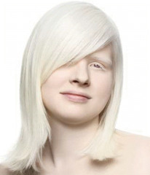
Heterozygous or Homozygous?
If a person shows the dominant phenotype, they could be either homozygous dominant (AA) or heterozygous (Aa).
A person who is heterozygous (Aa) for a recessive allele of a trait is called a carrier because they carry a copy of the recessive allele even though they don’t have the disease.
Only people who are homozygous for a recessive allele of a trait will have the trait.

Slide 10
Is the trait sex-linked or autosomal?
A sex chromosome is a chromosome that determines the sex of an organism.
Humans have two sex chromosomes, X and Y.
Females have two X chromosomes (XX), and males have one X and one Y (XY).
A sex-linked trait is a trait whose allele is found on a sex chromosome.
The human X is much bigger and has many more genes than Y.
There are many more sex-linked traits on X than Y.
Most are recessive, because males only have one X if they inherit the trait then they will express it. These traits are much more common in men than women.
Women have two X’s so if they express the trait then they got two copies of the allele, they can also only receive one copy and be a “carrier” of the trait.

Slide 12
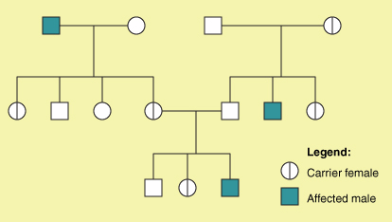
Color Blind Pedigree

Slide 13
Color Bind Punnett square

Slide 14
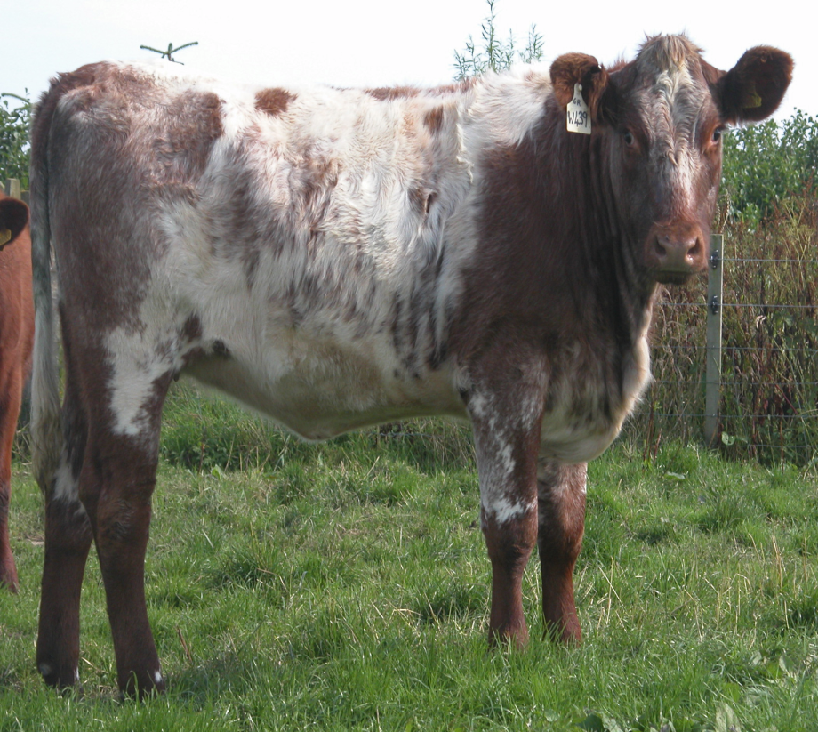
Codominance
both traits appear in a heterozygous offspring
Neither allele is completely dominant nor completely recessive.
Example: roan shorthorn cattle have codominant genes for hair color. The coat has both red and white hairs.

Slide 15
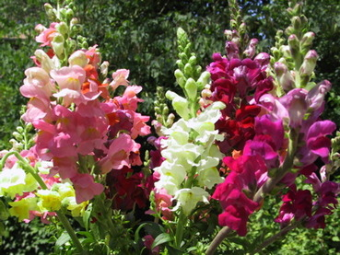
Incomplete Dominance
phenotype of the offspring is somewhere in between the phenotypes of both parents, a completely dominant allele does not occur.
mixing of both genes.
Example: when red snapdragon (CRCR) are crossed with white snapdragons (CWCW), the F1hybrids are all pink heterozygotes for flower color (CRCW). The pink color is an intermediate between the two parent colors. When two F1 (CRCW) hybrids are crossed they will produce red, pink, and white flowers.
The genotype can be determined by it’s phenotype

