Slide 1
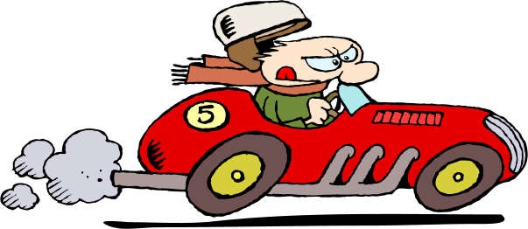
Kinetic Energy

Slide 2
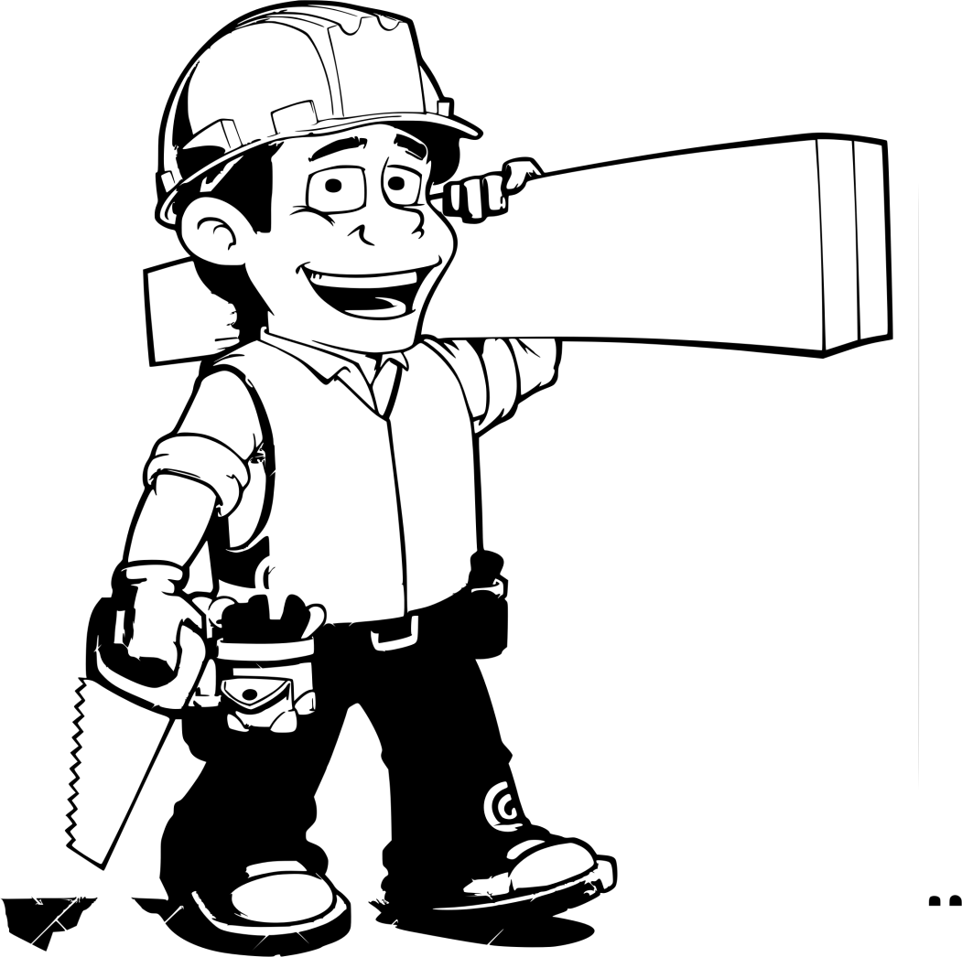
What is Energy?
Energy is the ability to do work.
Work is done when a force causes something to move

Slide 3
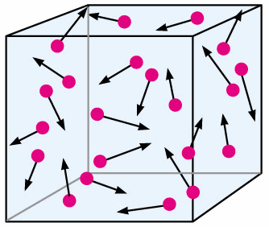
Kinetic Energy is energy in motion
Any type of matter that is in motion has kinetic energy

Slide 4
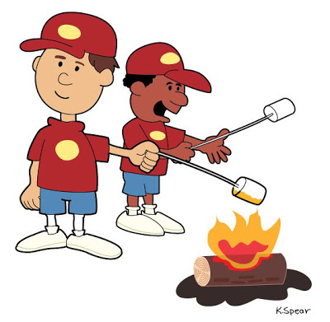
Kinetic Energy
There are many forms of Kinetic Energy
Some forms include:
light (radiant),
thermal (heat),
sound (acoustic),
electrical, and
mechanical

Slide 5
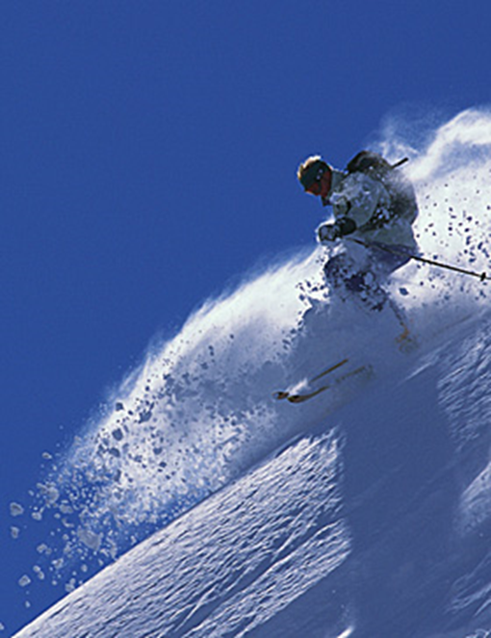
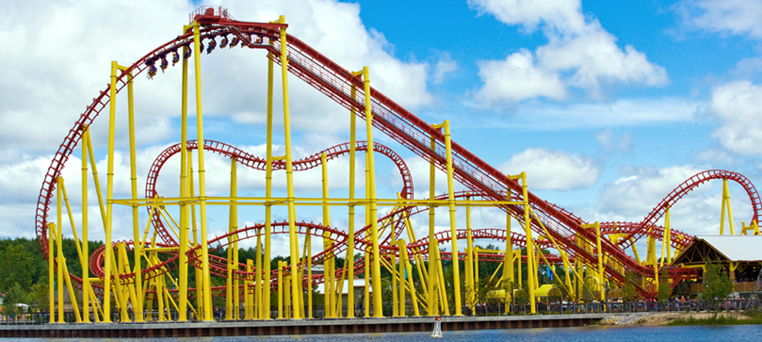
Examples of Kinetic Energy
A skier skiing down a hill.
An arrow shot through the air.
A roller coaster moving.

Slide 6
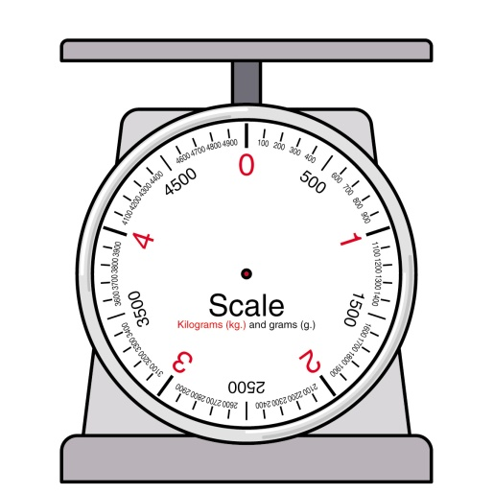
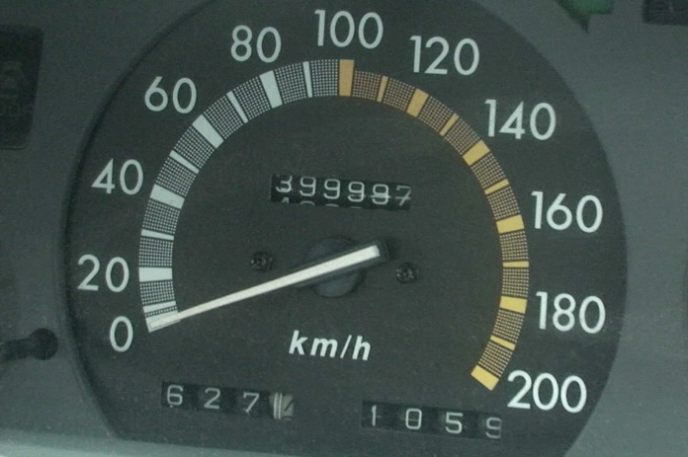
Kinetic Energy Equation
The amount of kinetic energy depends on 2 variables
Mass of the object (m) and
The speed of the object (v)

Slide 7
Kinetic Energy Equation
To identify the kinetic energy of a moving object, the following formula is used.
KE = 0.5 x m x v²
m = mass of object
v = speed of object

