Slide 1
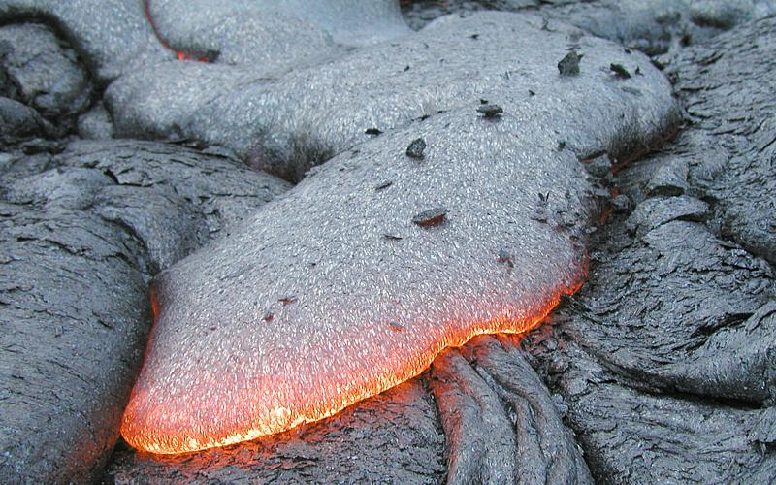
Rocks

Slide 2
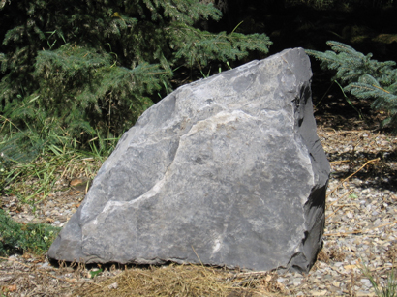
What is a Rock?
A rock is a naturally formed solid mixture containing mineral fragments, glass, and organic matter.

Slide 3
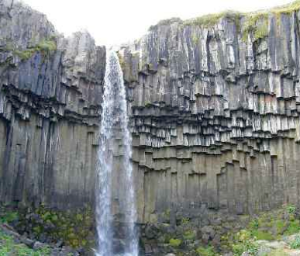
Igneous Rocks
Form from the cooling and hardening of lava or magma.
Lava: molten material on Earth’s surface.
Magma: molten material below Earth’s surface.

Slide 4
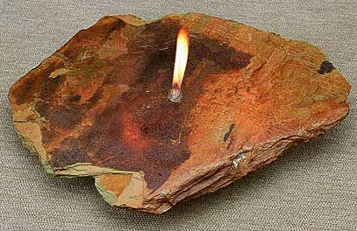
Cool Facts about Igneous Rocks
The word igneous comes from the Greek word for fire.
Igneous rocks are the oldest rocks on the Earth.

Slide 5
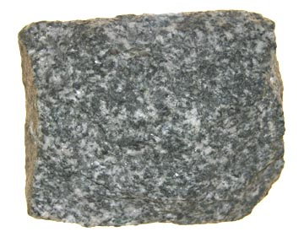
Intrusive Igneous Rocks
Form within the Earth’s surface from cooling & hardening magma.
Have larger grain sizes because the rock cooled slowly allowing the grains to form.

Slide 6
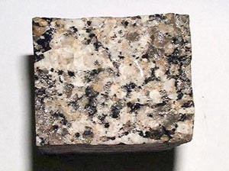
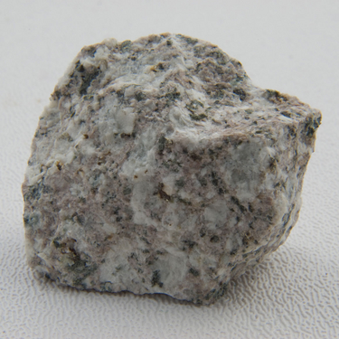
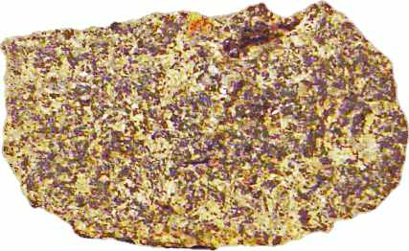
Examples of Intrusive Igneous Rocks
Granite
Monzonite
Gabbro

Slide 7
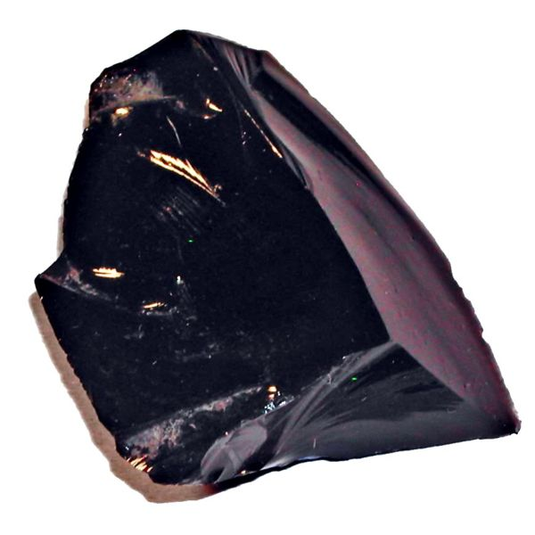
Extrusive Igneous Rocks
Form from the cooling and hardening of lava on the Earth’s surface.
Cool quickly, therefore
they have very small
or no grains.

Slide 8
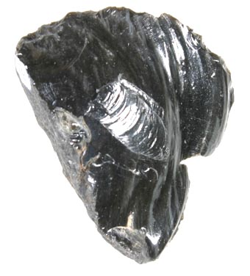
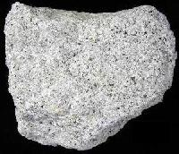
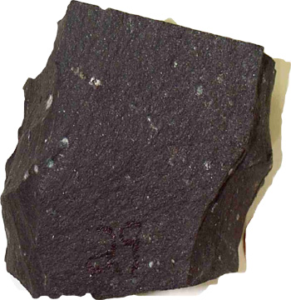
Examples of Extrusive Igneous Rocks
Obsidian
Andesite
Basalt

Slide 9
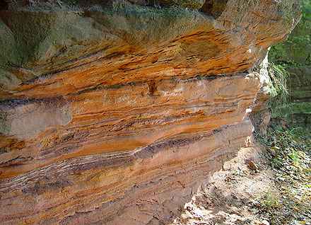
Sedimentary Rocks
Form through the compaction or cementation of sediments.

Slide 10
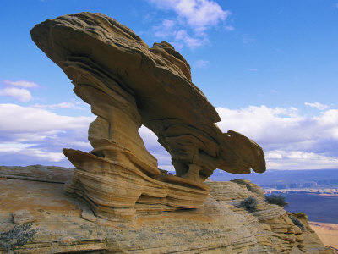
Sediments
Fragments of rocks & minerals
Formed from rocks broken down by weathering.

Slide 11
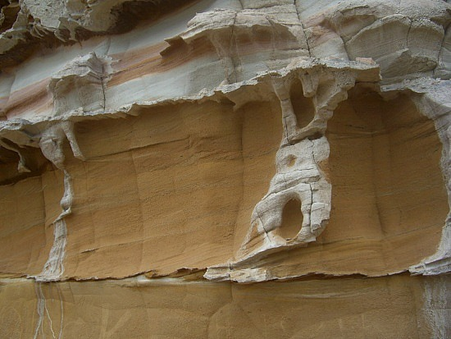
Compaction
Occurs when sediments are buried and pressed together by the weight of the material above them.
Sedimentary rocks have layers or stripes

Slide 12
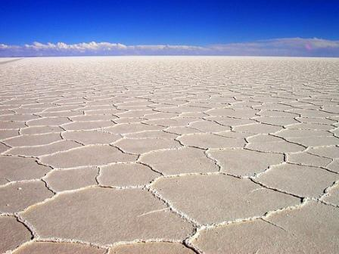
Cementation
Occurs when water carrying minerals that act like glue evaporates causing the sediments left behind to stick together.

Slide 13
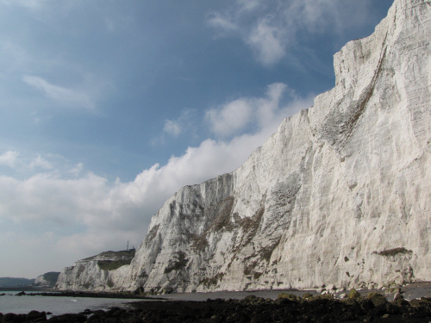
3 Types of Sedimentary Rocks

Slide 14
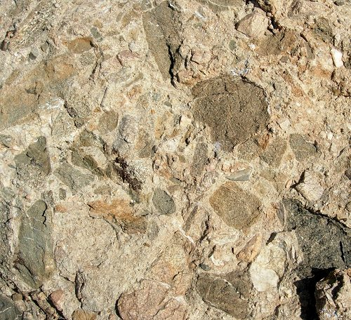
1. Clastic Sedimentary Rocks
Made mostly of sediments.
The sediments can come in 4 different sizes:
Coarse
Medium
Fine
Very Fine

Slide 15
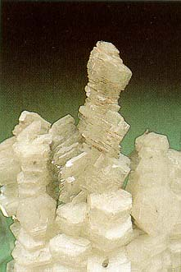
2. Chemical Sedimentary Rocks
Sedimentary rocks formed from water evaporating away leaving behind a cemented together rock.

Slide 16
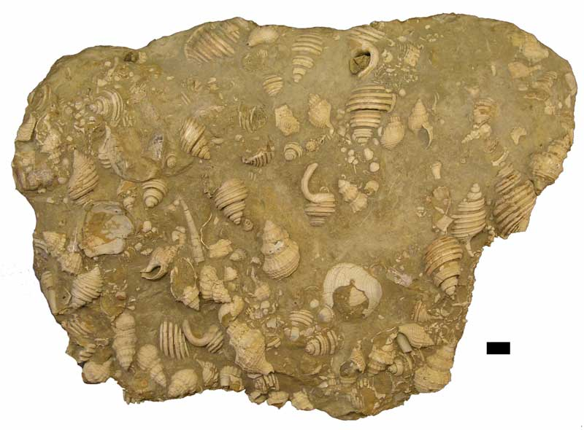
3. Organic Sedimentary Rocks
Formed from the remains of living organisms being pressed together.

Slide 17
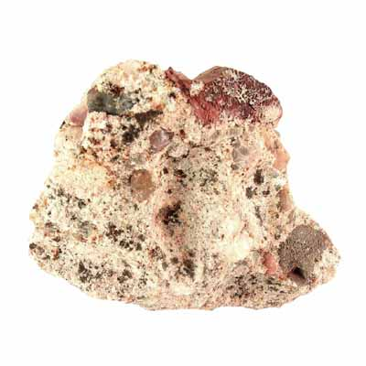
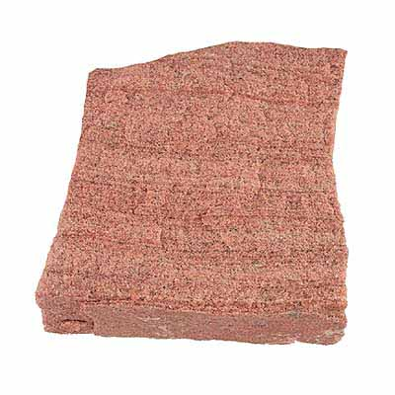
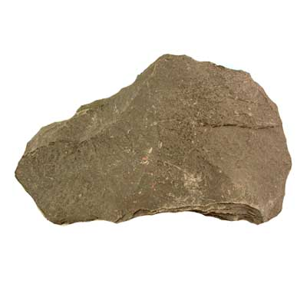
Examples of Sedimentary Rocks
Conglomerate
Sandstone
Shale

Slide 18
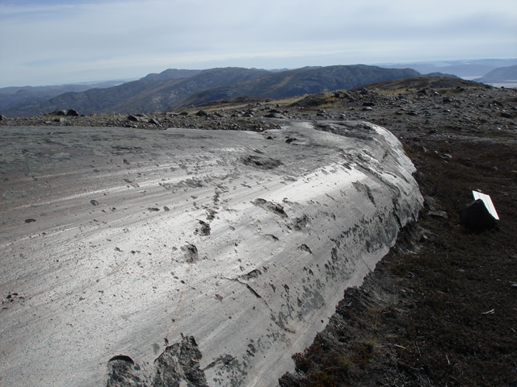
Metamorphic Rocks
Formed deep underground where other types of rocks encounter high heat and pressure to chemically change into new rocks.

Slide 19
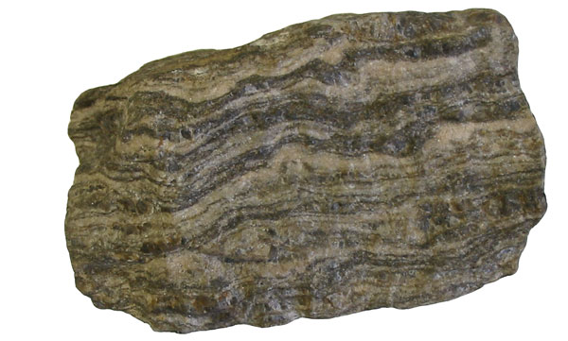
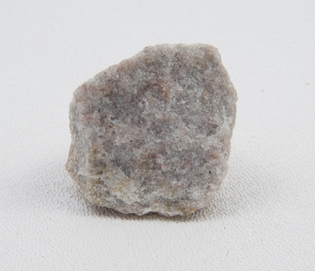
Types of Metamorphic Rocks
Foliated – has a banded appearance.
Non-foliated – does not have a banded appearance.

