Slide 1
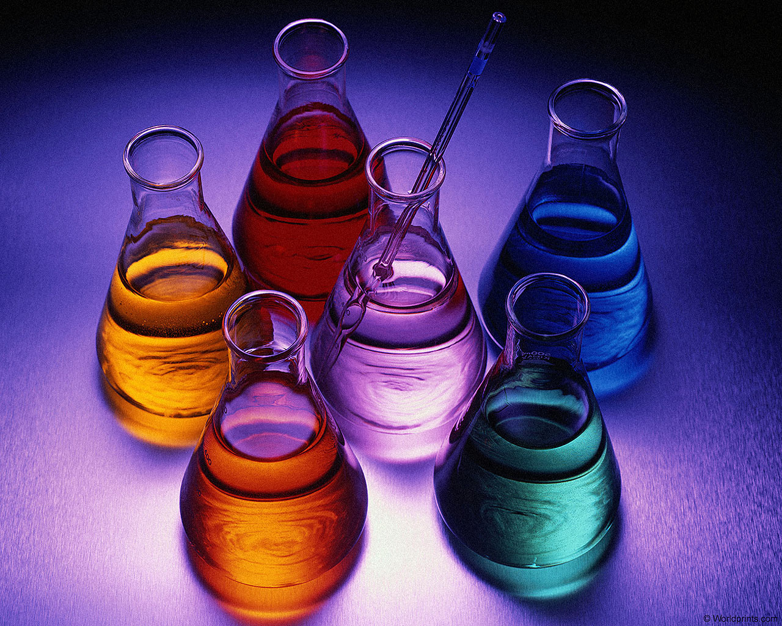
Physical And Chemical Properties

Slide 2
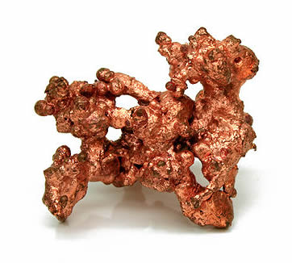
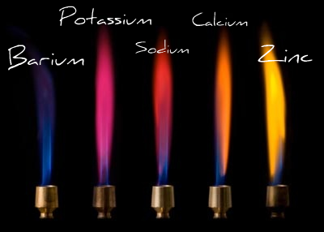
Properties
Properties are descriptions of matter.
There are 2 types of properties…

Slide 3
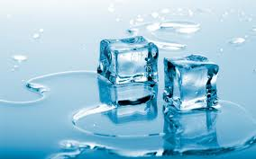
Physical Properties
Physical Properties can be measured or observed without matter changing the substance.
Color
Odor
Hardness
State/Phase – Solid, Liquid, Gas
Freezing/Boiling point
Ability to dissolve
Ability to mix
Ability to conduct heat or electricity
Density

Slide 4
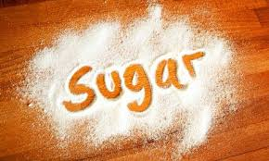
Physical Properties
List 3 Physical Properties of the following objects:

Slide 5
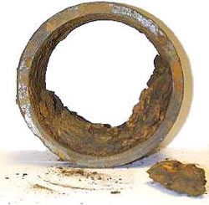
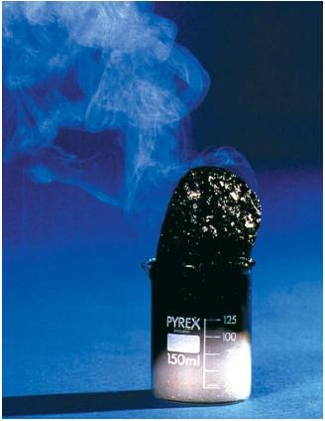
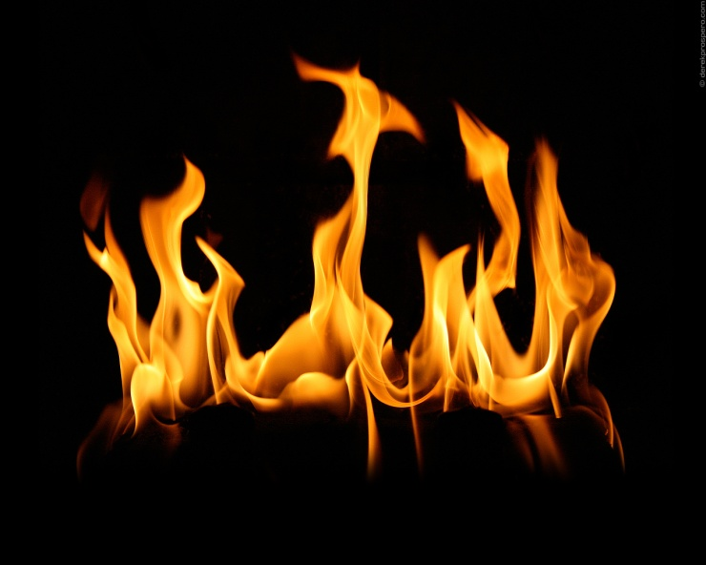
Chemical Properties
Chemical Properties describe the ability of an object to undergo a specific chemical change.
Flammability
Burns
combusts
Reactivity
Reacts with…
Rusts
Corrodes

Slide 6
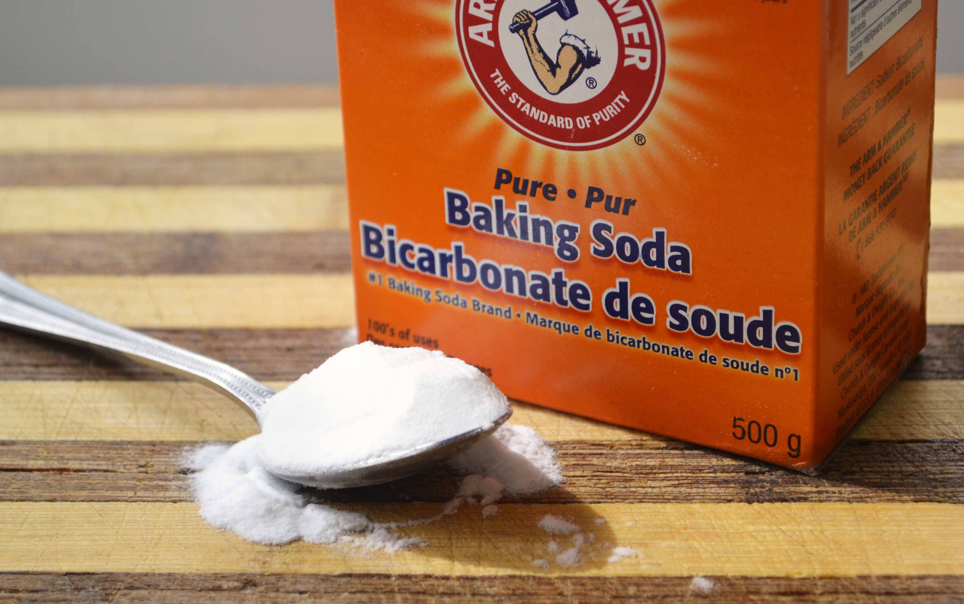
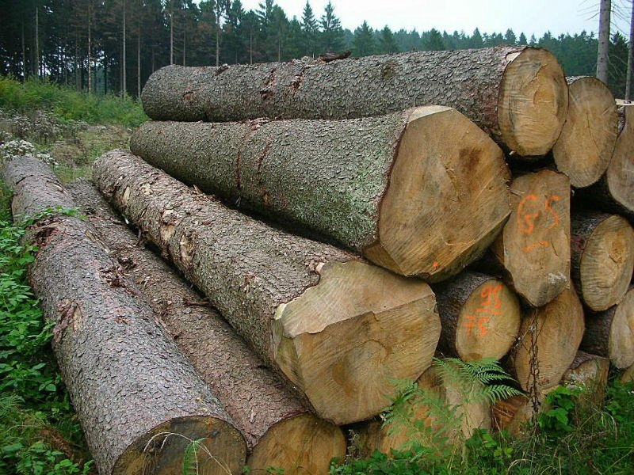
Chemical properties
List chemical properties of the following objects.

Slide 7
Indentify the following as either a physical or chemical property of paper
Burns
Chemical
Wrinkled
Physical
Rectangle
Physical
Reacts with light
Chemical
Thin
Physical
White
Physical
Flammable
Chemical

