Slide 1
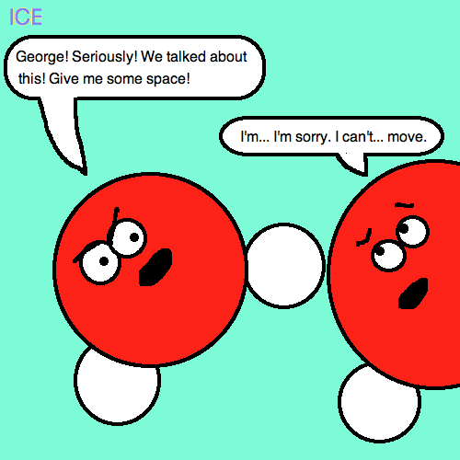
Particles in Motion
Phases of Matter

Slide 2
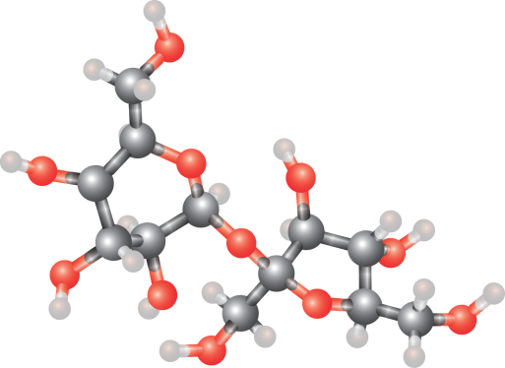
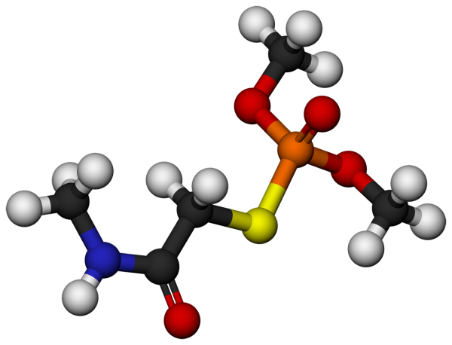
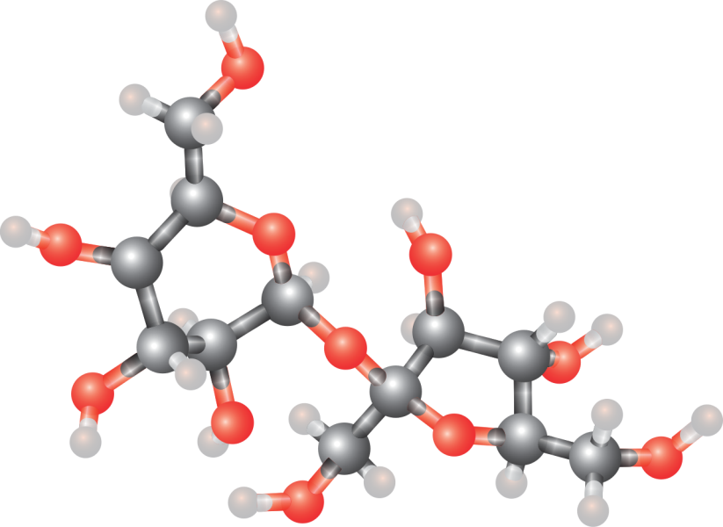
Particles in Motion
All matter is made of tiny particles.
These particles are in constant motion

Slide 3
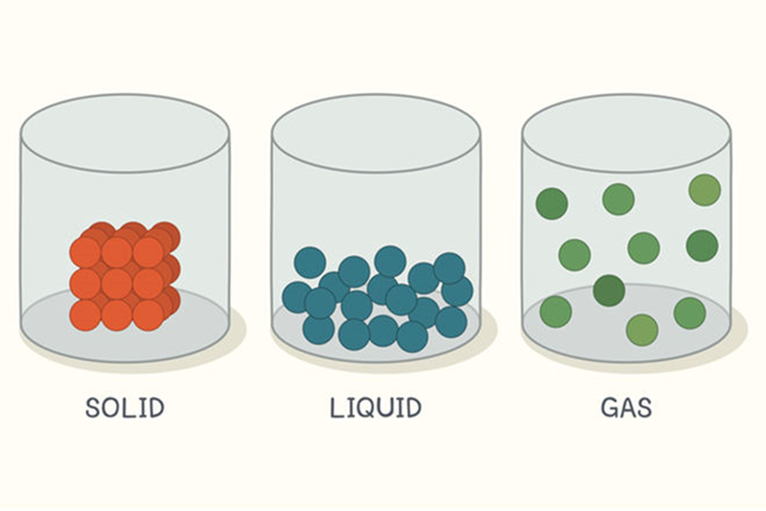
Particles in Motion
The change in motion of particles causes all forms of matter to have different phases.

Slide 4
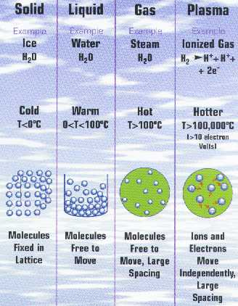
PHASES OF MATTER
4 Phases (States) of Matter
Solid
Liquid
Gas
Plasma
http://www.plasmas.org/E-4phases2.jpg

Slide 5
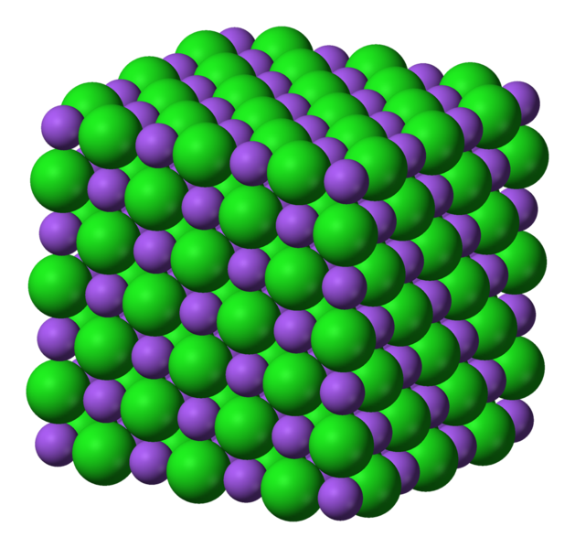
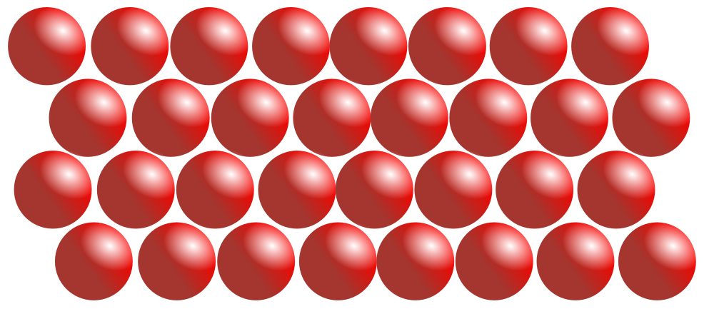
SOLIDS
Particles are tightly packed, close together and barely moving
Definite shape and volume because particles are packed close

Slide 6
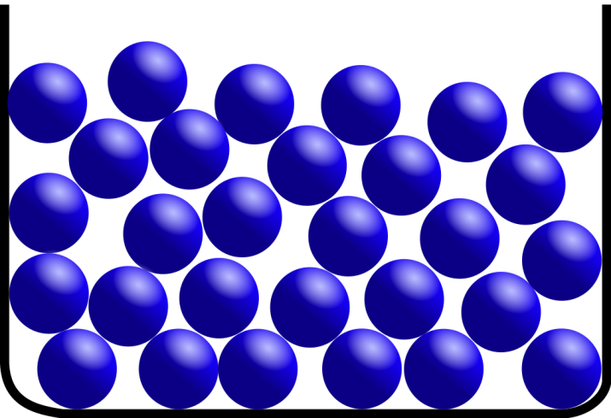
LIQUIDS
Particles move slowly past one another
No definite shape but do have a definite volume
chemed.chem.purdue.edu/.../graphics

Slide 7
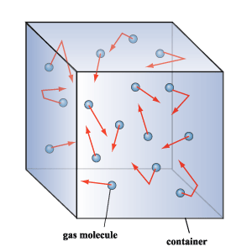
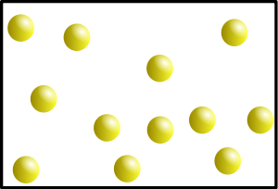
GASES
Particles are very far apart and move very fast
NO definite shape and NO definite volume
http://www.phy.cuhk.edu.hk/contextual/heat/tep/trans/kinetic_theory.gif

Slide 8
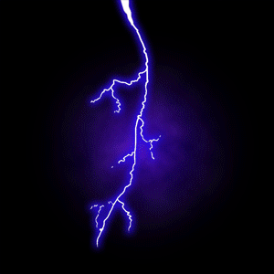
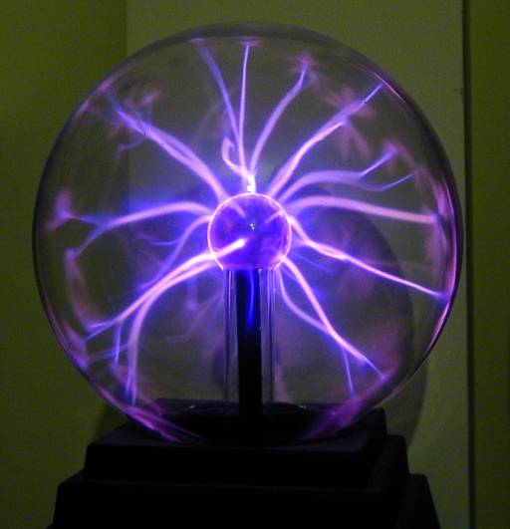
PLASMA
Particles are extremely far apart and move extremely fast
Basically, plasma is a hot gas that gives off light
Examples neon signs, stars,
lightning, and halogen lights in
classroom

Slide 9
http://www.mrzimmerman.org/New%20Folder/HW/STUDY%20GUIDE%20for%20Prop%20of%20Matter.htm

Slide 10
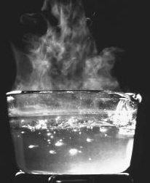
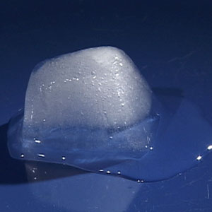
PHASE CHANGES
Melting – changing from a solid to a liquid
Freezing – changing from a liquid to a solid
Boiling – changing from a liquid to a gas
Condensating- changing from a gas to a liquid

Slide 11
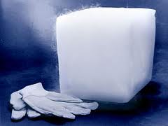
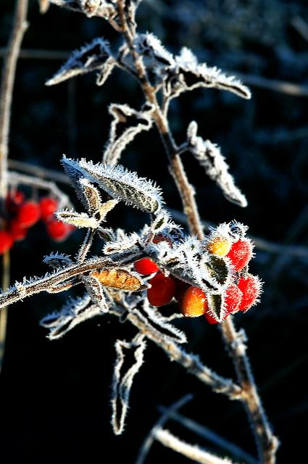
PHASE CHANGES
Sublimation - change from a solid to a gas
The best known example is "dry ice", solid CO₂
Deposition-when a substance changes directly from a gas to a solid
Example-formation of frost

Slide 12
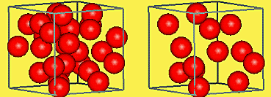
Changes in Density
Density is the ratio of mass per unit volume of a substance.
The mass means how much matter is in the substance
the volume is the space the matter takes up.
The more tightly packed the particles are in a certain space, the higher the density.

Slide 13
Changes in Density
Almost all atoms are more dense as solids than a gas.

Slide 14
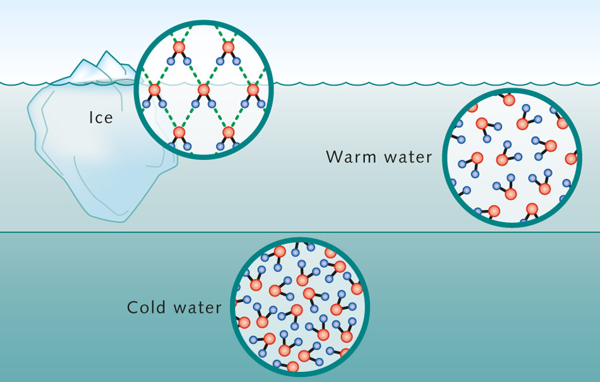
Exception- Ice and Water
Because of the way hydrogen bonds, when water freezes to ice, it leaves spaces between the molecules.
These spaces make the ice (solid form of water) less dense.

