Slide 1
Atoms & Molecules

Slide 2
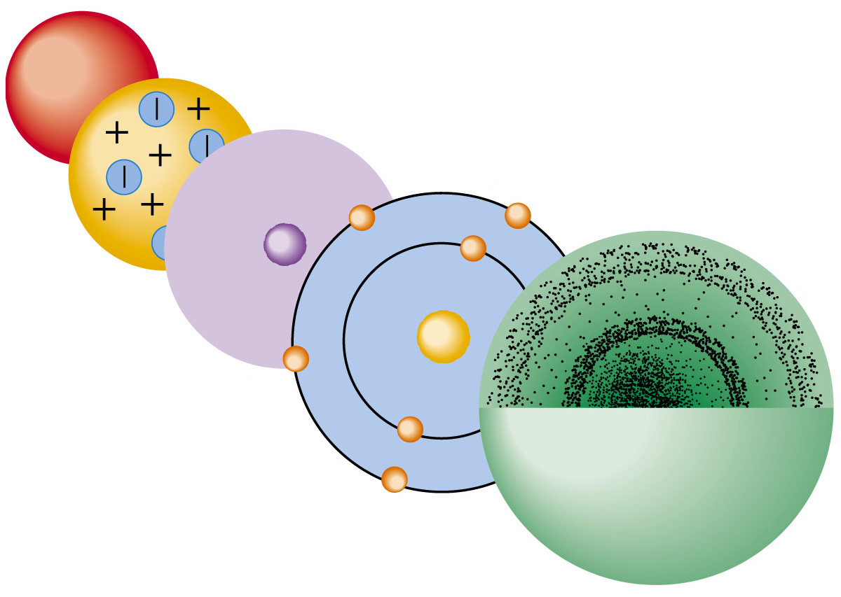
Atoms- the building blocks of matter

Slide 3
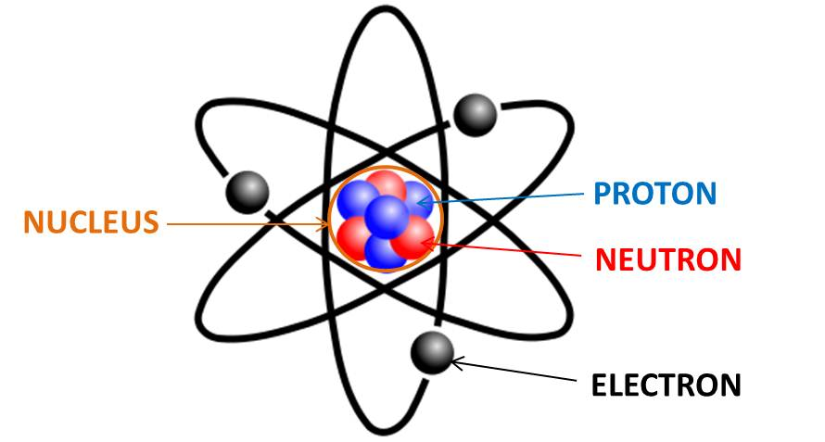
Parts of an Atom
Nucleus- center of atom
Protons- positive charge (+)
Neutrons- neutral charge (0)
Electrons- negative charge (-), move around the nucleus

Slide 4
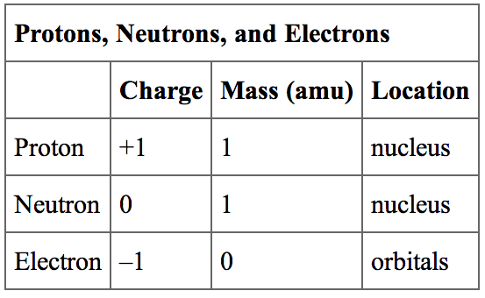

Slide 5
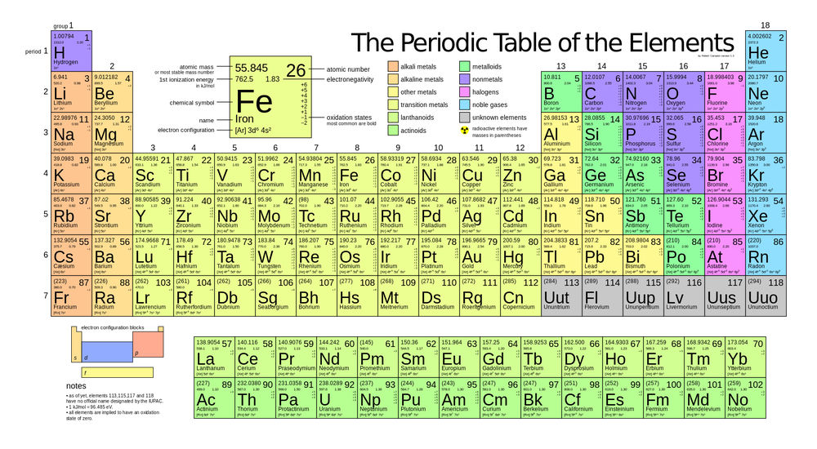
Elements
Pure Substances- made of only one kind of atom
# of Protons = Element on the periodic table

Slide 6
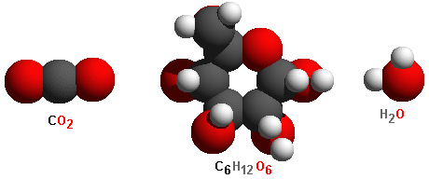
Molecules
Two or more atoms combined
In a chemical formula, the number of atoms comes after the symbol
Example CO2 is 1 Carbon atom and 2 Oxygen atoms

Slide 7
Compounds
Substance made of more than one element.

