Slide 1
Natural Vs. Synthetic

Slide 2
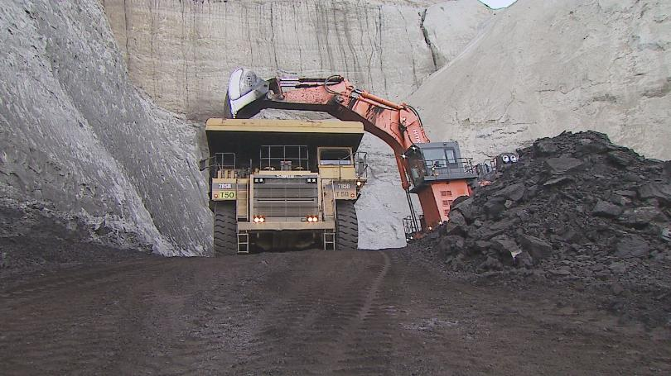
Natural Resources
Found in Nature
We have to:
Dig them out of the ground
Grow them
Take them from living things

Slide 3
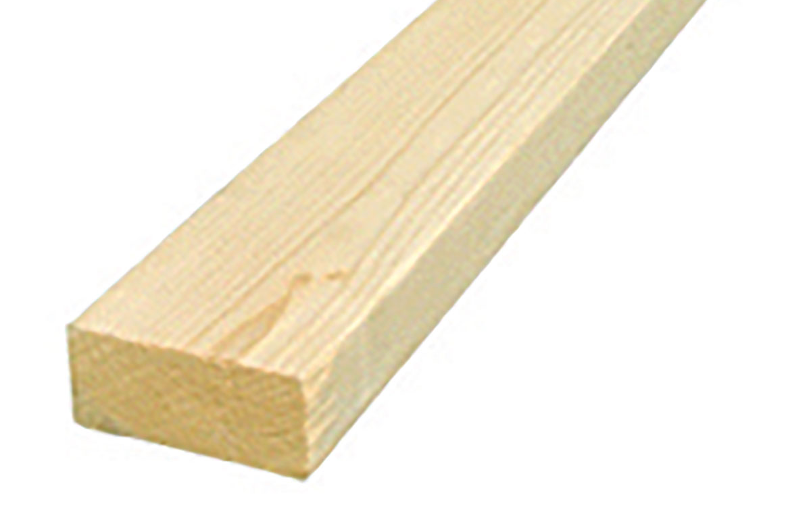
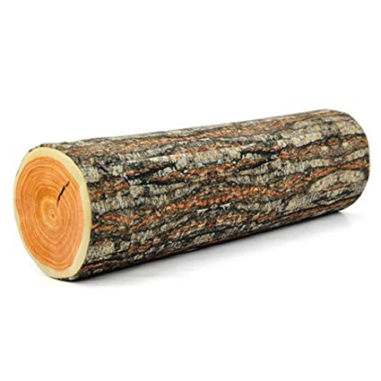
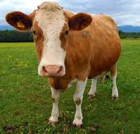
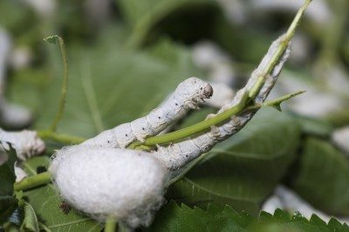
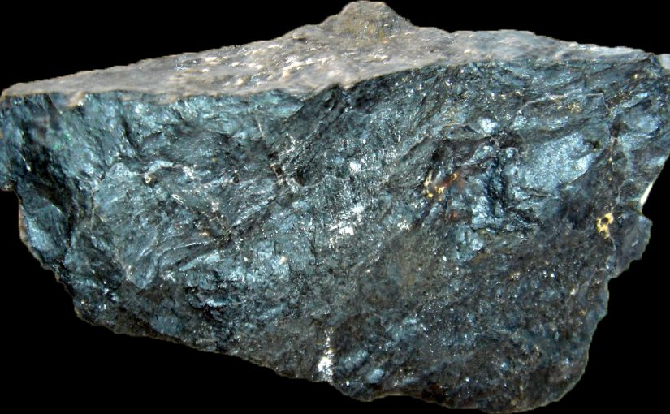
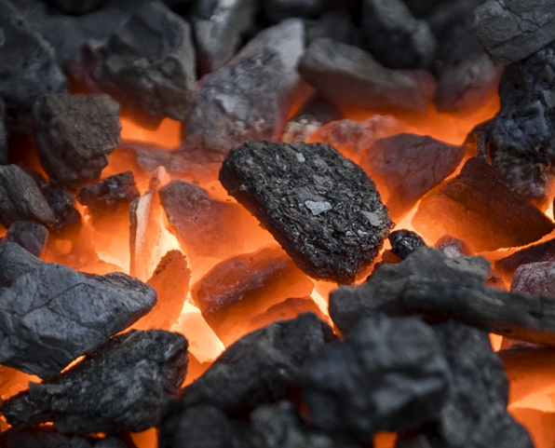
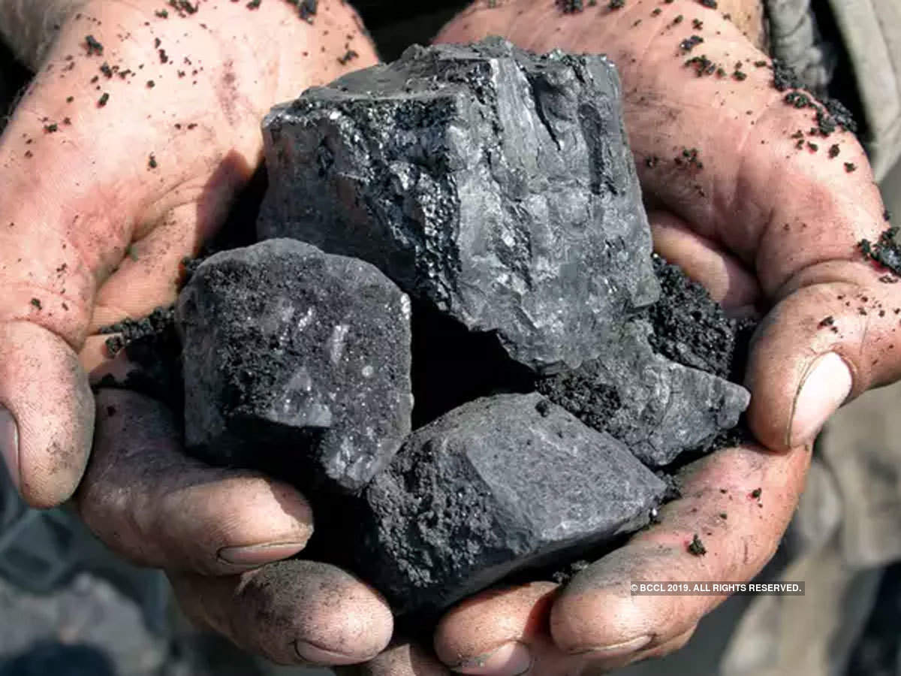
Examples of Natural Resources
Wood
Leather
Oil
Coal
Cotton
Silk
Metals
Sand

Slide 4
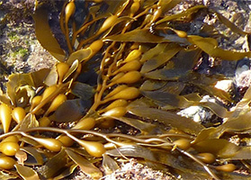
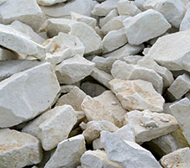
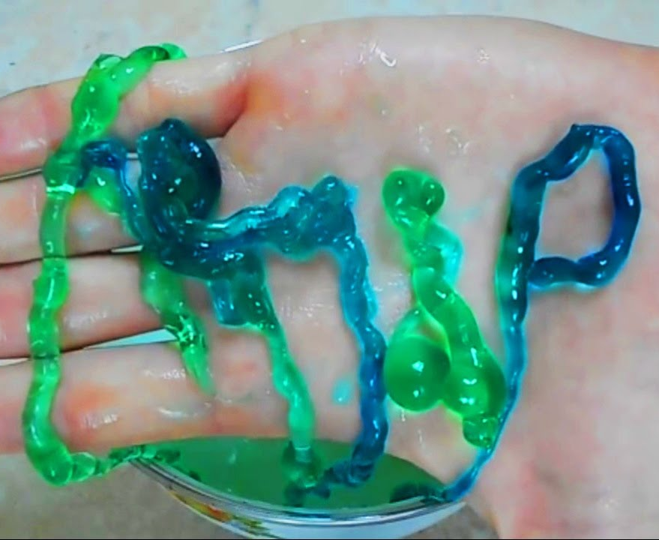
Synthetic
Man-Made
Natural substance changed by man.

Slide 5
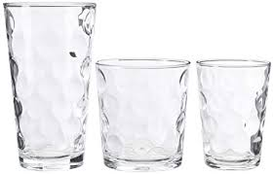
Examples of Synthetic Materials
(and the natural resource they are made from)
Plastic is made from oil
Glass is made from sand
Paper is made from wood
Nylon is made from oil

