Slide 1
Infographic for Proposal
A guide to starting your infographic

Slide 2
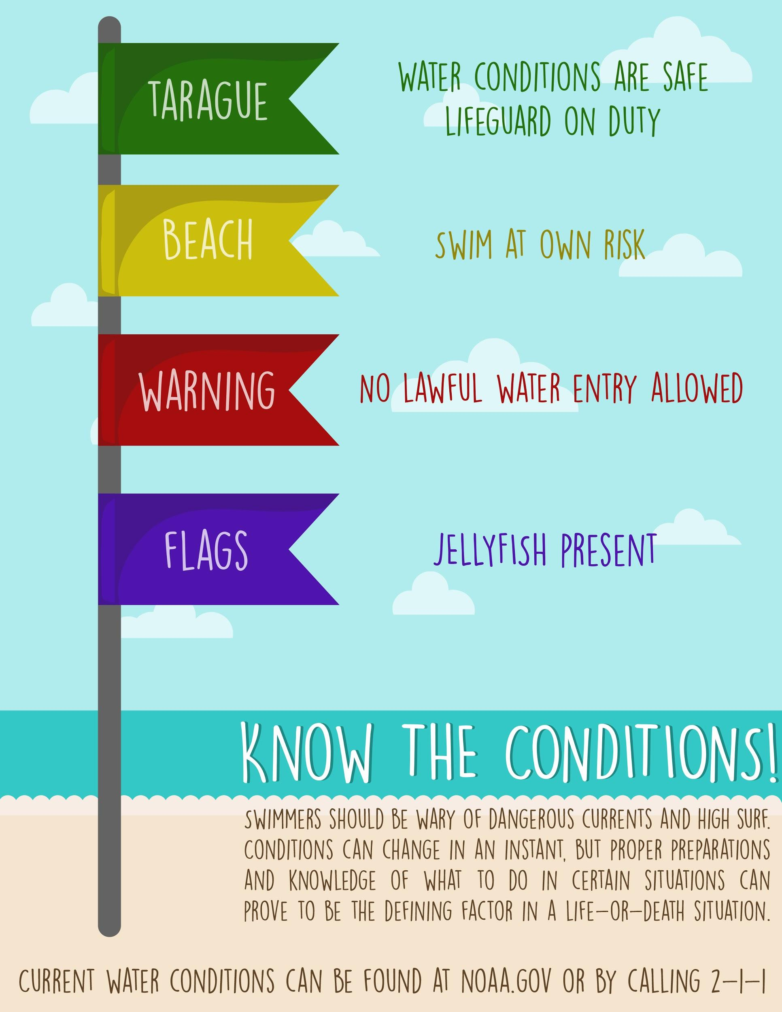
Selling your idea
An infographic a a visual aide to help share information with words and pictures in an effort to educate, sell, or convince your audience of an idea.

Slide 3
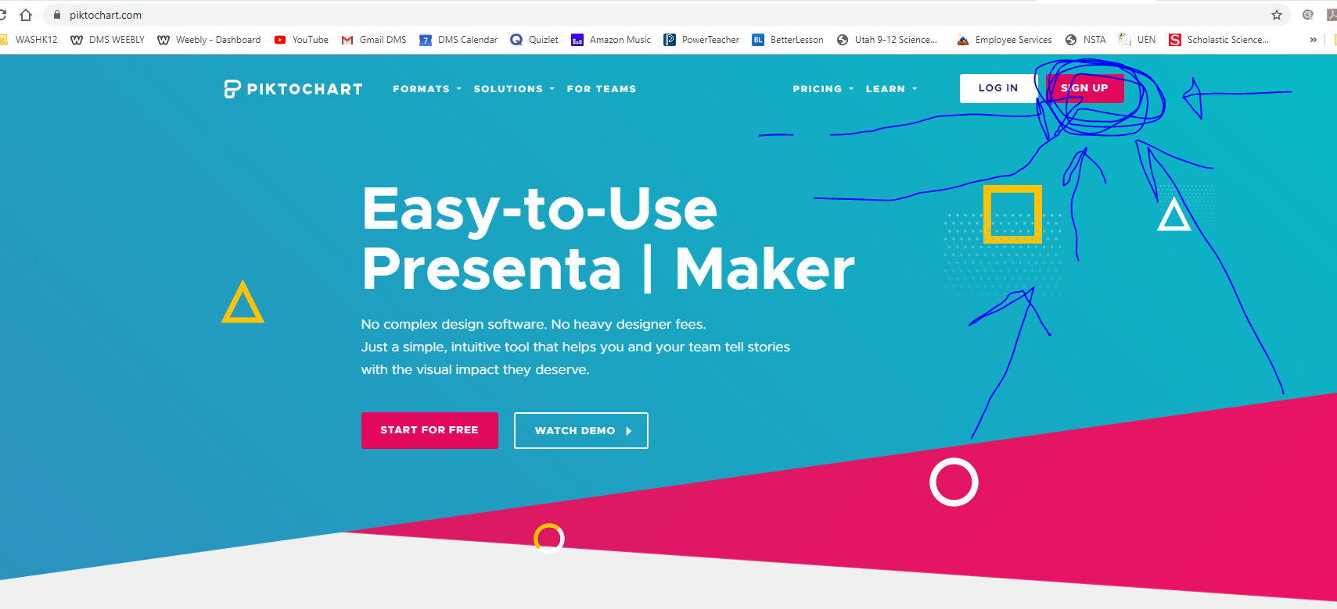
How to Start Your Infographic
Go to ‘piktochart.com’

Slide 4
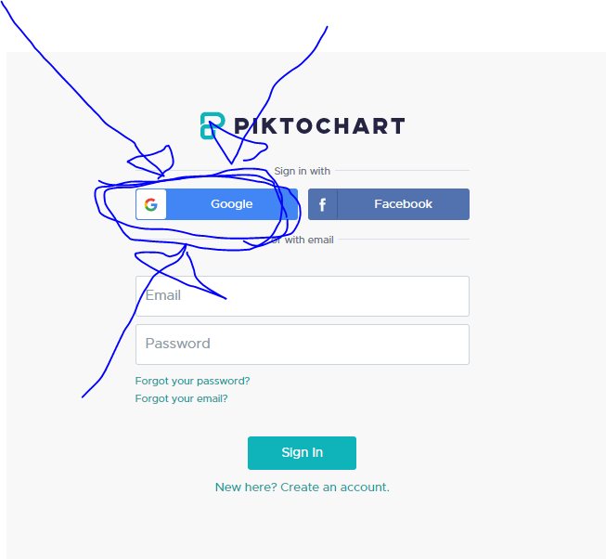
Tip
Click on Google to create your account.

Slide 5
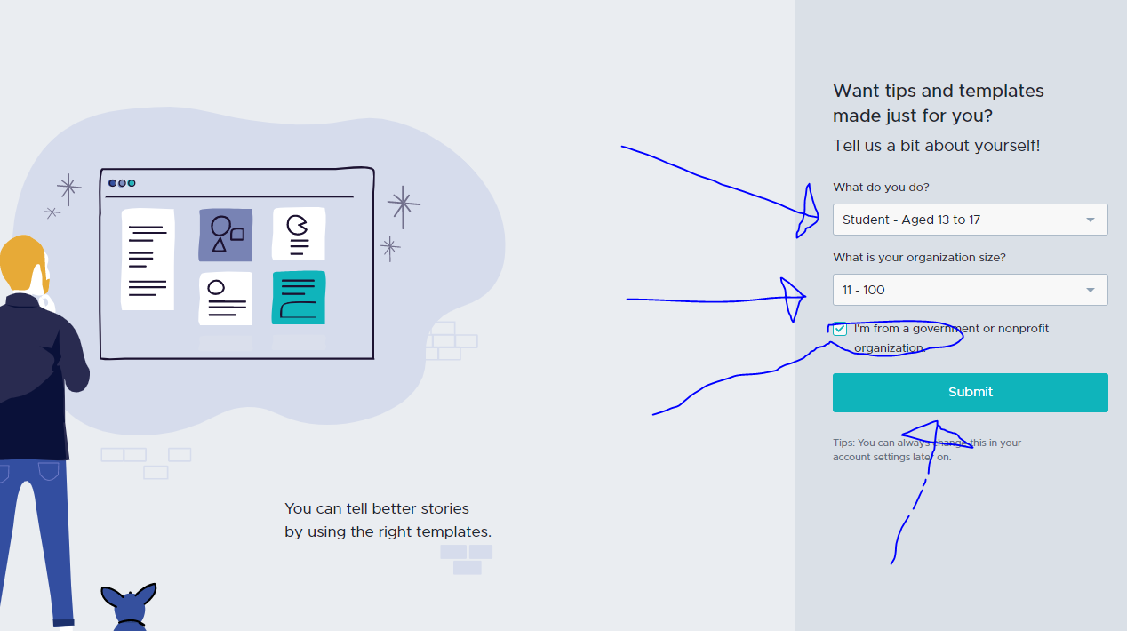
Tip
Remember. If something sounds like common sense, people will ignore it.
Highlight what is unexpected about your topic.

Slide 6
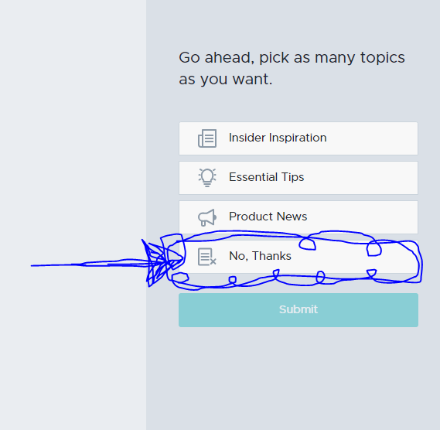
Tip
Click “No Thanks’ and then ‘Submit’.

Slide 7
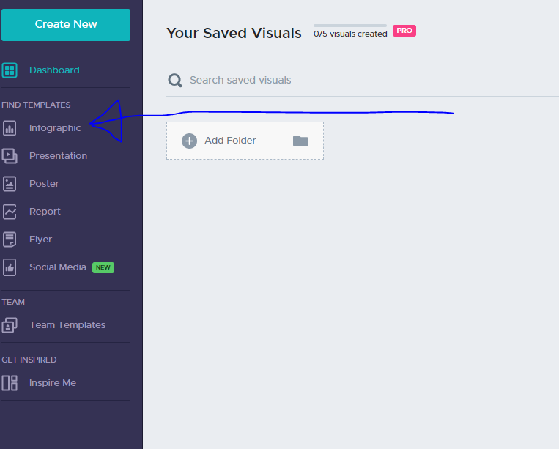
On the left side of the screen click on ‘Infographic’ under the templates.
2. Examples
By the end of this section, your audience should be able to visualize:
What What is the pain you cure with your solution?
Who Show them a specific person who would benefit from your solution.

Slide 8
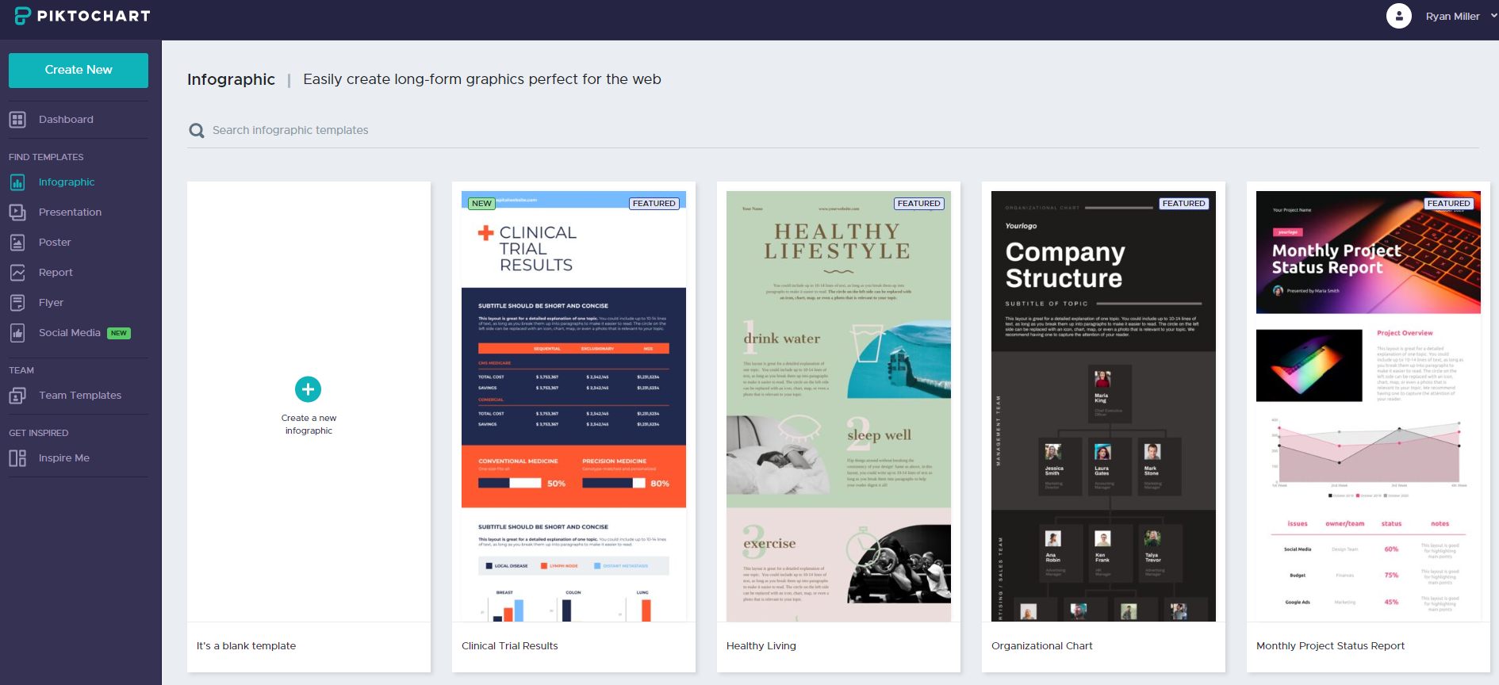
Meet Alberto.
He recently moved from Spain to a small town in Northern Ireland.
He loved soccer, but feared he had no way to talk to a coach or teammates.
Tip
Tell the audience about the problem through a story, ideally a person.

Slide 9
Requirements for Infographic Proposal
City name and location (describe its physical features and climate)
City’s importance. Why protect it? What does it contribute to the whole country?
What are the natural hazards of your country? What are the causes of the natural hazards?
What has been done in other cities to protect them from these natural hazards?
What technology do you recommend investing in to protect this city?
Use a template that will help you use the requirements for your proposal.

