Slide 1
Example- Music
Mrs. Kolodziej wants to see how different types of music will change students' pulse rates. She plays different types of music at the same volume: country, heavy metal, rap, R&B, pop and classical.

Slide 2
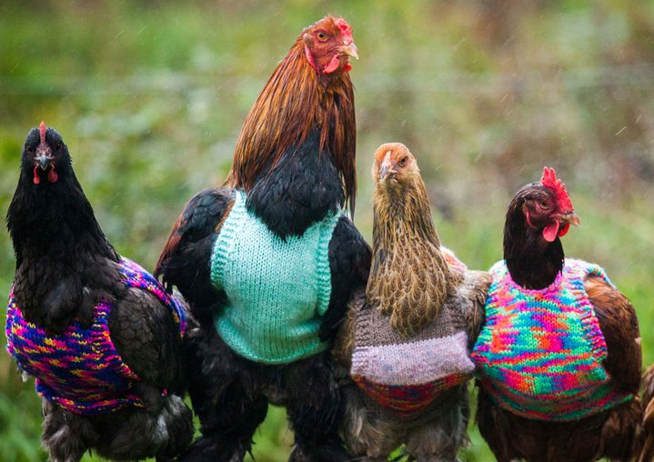
Station #1- Chicken Farmer
A chicken farmer wants to know the impact on giving a growth hormone to his chickens. One chicken is injected with a growth hormone while another chicken is not injected. Both chickens are weighed after a year.

Slide 3
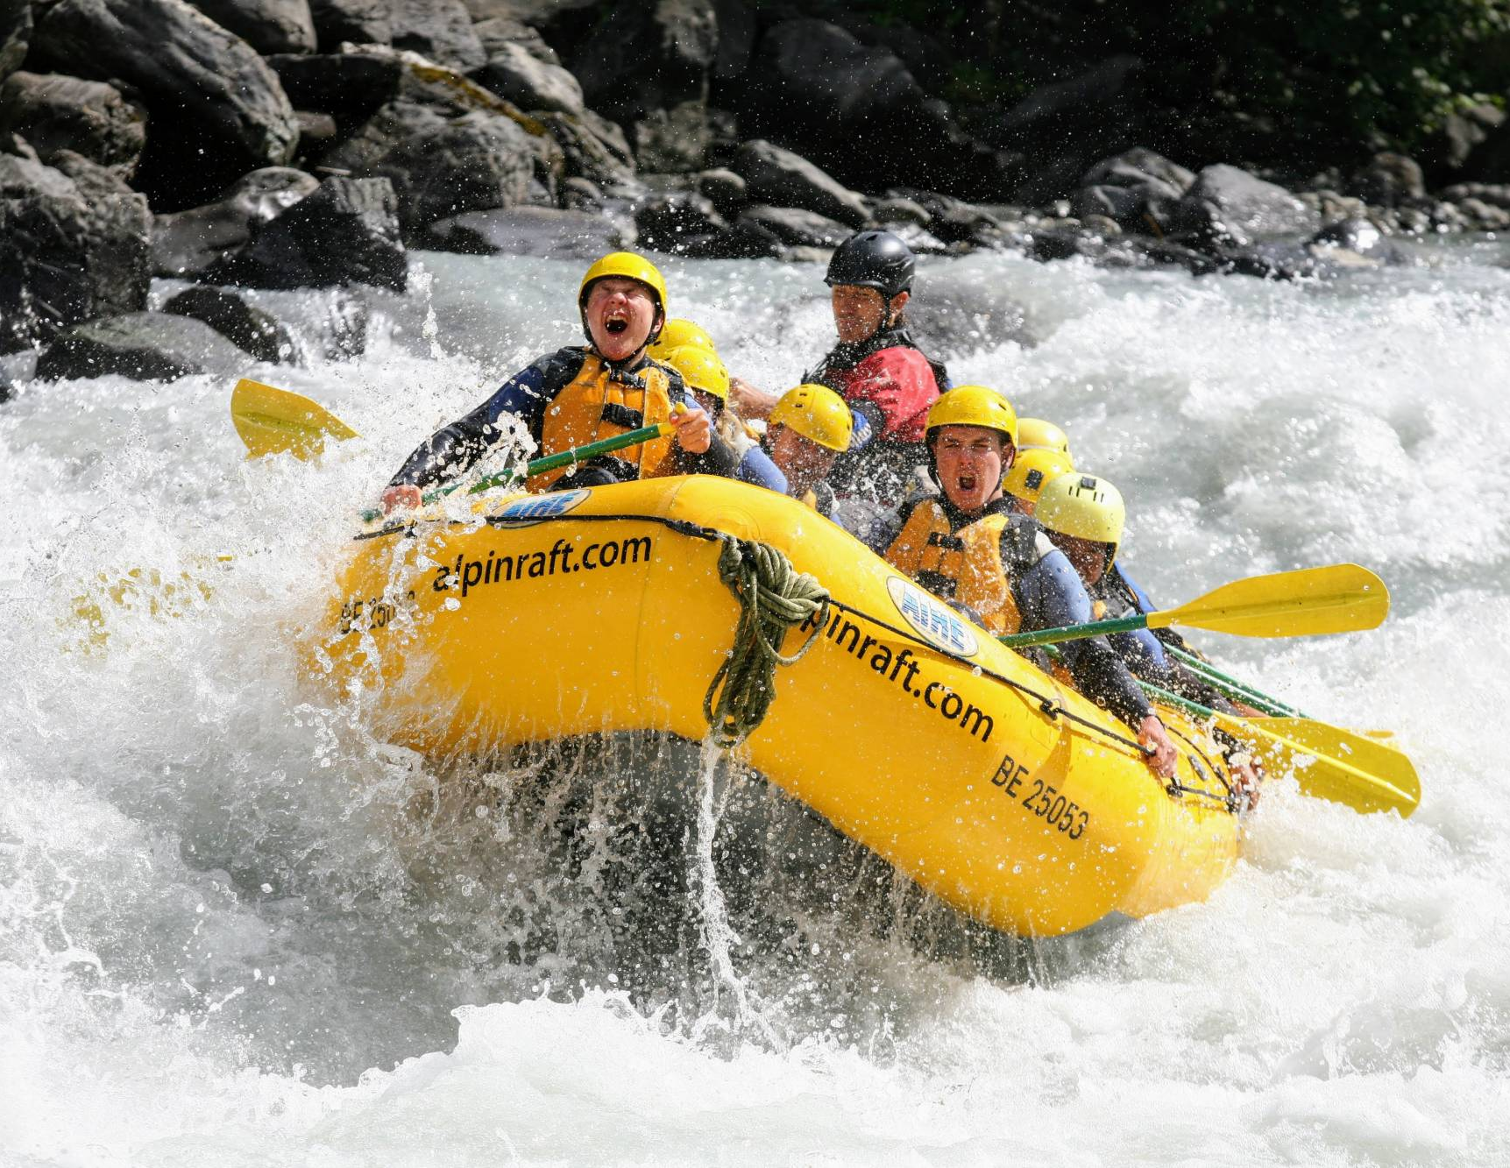
Station #2- Bug Repellant
The Scholes family is going river rafting down the Colorado River. The mosquitos are abundant on the river. The Scholes family wants to see if bug repellent will keep them from getting mosquito bites. Bug repellant is sprayed on the left arm. The right arm is not sprayed. The number of bug bites is recorded after 2 hours.

Slide 4
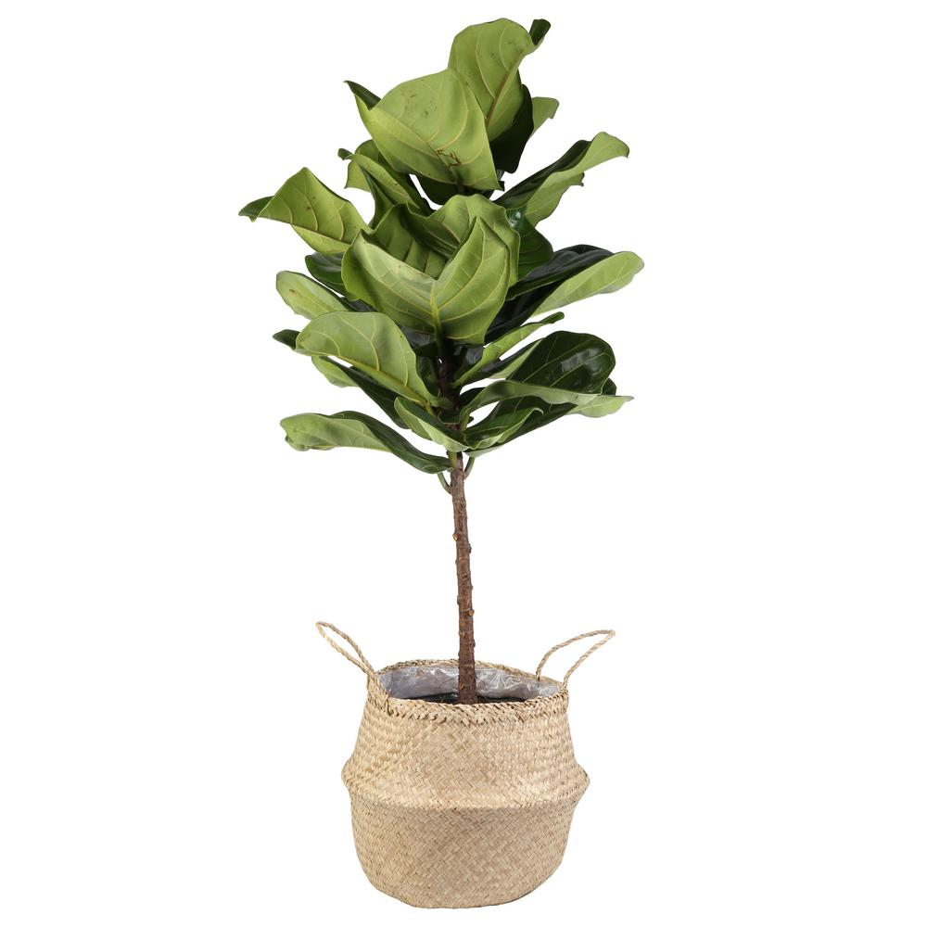
Station #3- Plant Color
Mandi wants to see if the amount of sunlight will affect how green the plant will be. One plant is given sunlight for 12 hours a day. Another plant is not given any sunlight. After 3 weeks, we compare how green each plant looks.

Slide 5
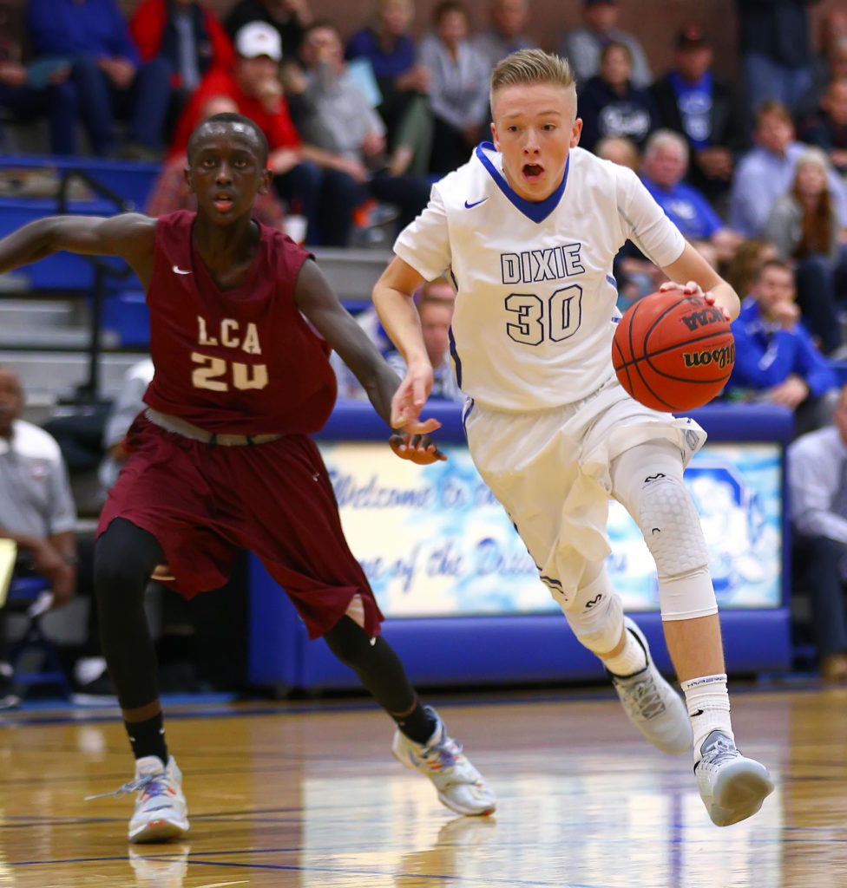
Station #4- Basketball
Tanner wanted to see if listening to music would make the basketball players make more baskets. On day one, he didn’t play any music and counted how many baskets they could make in 10 minutes. On day 2, he played rap music and counted the baskets, and on day 3, he played classical music and counted the baskets.

Slide 6
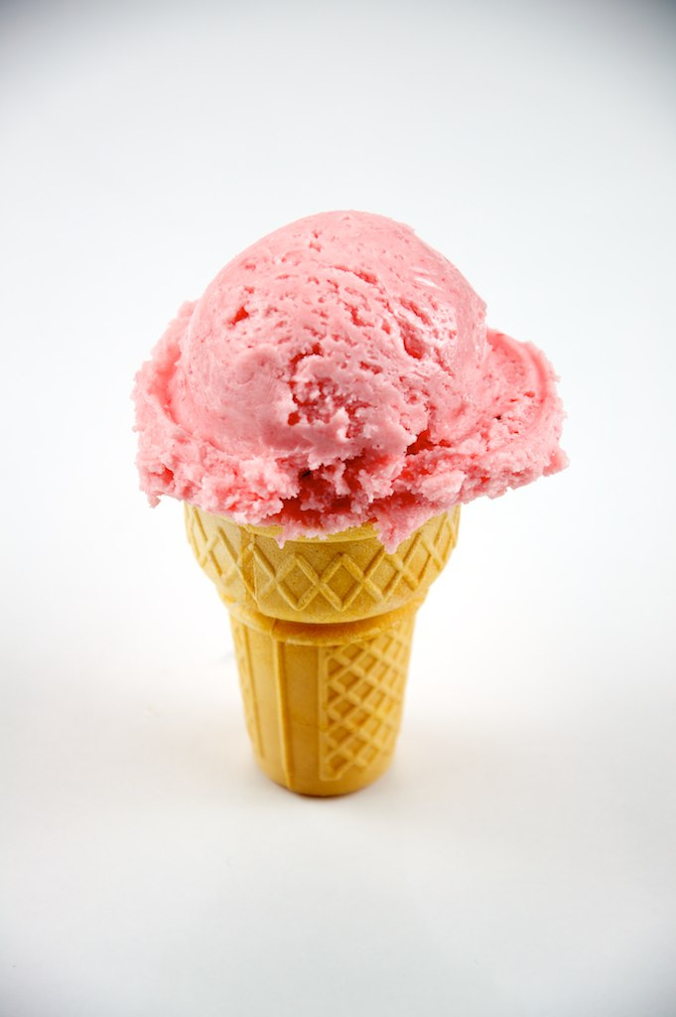
Station #5- Ice cream
Terek wants to know if different kinds of ice cream will melt at different rates. He buys one ice cream with 25g of sugar per serving and the other ice cream with 5g of sugar per serving. He puts one scoop of the ice cream in a bowl on the kitchen counter and checks the ice cream every 5 minutes for an hour.

Slide 7
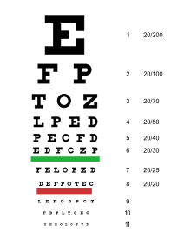
Station #6- Eye Color
Jordan wants to know if people with brown eyes can see better than people with blue eyes. He gets 10 people with brown eyes and 10 people with blue eyes and has them take a standard eye test.

Slide 8
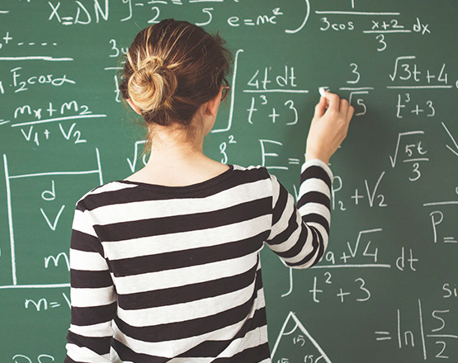
Station #7- Math Test
Mrs. Walker’s students want to see if studying for a math test will help them get better scores. Her 1st period spends 1 hour studying the night before the test and her 2nd period does not study. The scores of the two classes are compared.

Slide 9
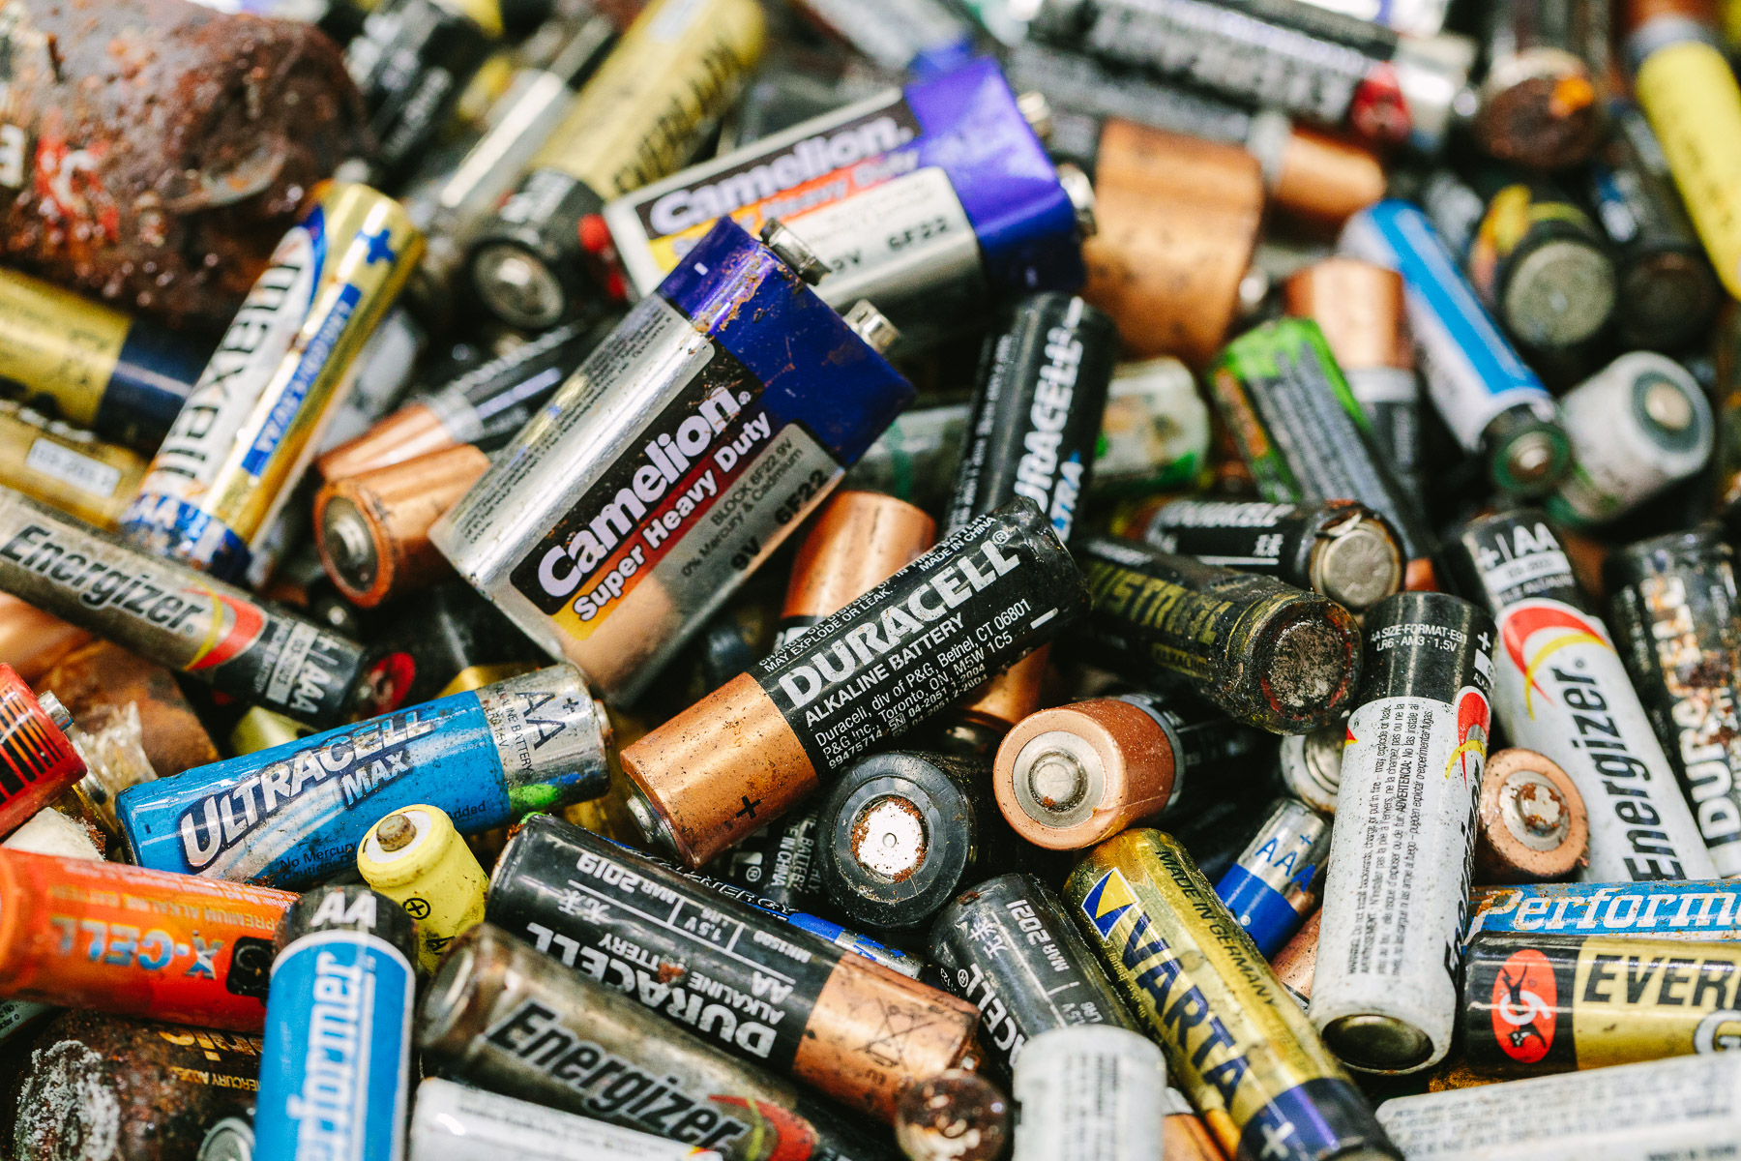
Station #8- Batteries
Anna wanted to see what battery lasted the longest. She put each battery into a clock and recorded the time that the clock stopped. She used Duracell, Energizer, Kroger brand, and EverReady.

Slide 10
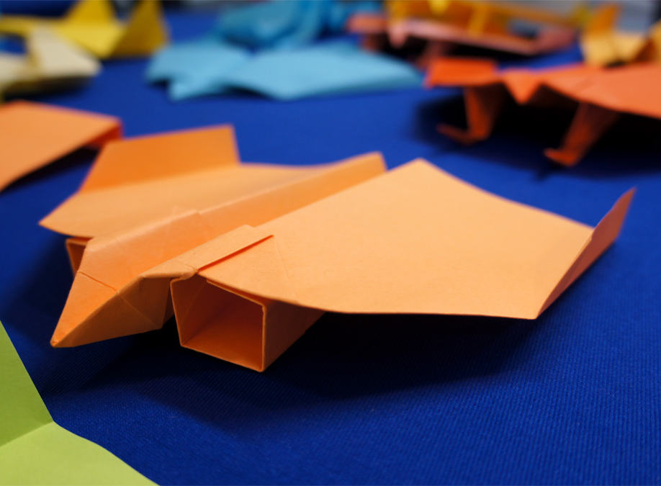
Station #9- paper airplanes
Darius wanted to test how the mass of a paper airplane affected the distance it would fly. Paper clips were added before each test flight. As each paper clip was added, the plane was tested to determine how far it would fly.

