Slide 1
Homeostasis Part 2
Cellular Level

Slide 2
Learn the answers:
Why do we use cell transport?
What structure regulates what can enter/leave a cell?
What is the term used for that structure’s ability to be choosey?
True/False? Diffusion is the movement of particles from a low concentration to high concentration of particles.
What is facilitated diffusion?
________ is the diffusion of WATER molecules.

Slide 3
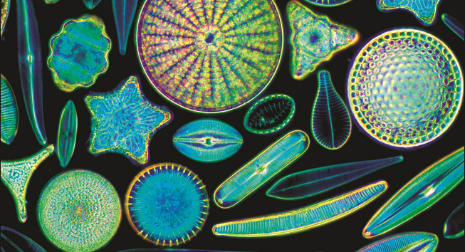
Cell Transport
Notes:
Read the lesson title aloud to students.

Slide 4
WHY DO WE USE CELL TRANSPORT?
To maintain homeostasis!
Homeostasis refers to the need for an organism to maintain constant or stable internal conditions.
In order to maintain homeostasis, all organisms have processes and structures that respond to stimuli in ways that keep conditions in their bodies conducive for life processes. Homeostasis depends, in part, on appropriate movement of materials across the cell membrane.

Slide 5
THE CELL MEMBRANE
*The cell membrane regulates the passage of material into and out of the cell.
Materials needed for cellular processes must pass into cells so they can be utilized. For example, oxygen and glucose are continuously needed for the process of cellular respiration.
Waste materials from cellular processes must pass out of cells as they are produced. For example, carbon dioxide is continuously produced within the cell during the process of cellular respiration.
Each individual cell exists in a *fluid environment, and the cytoplasm within the cell also has a fluid environment. The presence of a liquid makes it possible for molecules (such as nutrients, oxygen, and waste products) to move into and out of the cell.
A cell membrane is *semipermeable (selectively permeable), meaning that some molecules can pass directly through the cell membrane while other molecules cannot.

Slide 6
Passive v Active Transport

Slide 7
Passive Transport: Diffusion
Solutes
Outside Cell
Cell Membrane
Inside Cell
Higher concentration of solute on one side of the membrane than the other
Diffusion causes net movement of solute particles from the side of the membrane with the higher solute concentration to the side with the lower solute concentration.
At equilibrium, particles move equally in both directions, so there is no net change.
Notes:
Spray some air freshener into the air facing the students (not too close).
Tell students to raise their hands when they can smell the spray.
Ask: What is happening to the spray?
Answer: The particles of the spray are slowly moving out into the room.
Ask: How did the particles start out?
Answer: They started all bunched together and then spread out.
Tell students: This tendency for things to move from bunched up to spread out is called diffusion. When the same particles of things are all bunched together it is called a high concentration, and when only a few things are in an area it is called a low concentration.
Ask students for another example of something in a high and low concentration.
Sample answer: a crowded room and one with just a few people
Ask: Did the air freshener need energy to undergo diffusion?
Answer: No, diffusion does not require energy for the particles to move. Diffusion is passive movement.
Tell students that diffusion is the driving force behind the movement of many substances across the cell membrane.
Explain to students that some materials, such as oxygen, diffuse across the cell membrane without using energy, while other materials require energy to pass through.
Introduce the image by identifying parts of the diagram.
Click to reveal the labels one at a time: the cell membrane, the inside of the cell, the outside of the cell, and solute molecules.
Ask: What do you notice about the solutes inside and outside the cell?
Answer: There are more solutes outside than inside.
Click to show the answer and delete the labels.
Click again to show next image in the series.
Ask: What do the arrows mean?
Answer: The arrows indicate movement of molecules.
Ask: How do the first and second images differ?
Answer: The first shows a higher concentration of a solute outside than inside a cell. The second shows a greater number of molecules moving in than moving out, as indicated by more arrows pointing in than out.
Click to show the next image.
Ask: How do you know equilibrium has been reached in the third image?
Answer: There are equal numbers of molecules on both sides of the membrane, and the arrows show about the same number of molecules moving in and moving out.
Emphasize that equilibrium does not mean that movement stops; rather, it continues in both directions, and the same concentration is maintained on both sides of the membrane.

Slide 8
Passive Transport: Diffusion
Diffusion is the spreading out of molecules across a cell membrane until they are equally concentrated.
It results from the random motion of molecules and occurs along a concentration gradient (molecules move from an area of higher concentration to an area of lower concentration); molecules such as oxygen, carbon dioxide and water that are able to pass directly across the cell membrane can diffuse either into a cell or out of a cell.
Notes:
Spray some air freshener into the air facing the students (not too close).
Tell students to raise their hands when they can smell the spray.
Ask: What is happening to the spray?
Answer: The particles of the spray are slowly moving out into the room.
Ask: How did the particles start out?
Answer: They started all bunched together and then spread out.
Tell students: This tendency for things to move from bunched up to spread out is called diffusion. When the same particles of things are all bunched together it is called a high concentration, and when only a few things are in an area it is called a low concentration.
Ask students for another example of something in a high and low concentration.
Sample answer: a crowded room and one with just a few people
Ask: Did the air freshener need energy to undergo diffusion?
Answer: No, diffusion does not require energy for the particles to move. Diffusion is passive movement.
Tell students that diffusion is the driving force behind the movement of many substances across the cell membrane.
Explain to students that some materials, such as oxygen, diffuse across the cell membrane without using energy, while other materials require energy to pass through.
Introduce the image by identifying parts of the diagram.
Click to reveal the labels one at a time: the cell membrane, the inside of the cell, the outside of the cell, and solute molecules.
Ask: What do you notice about the solutes inside and outside the cell?
Answer: There are more solutes outside than inside.
Click to show the answer and delete the labels.
Click again to show next image in the series.
Ask: What do the arrows mean?
Answer: The arrows indicate movement of molecules.
Ask: How do the first and second images differ?
Answer: The first shows a higher concentration of a solute outside than inside a cell. The second shows a greater number of molecules moving in than moving out, as indicated by more arrows pointing in than out.
Click to show the next image.
Ask: How do you know equilibrium has been reached in the third image?
Answer: There are equal numbers of molecules on both sides of the membrane, and the arrows show about the same number of molecules moving in and moving out.
Emphasize that equilibrium does not mean that movement stops; rather, it continues in both directions, and the same concentration is maintained on both sides of the membrane.

Slide 9
Passive Transport: Facilitated Diffusion
Notes:
Tell students: In some cases diffusion starts to happen, but the particles involved need assistance moving across the membrane.
They need help because the physical characteristics of the particle or of the membrane prevent free flow.
Explain that facilitated diffusion is the process in which molecules that cannot directly diffuse across the membrane pass through special protein channels. Although facilitated diffusion uses special channels, it is still diffusion, so it does not require any additional use of the cell’s energy.
Click to highlight the protein (aquaporin) in the image.
Explain that water diffuses through aquaporins because the lipids have hydrophobic areas. Osmosis is the diffusion of water through a selectively permeable membrane.

Slide 10
Passive Transport: Facilitated Diffusion
Facilitated diffusion is the process by which some molecules that are not able to pass directly through a cell membrane are able to enter the cell with the aid of transport proteins.
Facilitated diffusion occurs along a concentration gradient and does not require energy from the cell.
Some molecules have chemical structures that prevent them from passing directly through a cell membrane. The cell membrane is not permeable to these molecules.
**Transport proteins provide access across the cell membrane.
Glucose is an example of a molecule that passes through the cellular membrane using facilitated diffusion.
Notes:
Tell students: In some cases diffusion starts to happen, but the particles involved need assistance moving across the membrane.
They need help because the physical characteristics of the particle or of the membrane prevent free flow.
Explain that facilitated diffusion is the process in which molecules that cannot directly diffuse across the membrane pass through special protein channels. Although facilitated diffusion uses special channels, it is still diffusion, so it does not require any additional use of the cell’s energy.
Click to highlight the protein (aquaporin) in the image.
Explain that water diffuses through aquaporins because the lipids have hydrophobic areas. Osmosis is the diffusion of water through a selectively permeable membrane.

Slide 11
Passive Transport: Osmosis
Osmosis song
aquaporin
sugar
water
cell membrane
Notes:
Tell students: The trick in understanding osmosis is that osmosis is about the movement of the water molecules, not the larger particles.
Ask volunteers to identify the labeled structures.
Students can identify these verbally or by writing on the board.
Click to reveal the answers one at a time.
Click again to reveal the label for sugar.
Point out that the sugar cannot cross the membrane.
Ask: Which side has the higher concentration of solute (non-water particles)?
Answer: right side
Ask: Which side has the lower concentration of water molecules?
Answer: right side
Ask: What do the white arrows in the figure represent?
Answer: movement of water molecules through aquaporins
Ask: Why are there more arrows pointing toward the right?
Answer: There are more water molecules on the left (higher concentration), so more molecules will move toward the right (toward the lower concentration).
Ask: Why are there no arrows showing movement of the sugar molecules?
Answer: The sugar molecules cannot cross the membrane because the proper proteins are not present.
On the chalkboard or chart paper, draw a circle with some dots inside it, and add dots around the outside of the circle as well. The concentration of dots inside and outside the circle should be similar.
Tell students: The circle represents a cell, the dots represent various solutes, and the area around the cell represents the extracellular environment.
Ask a volunteer to add or remove solute particles in a way that would cause water to enter the cell from the extracellular environment.
Answer: The student should either add dots to the inside of the cell or erase dots from the outside of the cell.

Slide 12
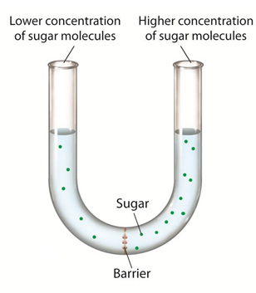
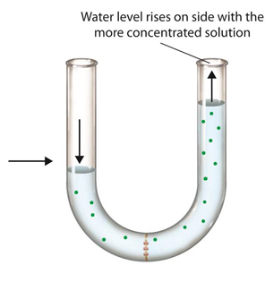
Osmosis
Notes:
Explain that this image is of a tube with a barrier, and that sugars dissolved in water are on each side of the barrier.
Ask: How would you describe the concentration gradient of the sugar?
Click to reveal the answer: There is more sugar on the right side.
Tell students that the barrier is permeable to water but not sugar.
Ask: What happens to the concentrations on each side of the membrane as water diffuses through?
Click to reveal the answer: The concentrations change until they reach equilibrium.
Ask: Why does the water level rise in the right side of the tube and drop in the left side?
Answer: The net movement of water molecules is to the right side, because initially the concentration of water is lower there compared to the sugar. The movement of water molecules across the barrier changes the water level on both sides of the tube.
Explain that water will tend to move across the membrane until equilibrium is reached. At that point, the concentrations of water and sugar will be the same on both sides of the membrane. When this happens, the two solutions will be isotonic. When the experiment began, the more concentrated sugar solution was hypertonic; the dilute sugar solution was hypotonic.

Slide 13
Osmosis
Osmosis is the diffusion of water molecules through a selectively permeable membrane from an area of greater concentration of water to an area of lesser concentration of water.
The diffusion of water molecules is a passive transport process because it does not require the cell to expend energy.

Slide 14
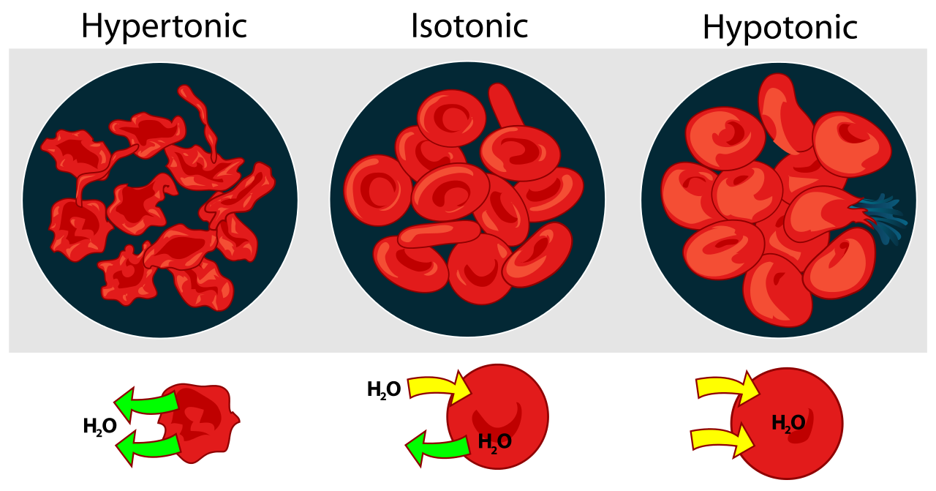

Slide 15
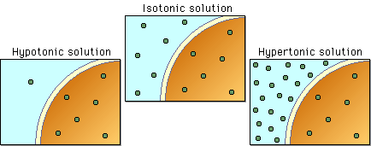
SOLUTIONS

Slide 16
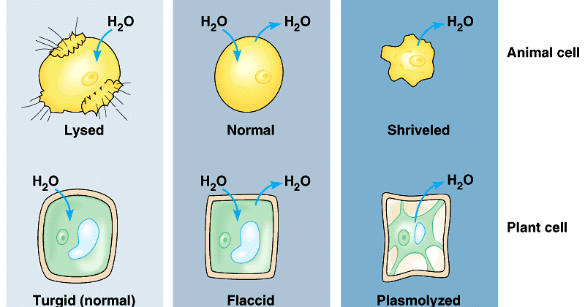

Slide 17
Active Transport
Protein pumps
Endocytosis
Exocytosis
Notes:
Ask: What if a cell needed to move materials against the concentration gradient, from an area of low to high concentration? What would be needed?
Answer: energy to move the particles against the natural flow of diffusion
Explain that energy is needed to get certain substances into or out of a cell because the cell membrane is selective. For substances that cannot pass through the membrane freely, active transport is used, and it requires energy.
Click to reveal the labels for and discuss each type of active transport:
Protein pumps: Energy from ATP is used to pump small molecules and ions across the cell membrane. Active transport proteins change shape during the process, binding substances on one side of the membrane and releasing them on the other.
Endocytosis: The membrane forms a pocket around a particle. The pocket then breaks loose from the outer portion of the cell membrane and forms a vesicle within the cytoplasm.
Exocytosis: The membrane of a vesicle surrounds the material, then fuses with the cell membrane. The contents are forced out of the cell.
Put students into groups of three. Give each group one of the types of active transport. More than one group can have the same type. Tell the students to prepare a charades-like demonstration of their type of active transport. Give them five minutes to prepare. Have each group perform in front of the class and have the other groups guess which type of transport is being acted out.

Slide 18
Active Transport: Pumps
Molecules move against the concentration gradient (from an area of low concentration to an area of high concentration) and require the cell to expend energy.
Unlike the process of facilitated diffusion, in active transport, molecules are “pumped” across the cell membrane by transport proteins. This pumping process requires an expenditure of chemical energy.
Because this process does not depend on diffusion, cells can use this process to concentrate molecules within the cell, or to remove waste from a cell.
Calcium, potassium, and sodium ions are examples of materials that must be forced across the cell membrane using active transport.

Slide 19
Active Transport: Bulk Transport
When molecules are too large to pass through a cell membrane even with the aid of transport proteins, they require the use of vesicles to help them through the membrane.

Slide 20
Endocytosis
Notes:
Explain that phagocytosis is a type of endocytosis, in which extensions of cytoplasm surround a particle and package it within a food vacuole. Amoebae use phagocytosis to engulf food. This white blood cell is using phagocytosis to surround and engulf a damaged red blood cell.
Ask: Why is endocytosis an example of active transport and not facilitated diffusion?
Answer: Endocytosis requires energy to engulf a particle and form a vesicle around it.

Slide 21
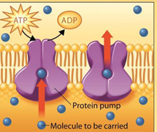
Exit Ticket: Active Transport vs. Diffusion
Compare and contrast active transport and diffusion.
Notes:
Have students write a paragraph distinguishing active transport from diffusion.
Have students share their answer with a partner.
Ask volunteers to read their answers aloud.

Slide 22
VIRTUAL LAB
Page 41. Go to the website and complete the virtual lab online as well as the worksheet.

