Slide 1
How did these people get their physical appearance?

Slide 2
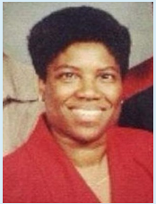
Who is this? What are some defining physical characteristics?

Slide 3
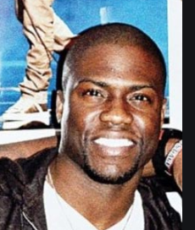
What’s similar? How did they share the same looks?

Slide 4
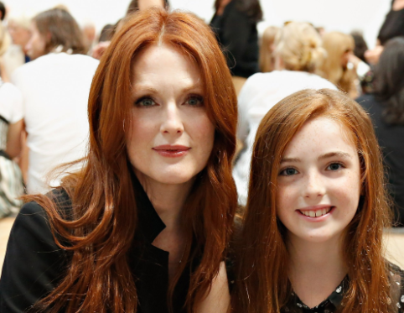
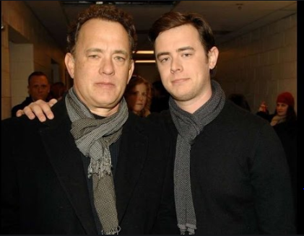

Slide 5
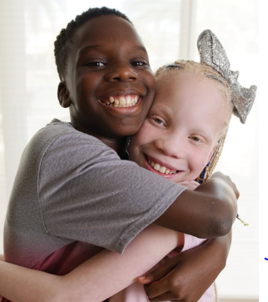
What if I told you they were twins?

Slide 6
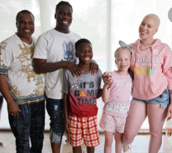

Slide 7
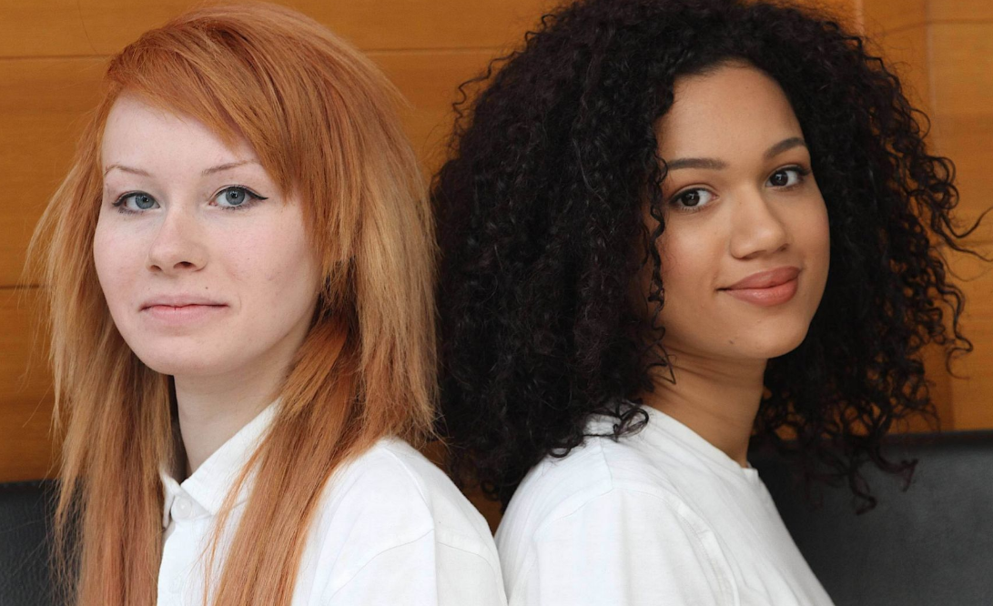
Best friends or siblings?

Slide 8
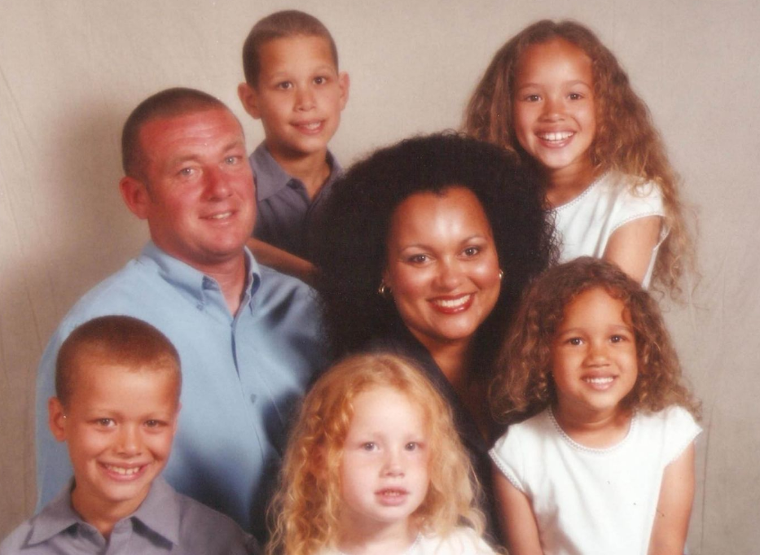
How about twins?! How can this be?

Slide 9
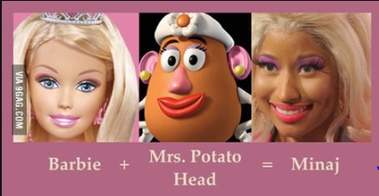
Last one...

