Slide 1
Evaluating Website Credibility

Slide 2
Evaluating Websites -
CRAP Test
Currency
Reliability
Authority
Purpose/Point of View

Slide 3
CRAP Test - Currency
How recent is the information?
Can you locate a date when the page(s) were written/created/updated?
Does the website appear to update automatically (this could mean no one is actually looking at it)?
Based in your topic, is it current enough?

Slide 4
CRAP Test - Reliability
What kind of information is included in the website?
Based on your other research, is it accurate? ...complete?
Is the content primarily fact, or opinion?
Is the information balanced, or biased?
Does the author provide references for quotations and data?
If there are links, do they work?

Slide 5
CRAP Test - Authority
Can you determine who the author/creator is?
Is there a way to contact them?
What are their credentials (education, affiliation, experience, etc.)?
Is there evidence they're experts on the subject?
Who is the publisher or sponsor of the site?
Is this publisher/sponsor reputable?

Slide 6
CRAP Test - Purpose/Point of View
What's the intent of the website (to persuade, to sell you something, etc.)?
What is the domain (.edu, .org, .com, etc.)? How might that influence the purpose/point of view?
Are there ads on the website? How do they relate to the topic being covered
Is the author presenting fact, or opinion?
Who might benefit from a reader believing this website?
Based on the writing style, who is the intended audience?

Slide 7
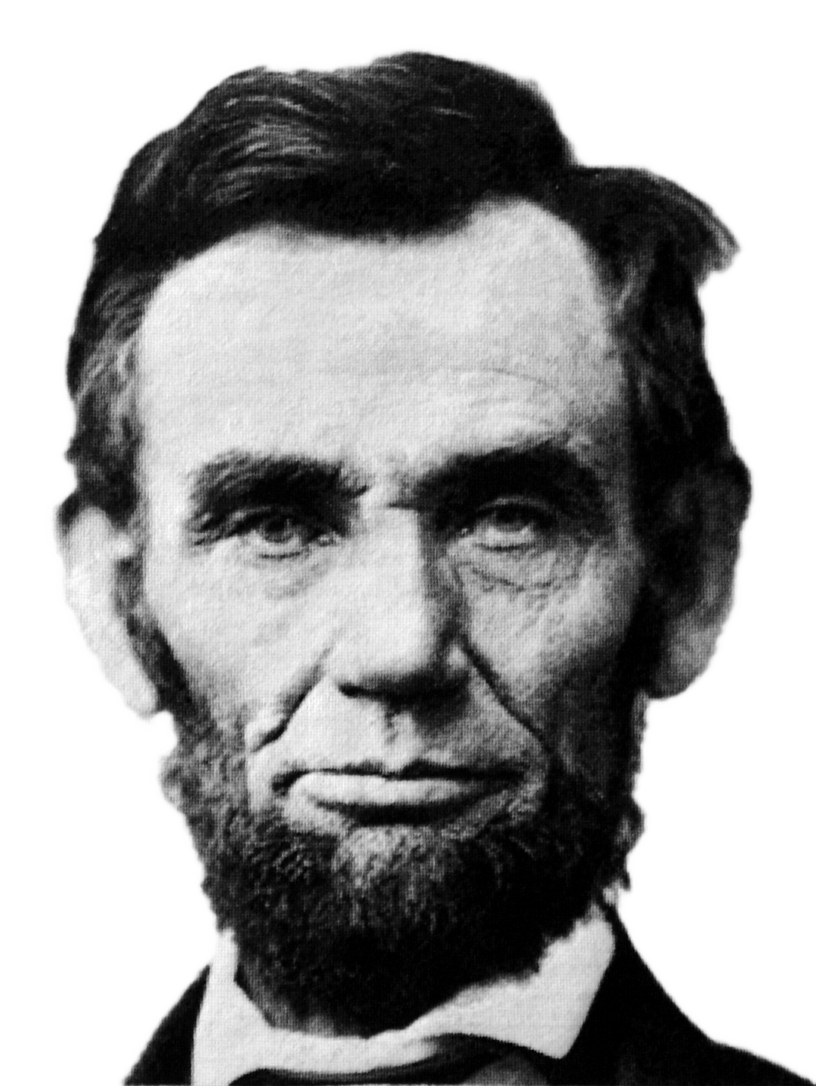
“Don’t believe everything you read on the Internet just because there’s a picture with a quote next to it.”
Abraham Lincoln

Slide 8
References- how to site your sources
Author, (date). Title. Retrieved from {insert web address here}
These sites may help you retrieve this information:
http://www.citethisforme.com/
Use APA style

