Slide 1
THE DOPPLER EFFECT
The colored words are important. They are the words you need to write on your note sheet!

Slide 2
THE DISTANCE OF GALAXIES
How do we know galaxies are moving away from Earth?
The Doppler Effect!

Slide 3
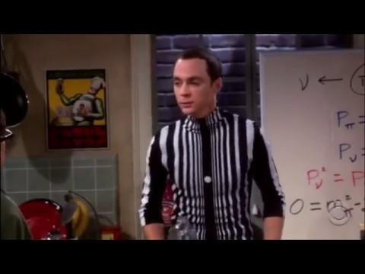
WHAT IS THE DOPPLER EFFECT?
Notes:
Video available: https://www.youtube.com/watch?v=z0EaoilzgGE

Slide 4
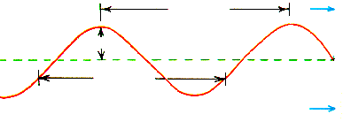
WHAT IS THE DOPPLER EFFECT?
To understand Doppler Effect you need to understand waves.
wavelength
Crest→
amplitude
wavelength
←Trough
Notes:
Your students should already know the parts of a wave. This is a reminder of what they already know.

Slide 5
WHAT IS THE DOPPLER EFFECT?
The frequency of a wave is equal to the
number of waves that pass a particular
point in one second.
Which wave has the
highest frequency?
Notes:
I like to have my students hold a finger in the air and “draw” waves as I call out “HIGH FREQUENCY!” and “LOW FREQUENCY!”

Slide 6
WHAT IS THE DOPPLER EFFECT?
Which wave has the
lowest frequency?

Slide 7
Doppler Effect in Water
A
Top view of water waves made by a stationary bug kicking in still water. Both the frequency and the wavelength are the same at points A and B.
A
B
B
Notes:
Make sure students understand that they are imagining that they are above a pond, looking down at a bug.

Slide 8
A
Doppler Effect in Water
Water waves made by a bug swimming in still water. The frequency is higher and the wavelength shorter at point B.
A
B
B

Slide 9
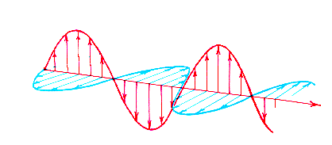
DOPPLER EFFECT IN LIGHT
Magnetic Field
Electric Field
Direction
of Travel
Light is an electromagnetic wave.
Notes:
A lot of students don’t understand that light travels from one place to another in the form of a wave.

Slide 10
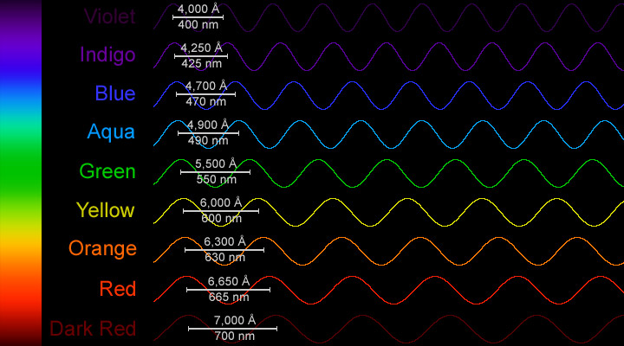
Each color of the rainbow has a different wavelength!
Red light has a low frequency and blue light has a high frequency.

Slide 11
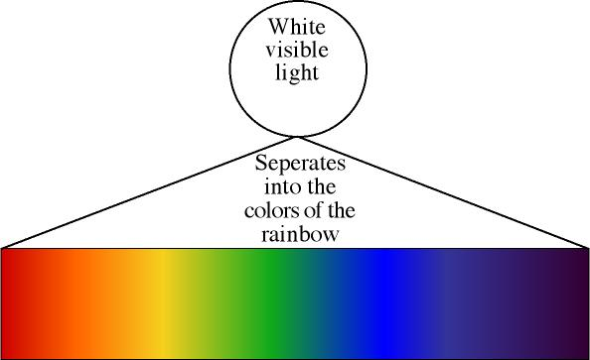
DOPPLER EFFECT IN LIGHT
Blue Light has a much HIGHER wavelength…so it has a HIGHER frequency!
Red Light has the LONGEST wavelength…so it has the LOWEST frequency!

Slide 12
WHAT DOES THIS HAVE TO DO WITH ANYTHING?!!!!
How can we tell that the universe is expanding?
How can we tell stars are moving away from us?
EASY…by their COLOR!

Slide 13
An increase in frequency is called a blue shift because blue light has a short wavelength.

Slide 14
A decrease in frequency is called a red shift because red light has a long wavelength.

Slide 15
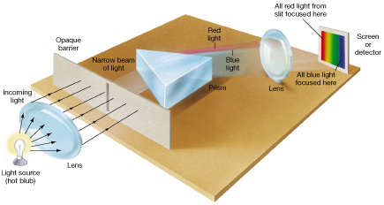
ELEMENTS BURN
When elements burn they DO NOT give off every color of light!
They give off specific wavelengths of light that scientists can see with a SPECTROSCOPE

Slide 16
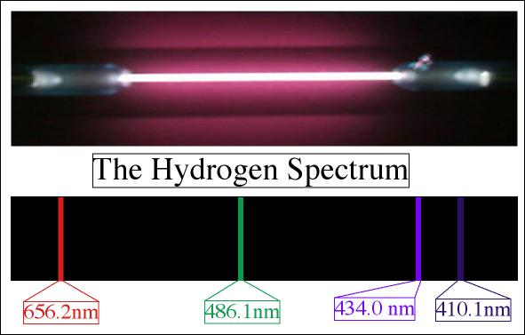
HYDROGEN
When hydrogen burns it gives off FOUR wavelengths of light.
(Hydrogen Lamp)
This is what burning hydrogen looks like through a SPECTROSCOPE. We call this the hydrogen spectrum.

Slide 17
REMEMBER:
LIGHT WAVES traveling TOWARD you have a higher frequency and wavelength than light waves traveling AWAY from you.

Slide 18
WHEN A WAVE OF LIGHT THAT IS GREEN BECOMES SQUISHED…
The FREQUENCY of the wave changes (the WAVELENGTH changes) and the light becomes blue!

Slide 19
HOW DO YOU KNOW LIGHT IS TRAVELING TOWARD YOU?
You use the SPECTROSCOPE!
Light traveling TOWARD you will have all the spectral lines shifted to the blue end of the spectrum.
Red End
Blue End

Slide 20
THE OPPOSITE IS TRUE FOR LIGHT TRAVELING AWAY FROM YOU…
Through the SPECTROSCOPE light traveling AWAY from you will have all the spectral lines shifted to the red end of the spectrum.
Red End
Blue End

Slide 21
COLOR YOUR OWN BLUE AND REDSHIFT
2. Color BLUESHIFTED hydrogen and helium lines
(the dotted lines show the original lines)
Hydrogen Spectrum
All lines move toward the blue end.
The color of the lines changes because they have been moved closer to the blue end!

Slide 22
COLOR YOUR OWN BLUE AND REDSHIFT
2. Color BLUESHIFTED hydrogen and helium lines
(the dotted lines show the original lines)
Helium Spectrum
All lines move toward the blue end.
The color of the lines changes because they have been moved closer to the blue end!

Slide 23
COLOR YOUR OWN BLUE AND REDSHIFT
3. Color REDSHIFTED hydrogen and helium lines
(the dotted lines show the original lines)
Hydrogen Spectrum
All lines move toward the red end.
The color of the lines changes because they have been moved closer to the red end!

Slide 24
COLOR YOUR OWN BLUE AND REDSHIFT
3. Color REDSHIFTED hydrogen and helium lines
(the dotted lines show the original lines)
Helium Spectrum
All lines move toward the red end.
The color of the lines changes because they have been moved closer to the red end!

Slide 25
REDSHIFT AND DISTANCE
The more shifted the spectral lines, the faster the star is traveling. More redshift also means more distance.
Both of these stars are redshifted. Which star is traveling the fastest?
Star A
Star B

