Slide 1
Cellganelle Project
Honors Biology

Slide 2
Go to the website, spark.adobe.com, and click ‘Get started now’
spark.adobe.com

Slide 3
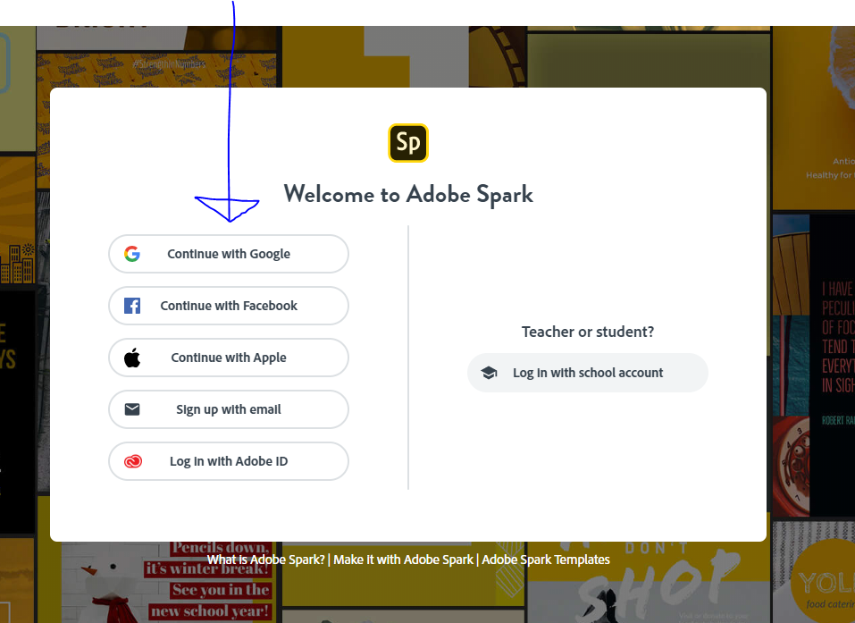

Slide 4
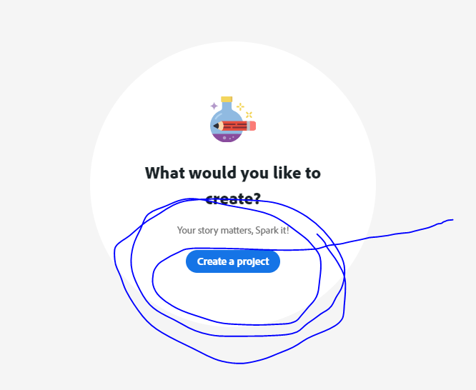
Click on ‘Create a Project’

Slide 5
Find the ‘Teach and Study’ and click on the ‘Lesson Plan Video’

Slide 6
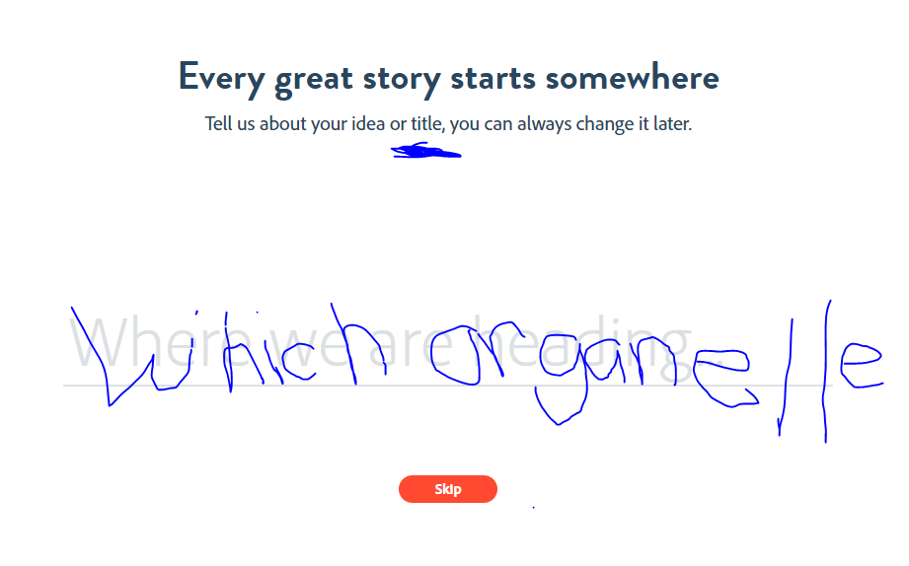
Type in your topic for your title.

Slide 7
El coche

Slide 8
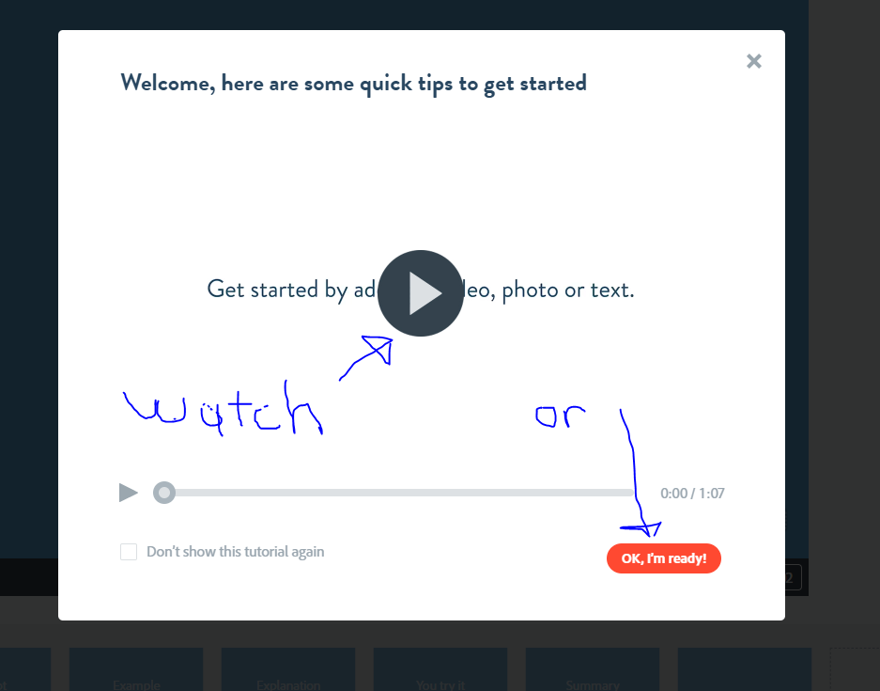
Bicycle

Slide 9
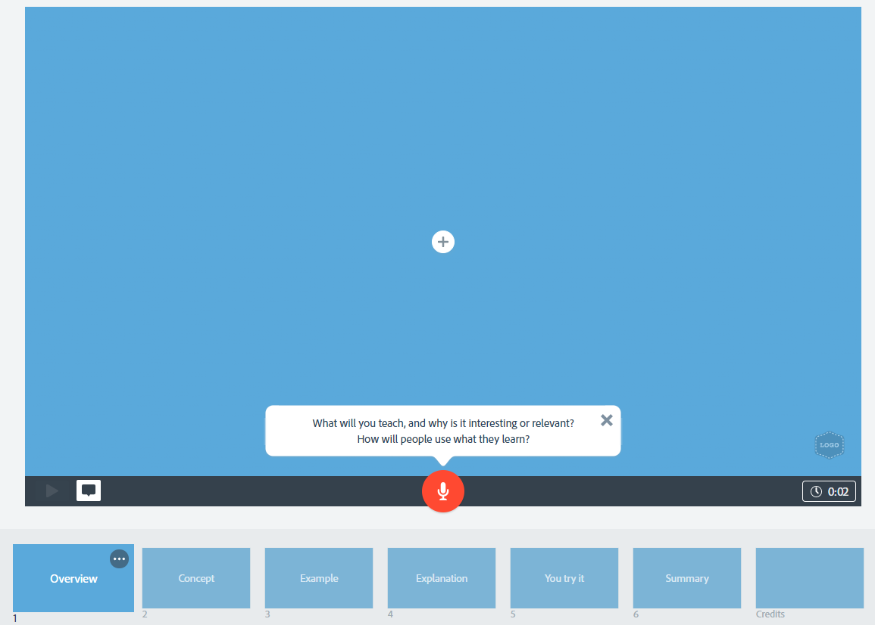
Bicicleta
Bicycle
You will use the six slides with their hints and tips. Insert video clips or slides and VOICE OVER to explain.

Slide 10
Follow the prompts from Spark for each slide along with the rubric.
Make sure you fit the following information into your presentation:
Describe its purpose (job) in the cell, how it functions, its structure, location or part of the cell, if it is unique to a type of cell or in all three cell types: prokaryote, eukaryote: animal, plant. Finally, describe health issues that could occur if this organelle malfunctions.
Your presentation must be between 1:30-2:00 minutes.

